Slide 1
E-mailka

Slide 2
E-mailka
E-mailka waa nidaam fudud oo lagu xiriiro.
Waa lacag la’aan marka aad dirayasid e-mailka, laakin waxaa loo bahanyahay qad internet leh.
Waxaad u diri karta e-mail cid walba/goobta ay aduunka ka joogaan.
Ciwaanka e-mailka waa shaqsiyeed markaas looma baahna in aad baddesho mar hadii aad socdaal tahay ama aad guurtid.

Slide 3
Samaaynta e-mail akwanti
Mar hadii aadan heysanin ciwaan e-mail waad
samaysan karta keligaa. Waxaa jira e-mailo qarash
laan ah oo aad furan kartid . Tusaalooyin waa
kuwan hoos:
G-mail (waxaa iska leh Google), Yahoo mail iyo kuwa kale oo badan.
Halkan waxaan idin tusaynaa hal e-mail akwanti sida loo furto sida G-mail.

Slide 4
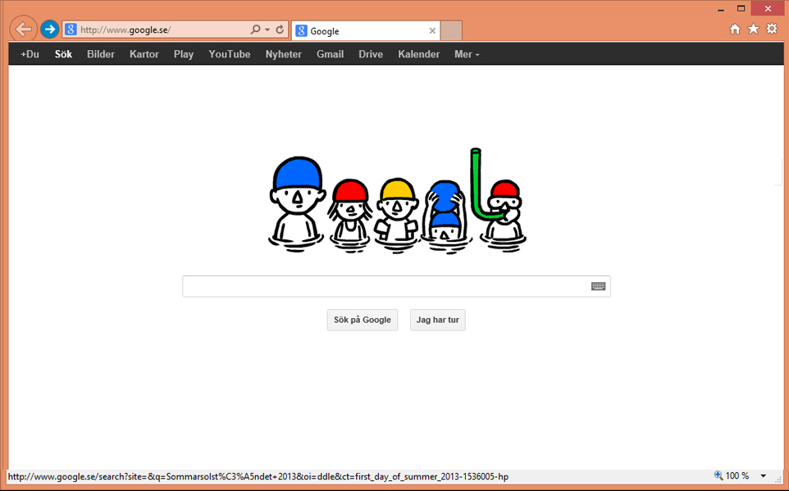
Ku qor Google ciwaanka bogg akhriye : http://www.google.com
Sii riix G-mail.

Slide 5
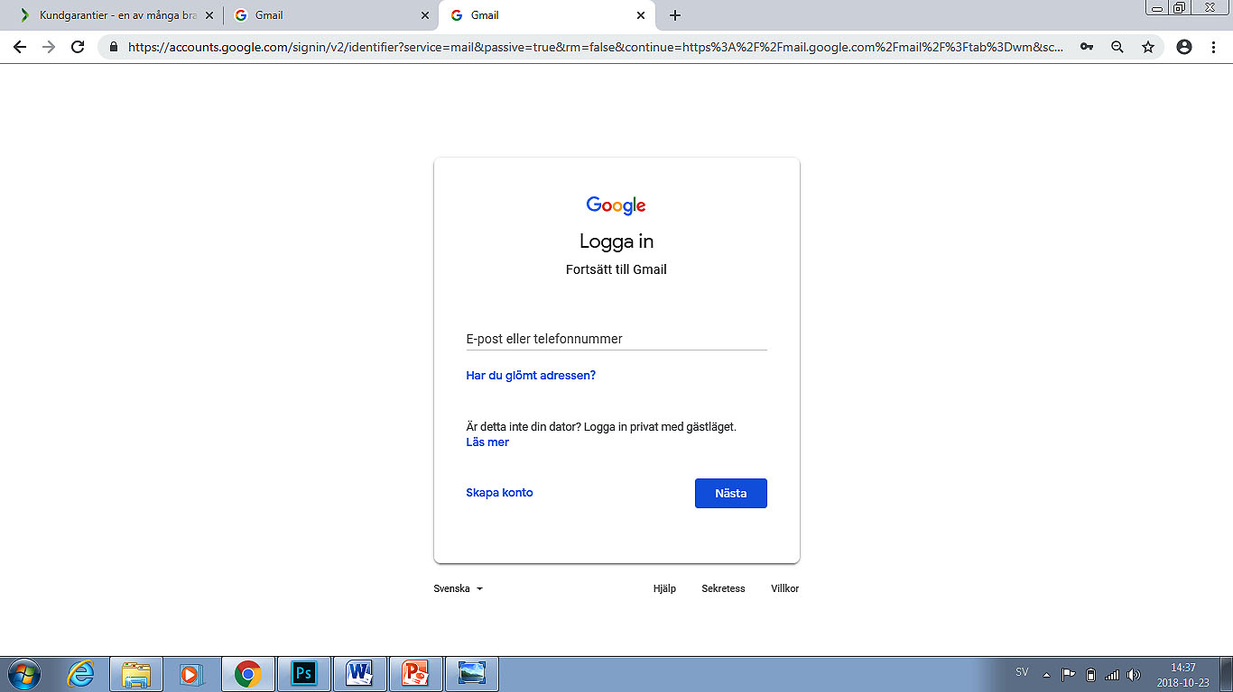
Haddii aadan lahayn cinwaan iimayl oo aad rabto akown iimayl, guji Akown samayso.
Haddii aad hore u leedahay akown Gmail, cinwaankaaga iimayl geli (bannaanka magaca isticmaalaha) iyo ereygaaga isgaradka, ka dibna guji badhanka “Gal”.
Geli cinwaankaaga iimayl.
Halkan guji si aad u samaysato akown iimayl.
guji xiga si aad u samaysato ereyga isgaradka.

Slide 6
Fikrado lagu samaysto cinwaan iimayl cusub
Macluumaadka waajib kugu ah in aad geliso waxay ku xiran yihiin iimayl bixiyaha aad doorato (matalan Gmail).
Cinwaan kastoo iimayl waa gooni, waxaanad dooran kartaa uun cinwaan uusan qof kale lahayn. Adeegga iimayl ayaa hubinaya diyaar ahaanta cinwaanka aad gelisay ka dibna kuu tilmaamaya cinwaanno la siman haddii midka aad rabto qof kale qaatay. Ma isticmaali kartid xuruufta å, ä ama ö. Waxaad dooran kartaa magacaaga dhabta ah ama mid aad abuuratay.
Ereyga isgaradka ama sirta ah waa in uu lahaado ugu yaraan lix god. Isku qas xuruufta, tirooyinka iyo/ama calaamadaha gaarka ah (matalan!, @, #, $, %, ^, &, *) si aad u samaysato erey isgarad adag. Magacaaga ama taariikhdaada dhalashada ha u isticmaalin ereygaaga isgaradka.
Lagaama sugayo in aad bixiso macluumaad shakhsi ahaaneed, sida lambarkaaga aqoonsiga shakhsi ahaaneed ama jinsigaaga.
Cinwaanka iimayl ee kale iyo su’aasha amniga ee suurogalka ah waxaa lagu ilaaliyaa akownkaaga iimayl. Haddii aad geli kari weydo akownkaaga iimayl, waxaa kaaga fududaanaysa in aad akownkaaga soo ceshato haddii aad bixisay kuwan sare midkood. Hubi in aad geli karto cinwaanka iimayl aad ku sheegtay cinwaankaaga iimayl ee kale. Hubi in aad doorato jawaab aadan illaawi doonin oo uusan qof kale garan karin haddii aad gelisay su’aal amni (Gmail kuma deeqo fursaddan).
Ereygaaga isgaradka ku hayso meel adag si uusan qof kale u arki karin.

Slide 7
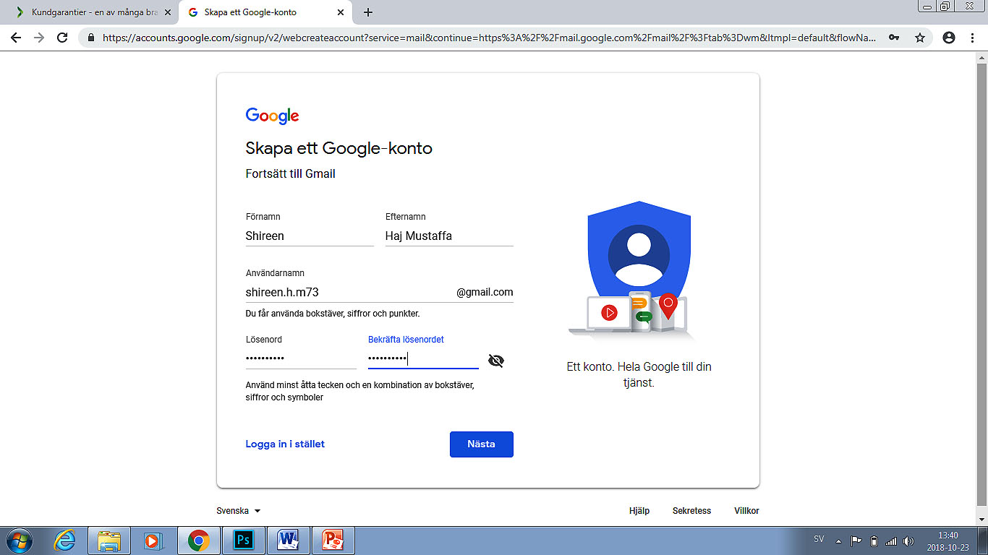
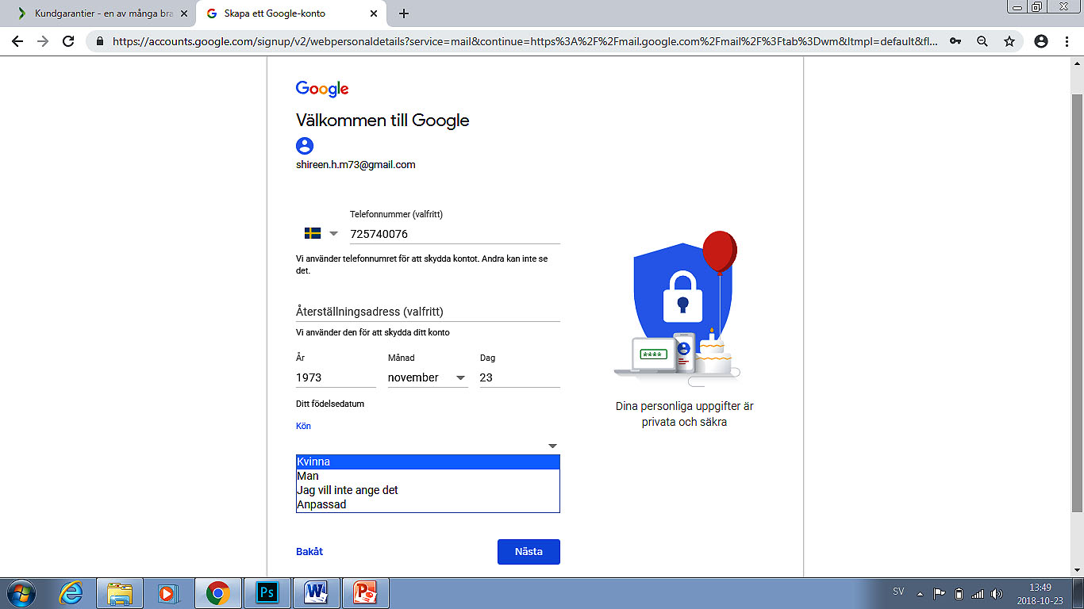
Samaysiga akown iimayl cusub
Geli lambarkaaga telefoonka gacanta si aad uga dhigato aqoonsi kaloo gooni ah.
Magacaaga geli.
Dooro cinwaanka iimayl aad rabto.
Geli sanadka, bisha, maalinta aad dhalatay.
Erey isgarad dooro.
Sheeg haddii aad nin ama haweeney tahay, ama dooro “Mid kale".
Repeat the password.

Slide 8
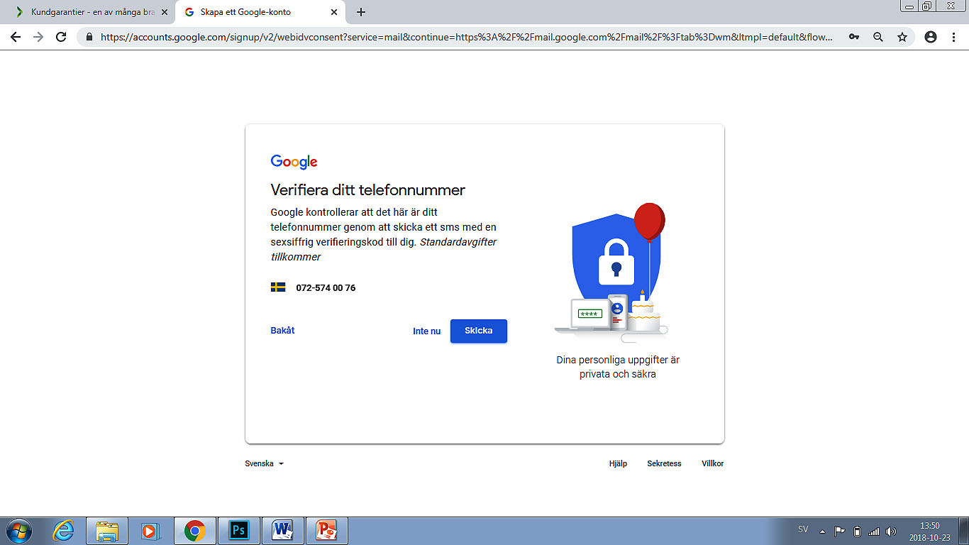
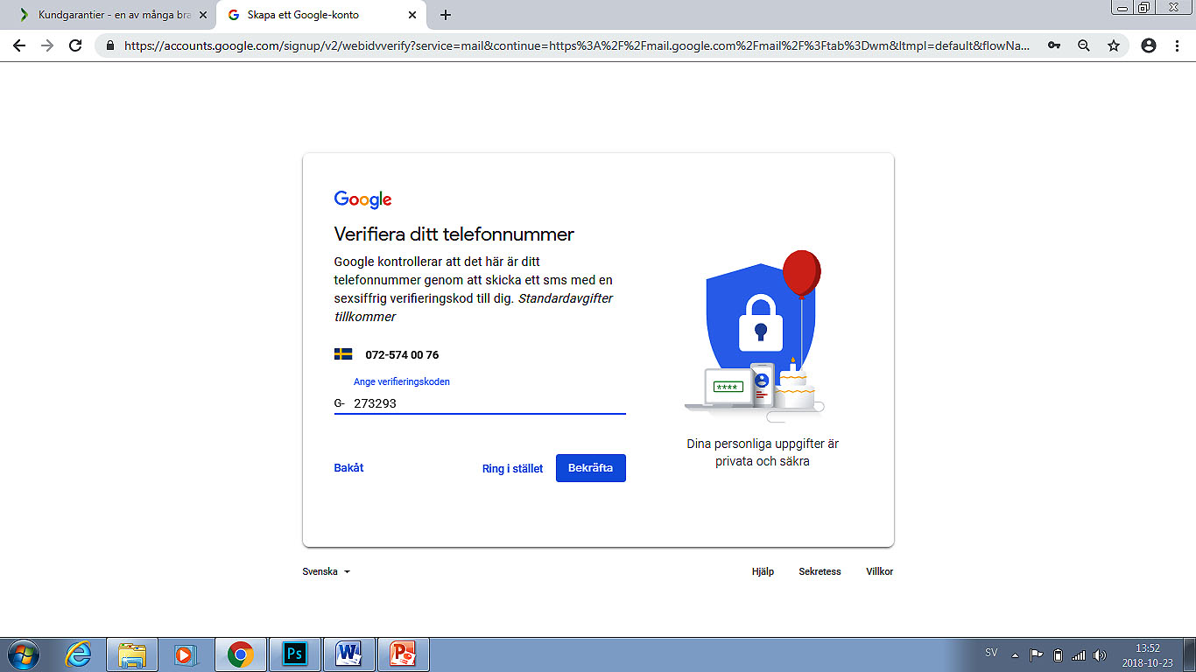
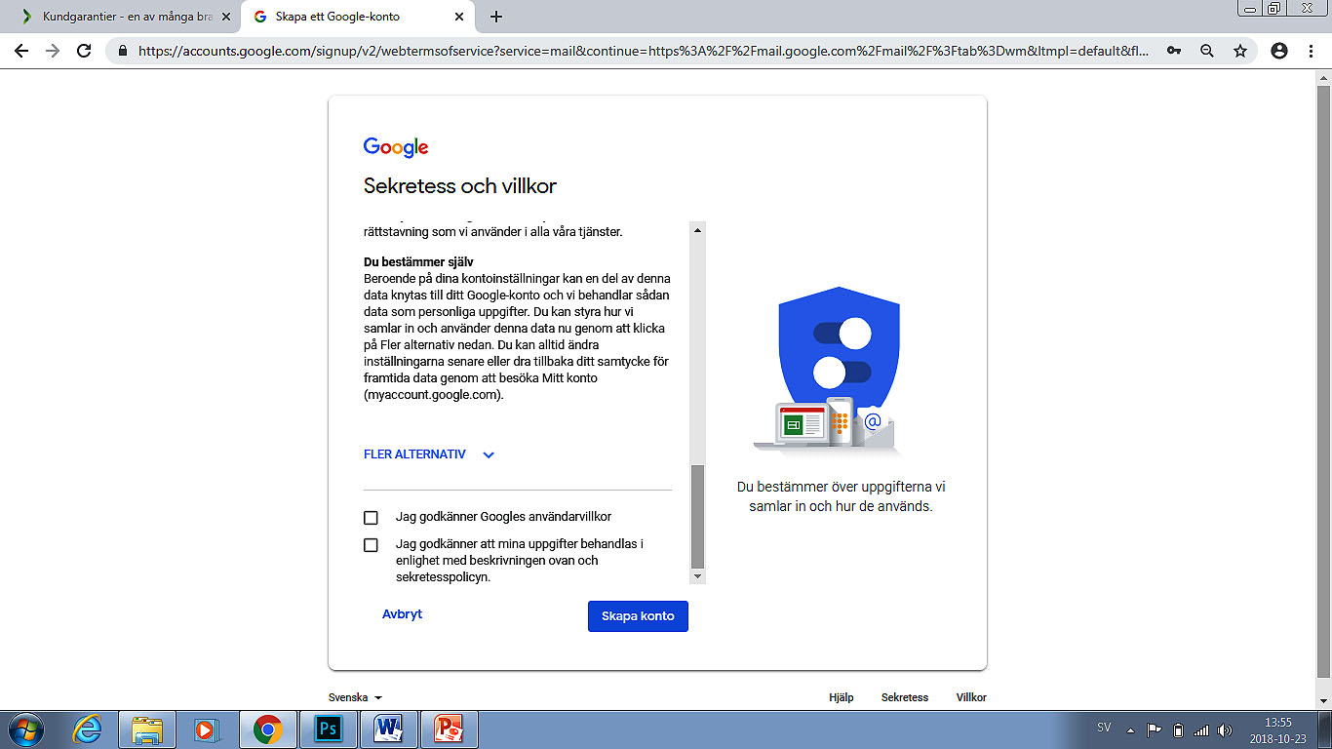
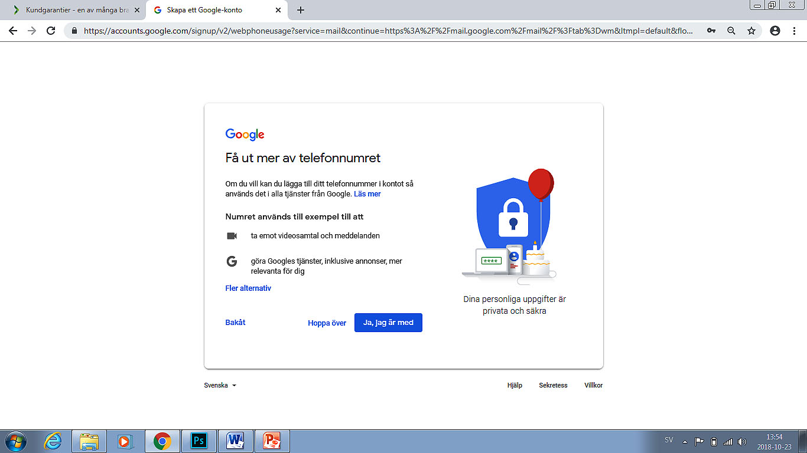
Samaysiga akown iimayl cusub
Akhriso shuruudaha adeegga ama qof kale gargaar weydiiso.
Guji “Tallaabo xigta” si aad Gmail uga hesho kood lagu xaqiijinayo lambarkaaga telefoonka.
Aqbal heshiiska adigoo calaamadda saxda gelinaya sanduuqa.

Slide 9
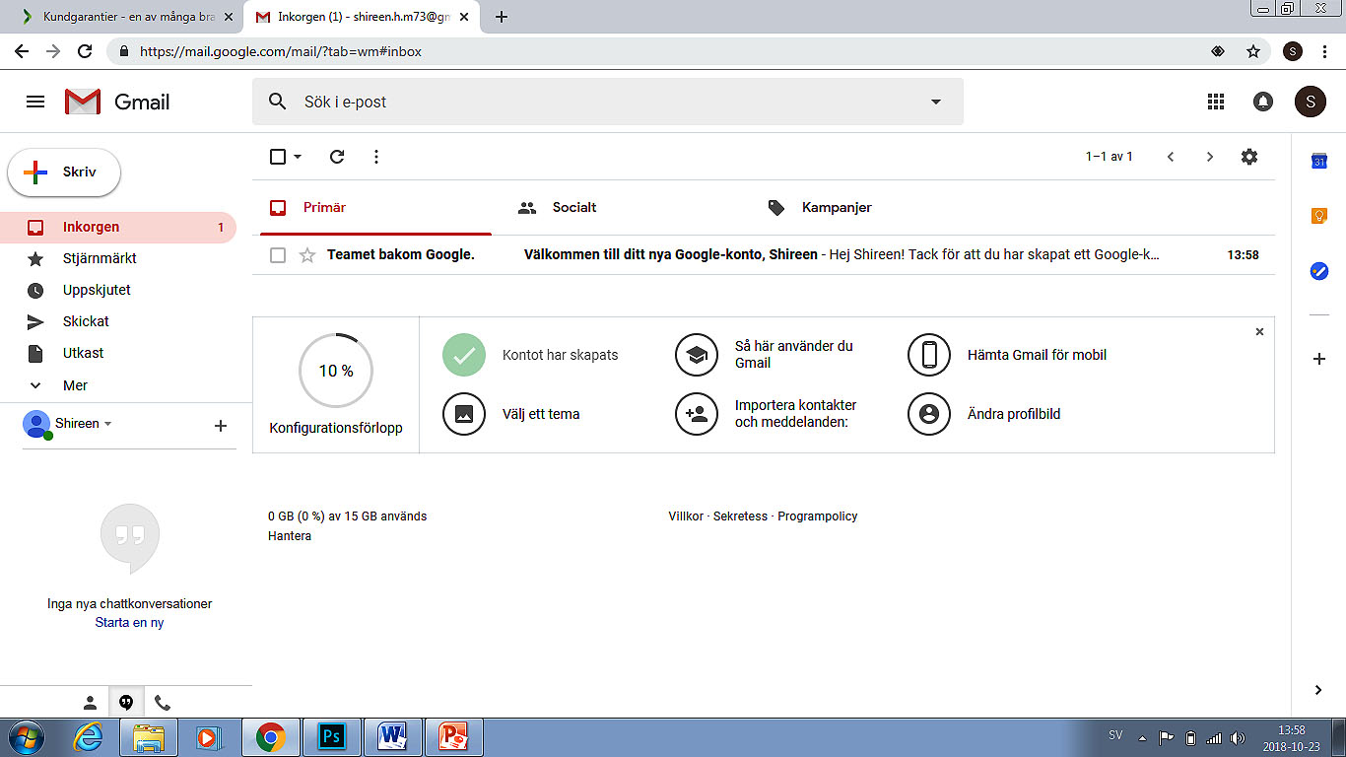
FARRIIMO
Marka aad furto farriimahaaga, waxaad arki doontaa dhammaan farriimaha laguu soo diray. Farriin kaste waxay ka muuqataa xarriiq gaar u ah, waxaana ku jira qaybaha soo socda: taariikhda iyo saacadda, mawduuca/magaca, diraha, iyo sanduuq laga doorto farriinta. Xarriiqa meel ka guji si aad farriinta u furto.
Sharraxaadaha:
Dooro – tan isticmaal si aad uga shaqayso farriimo gaar ah. Matalan si aad kuwaas meel kale ugu qaaddo ama u masaxdo.
Dib u bilow – tan isticmaal si aad u soo qaadato farriimaha cusub ee laga yaabo in adiga laguu soo diray.
Qor – tan isticmaal si aad u abuurto farriin iimayl cusub.
Xayaysiis – Kuwani waa iimayllo aanan la rabin oo laga yaabo in ay ku jiraan xayaysiiska badeeco ama adeeg, ama farriimo ay ku jiraan sawirro, isuxireyaal ama lifaaqyo fayl oo la awday.

Slide 10
Iimaylladaada ayaa halkan ka muuqanaya.
Guji “Farriimo" si aad u eegto farriimahaaga iimayl.
Waxaad farriin xiddigayn kartaa marka aad gujiso muuqa xiddigta ee ku ag yaalla farriinta.
Xiddigaha ayaad iimayllada ugu yeeli kartaa darajo gaar ah si ay kaaga fududaato in aad kuwaas soo hesho
“Farriin La diray" waxaa ku jira farriimaha iimayl ee aad dirtay.
“Qabyado" waa halka lagu kaydiyo farriimaha iimayl ee aanan weli la dirin.
Isticmaal “Dheeraad" si aad u muujiso qashin, xayaysiis, sheekaysiyo, iwm.

Slide 11
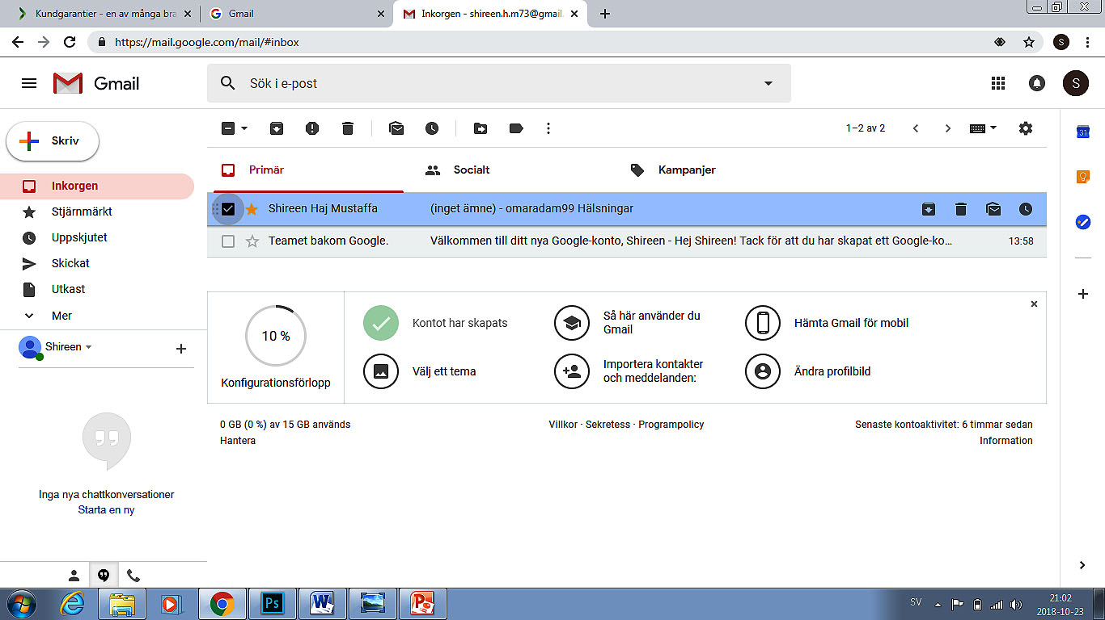
Kaydka
Xayaysiis sheeg
U qaad
Hawlo dheeraad ah
Calaamado
Iimayllada masax
Dooro hal farriin ama in ka badan si aad kuwaas meel kale ugu qaaddo ama ugu riddo qashinka.
Haddii hal iimayl ama in ka badan la doorto, waxaa muuqanaya jeex qalab cusub.

Slide 12
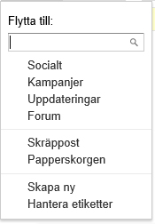
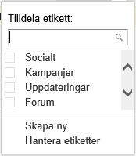
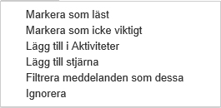
U qaad
Calaamado
Hawlo dheeraad ah
Isticmaal “U qaad” si aad iimayllada aad doorato u geliso calaamado hore u jira. Waxaad weliba dooran kartaa in aad samayso calaamado cusub.
Waxaad isticmaali kartaa“Ku calaamadee" si aad hal cinwaan iimayl ama in ka badan ugu xirto calaamado kaladuwan. Waxaad weliba samayn kartaa calaamado cusub.
Tag“Dheeraad” si aad xulashooyin dheeraad ah uga hesho darajo siinta iimayllada aad doorato.

Slide 13
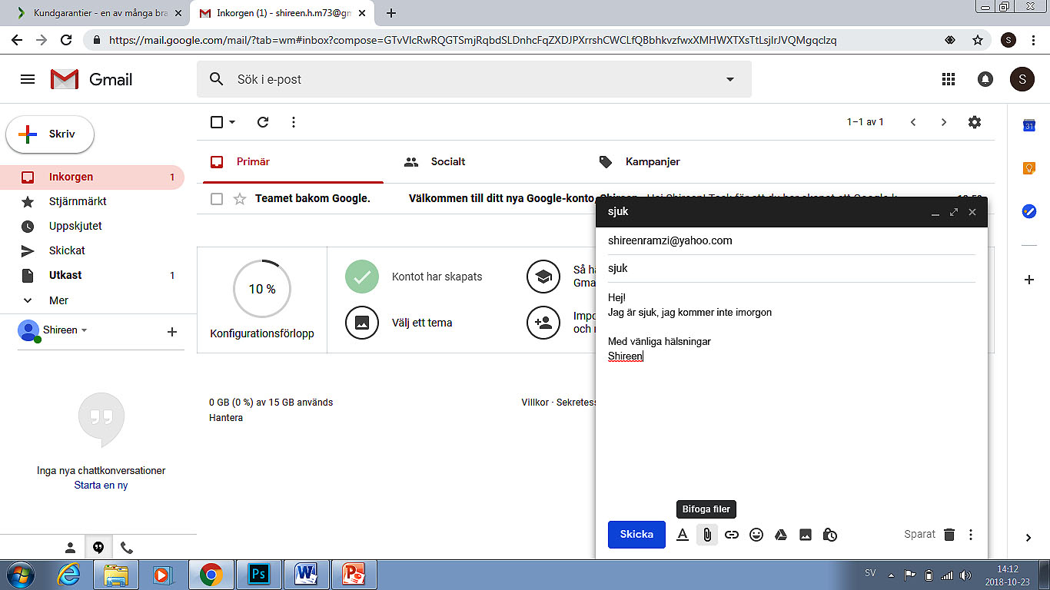
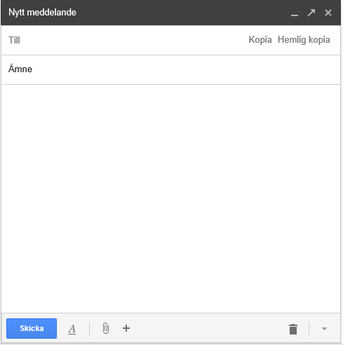
Guji “QOR" si aad u furto daaqad farriin cusub.
Bannaanka “Ku“, geli cinwaanka iimayl ee qofka ama dadka aad rabto in aad farriinta u dirto. Farriinta waxaa loo diri karaa dad tiro kaste ah.
Isticmaal bannaanka “Nuqq" si aad nuqulka farriinta ugu dirto cinwaan aanay arkin dadka kale ee hela.
Bannaanka “Nuq" waxaad gelin kartaa cinwaanka iimayl ee qofka aad rabto in uu nuqul ka helo farriinta.
Bannaanka “Mawduuca" waxaa lagu soo gaabiyaa waxa ay farriintu ku saabsan tahay
Halkan guji si aad fayl ama sawir kaga xirto kaydka Google Drive.
Halkan guji si aad sawir ugu xirto.
Halkan guji si aad fayl ugu xirto.
Halkan guji si aad isuxire u geliso.
Halkan guji si aad u geliso shucuur muujiye.
Halkan guji si aad u muujiso xulashooyinka qaabaynta qoraalka.

Slide 14
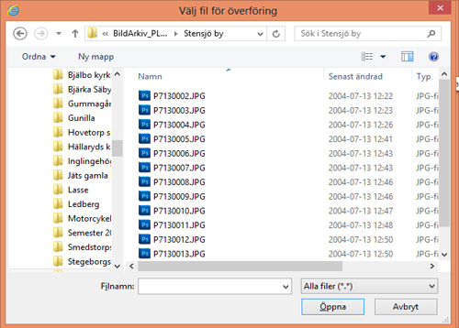
Dooro faylka aad rabto in aad farriinta ku darto.
Guji “Fur" si aad faylka ugu xirto farriintaada.
Halkan guji si aad fayl ugu xirto.

Slide 15
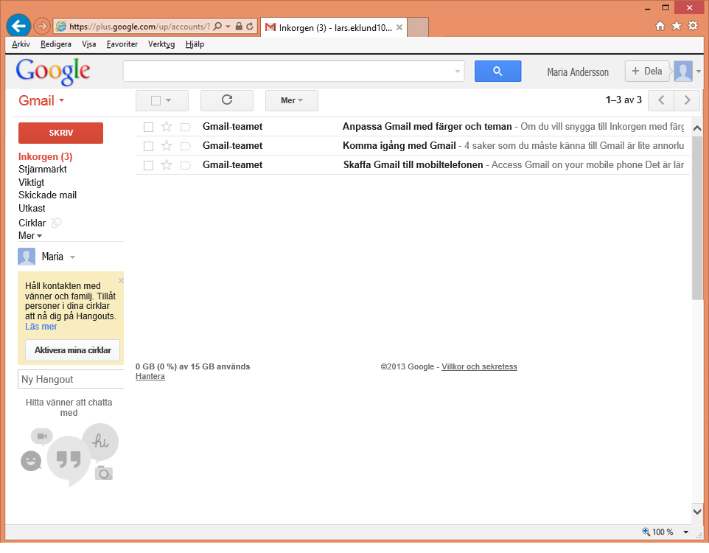
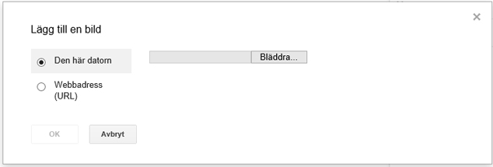
Dooro faylka aad rabto in aad farriinta ku darto.
Guji daalaco.
Guji “Fur" si aad sawirka ugu xirto farriintaada
Si aad u dhammayso guji “Dir" si aad farriinta u dirto.
Halkan guji si aad fayl ama sawir kaga xirto kaydka Google Drive. FG! Waa in aad leedahay akown noocan ah si aad sifadan u isticmaasho!
Sawir geli

Slide 16
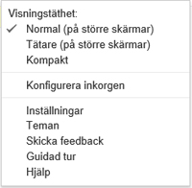
Guji calaamadda giirka si aad u muujiso liis aad kaga habayn karto gundhigyada.
Guji “Gundhigyada".

Slide 17
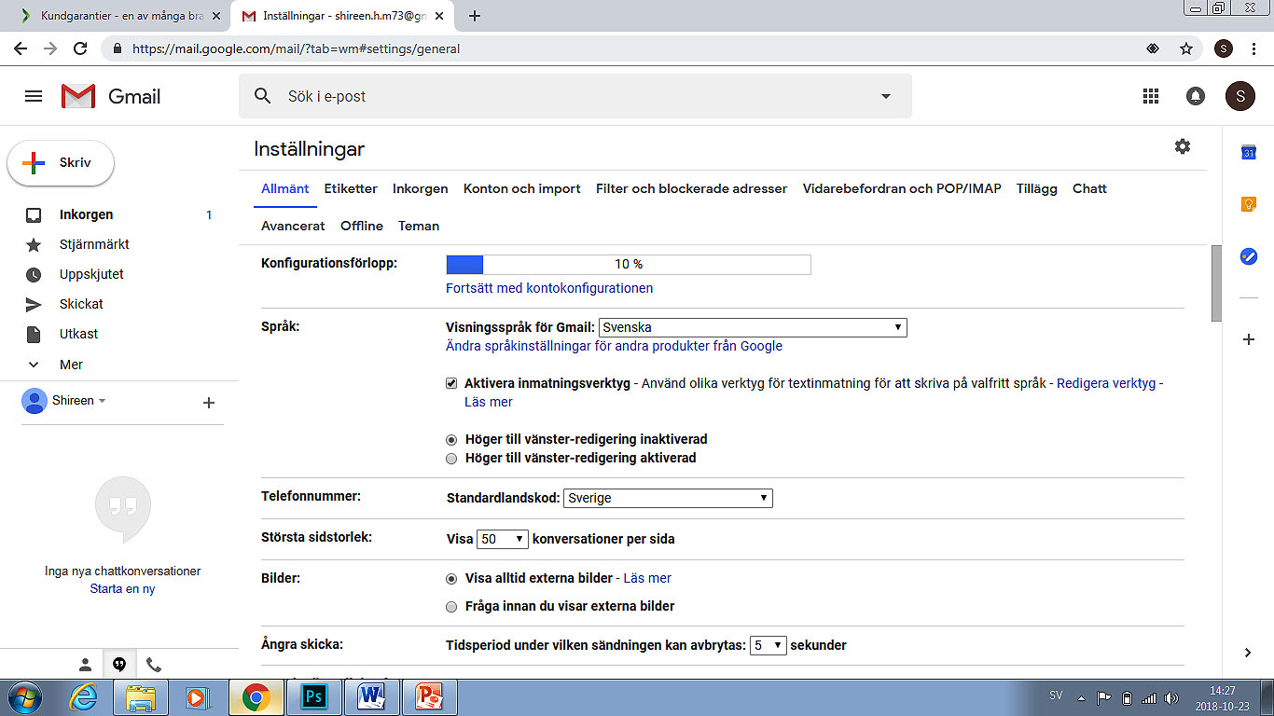
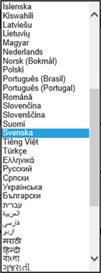
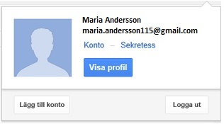
Ka dib hakan guji!
Si aad u hubiso in uusan qof kale akhrin karin farriimahaaga, ka bax akownkaaga iimayl marka aad isticmaalkiisa dhammayso. Tani waxay si gaar ah muhiim u tahay haddii aad isticmaalayso kumbiyuutar dadweynaha u furan.
Halkan guji si aad u habayso luqadda!

Slide 18
Akownka masax

