Slide 1

Computer literacy for beginners

Slide 2
Introduction to the computer
The computer is one of the most important tools of our time. It gives you the ability to store, retrieve and analyse a very large amount of information. Computers are high speed and accurate.
The computer is now available in most parts of the world, and is used by people in numerous contexts. Among other places, it is used in schools, universities, factories, institutional settings and in the home.

Slide 3
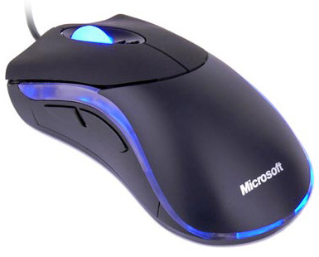
The mouse
You can use the mouse to work with the objects you see on the screen. You can launch programs. You can also move, copy and delete files by pointing and clicking with the mouse.
The mouse has a left button and a right button. In the middle of the mouse is a scroll wheel.
You can change the mouse settings. For example, you can adjust the double-click speed and change the appearance of the mouse pointer.
Left button
Scroll wheel
Right button

Slide 4
Right mouse button
Right-click = Clicking the right mouse button.
When you right-click, a context menu displays, giving you different options to choose from.
The context menu displays different content depending on what you click on with the right mouse button.

Slide 5
Left mouse button
Single-click using the left mouse button
to choose or select.
Double-click (two quick clicks) using the left mouse button to open a file, folder or program.
Dragging and dropping using the left mouse button:
Select a file shown on the screen. Hold down the left mouse button while dragging the file to the new location, and then release the mouse button. This way you can copy or move your files (and folders) from one place to another in the computer without having to cut and paste.

Slide 6
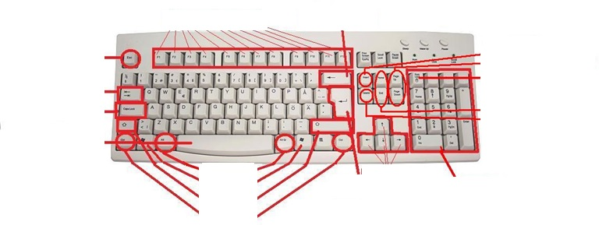
Keyboard
Function keys F1-F12
Backspace
Insert key
Esc key
Page up and Page down keys
Tab key
NumLuck key
Caps lock key
Home and End keys
Spacebar
Delete key
Alt keys
Arrow keys
Winkeys
Enter key
Numeric keys
Shift keys
Ctrl keys
The keyboard is one of the main ways to enter information into the computer. You can enter letters, symbols and numbers.
You can also use the keyboard to control your computer. A few simple keyboard commands allow you to work better and more quickly with your computer.

Slide 7
Keyboard groups
Keys for letters and numbers.
Control keys (Ctrl, Alt, Esc, Win). These keys are used singly or in combination with other keys to perform certain actions.
The function keys (F1, F2, F3, F4, ... F12) are used to perform defined functions. Function keys have different functions depending on the program you are using. We will be explaining how some of these are used in Windows XP.
The navigation keys (arrow keys, HOME, END, PAGE UP, PAGE DOWN, DELETE, INSERT) are used to navigate within documents or websites, and to edit text.
Numeric keypad. The numeric keypad lets you enter numbers quickly, as the numbers are grouped together. Some laptops do not have a numeric keypad.

Slide 8
Hold down the SHIFT key as you press a letter key to make it a capital letter. SHIFT is also used to produce the upper characters shown on the number keys, for example, ! " % * & / | SHIFT
Use CAPS LOCK when you want to type multiple capital letters in a row. A keyboard LED lights up to indicate when this key is activated. | CAPS LOCK
Moves the cursor forward. Can be adjusted using the screen’s ruler. | TAB (two opposing arrows)
Insert a space between the words. | Space
Deletes the character to the left of the cursor. | Backspace (thick left arrow)
Moves the cursor to the beginning of the next line. If you press Enter while in a dialogue box, the highlighted button is enabled. | ENTER
Cancels the current task. | ESC
Pressing this usually brings up a menu. Performs the same commands as when you right-click | Menu key
Opens the Start menu. | Windows
Moves the cursor to the beginning of the line. | HOME
Moves the cursor to the end of the line. | END
Deletes the character to the right of the cursor. | DELETE
Inserts new text over the previous text. | INSERT
Moves the cursor one page up. | Page Up
Moves the cursor one page down. | Page Down
Move the cursor one step in the direction of the arrow. | Arrow keys
Press the Num Lock key when you want to use the numeric keypad to enter numbers. Most keyboards have an LED indicating when the numeric keypad is enabled. | Num Lock

Slide 9
Shortcuts
Switches between open windows | ALT + TAB
Switches between languages ​​(the ones installed) | Alt + Shift
Selects all | CTRL + A
Copies | CTRL + C
Cuts | CTRL + X
Pastes | CTRL + V
Saves | CTRL + S
Undoes the last operation | CTRL + Z
Opens a file in the program that’s open | CTRL + O

Slide 10
Function keys
Help | F1
Rename | F2
Search | F3
Refresh | F5
Save | F11
Save as | F12

Slide 11
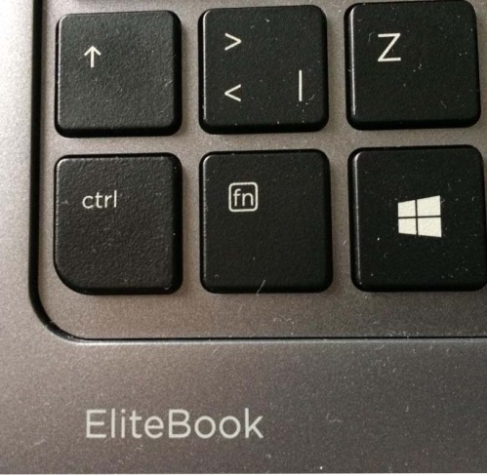
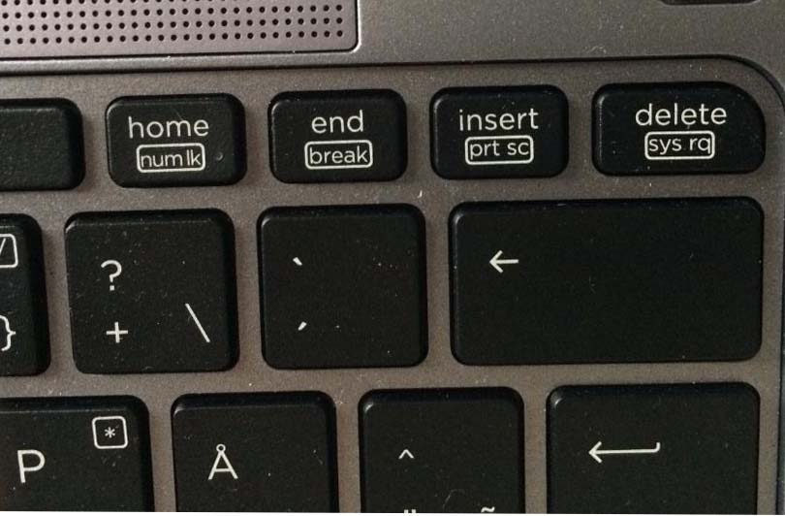
Special key
Print Screen
Captures an image of the entire screen ("screenshot"). Press (fn+Insert prt sc) first and then you can paste this image (Ctrl + V) into Paint or another program.

Slide 12
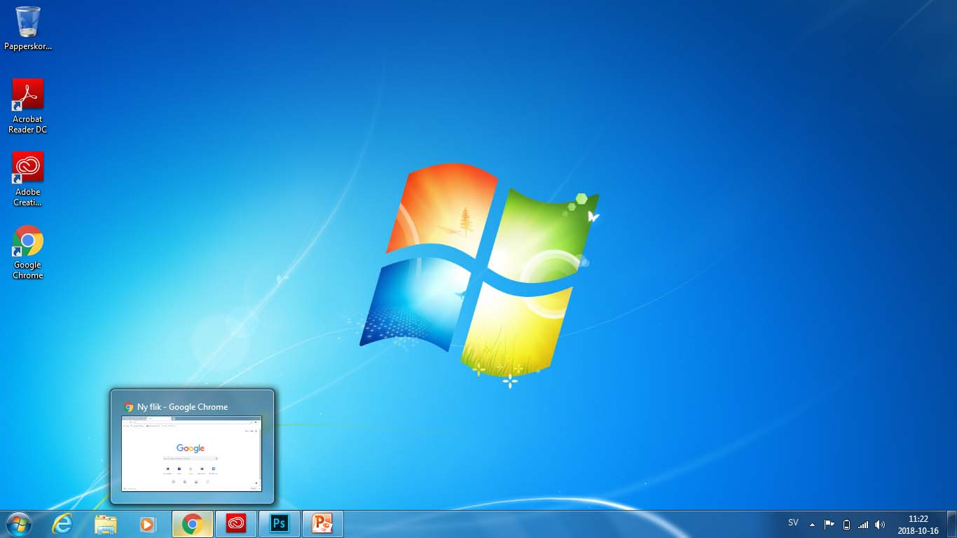
The Desktop
When you start your computer, the Windows Desktop opens on your monitor. The Desktop has icons and shortcuts. At the very bottom you will see the Taskbar. You can launch a program directly from the Desktop or via the Start menu using the Start button.
When using the computer for the first time, there is only one icon on the Desktop: the Recycle Bin. We will explain how you can add other icons to the Desktop at a later stage.
(The Recycle Bin)
The Desktop
Icons
The program
google Chrome
Clock
date
Opened files
Speaker
Start
Taskbar
Language

Slide 13
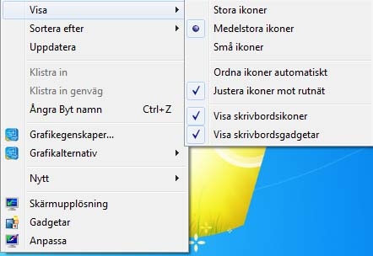
The icons on the Desktop
    Right-click using the mouse in an empty area on the Desktop to display this context menu.
View: Here you can resize the desktop icons, among other things.
Sort by: It is possible to sort the icons by size, name, item type, or date modified.

Slide 14
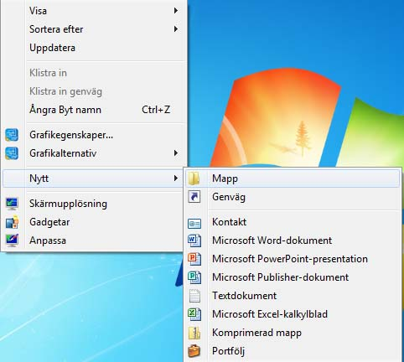
Creating a new file or new folder on the Desktop
Right-click with the mouse in an empty area of the Desktop.
Select "New".
Select the type of file you want to create.

Slide 15
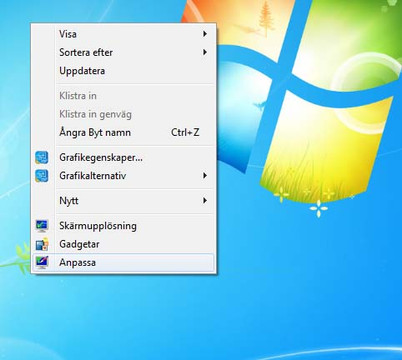
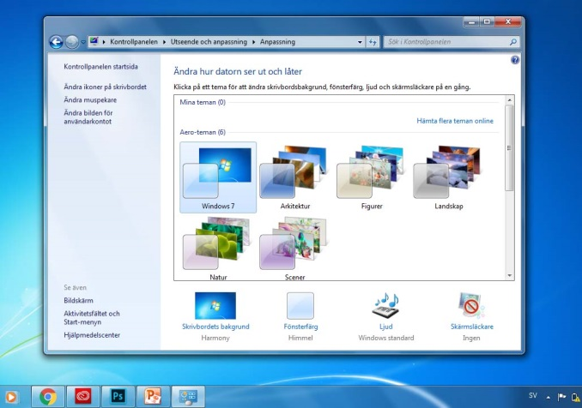
Make settings adjustments to your Desktop
Right-click with the mouse in an empty area on the Desktop. Select "Personalize":
Use this feature to add background images or to select the background colour, among other things. Make a selection in the dropdown list under "Background" to choose whether to display an image, a slideshow or a single colour. You can also choose different themes or another font for your desktop. You can also change what will appear in the Start menu.

Slide 16
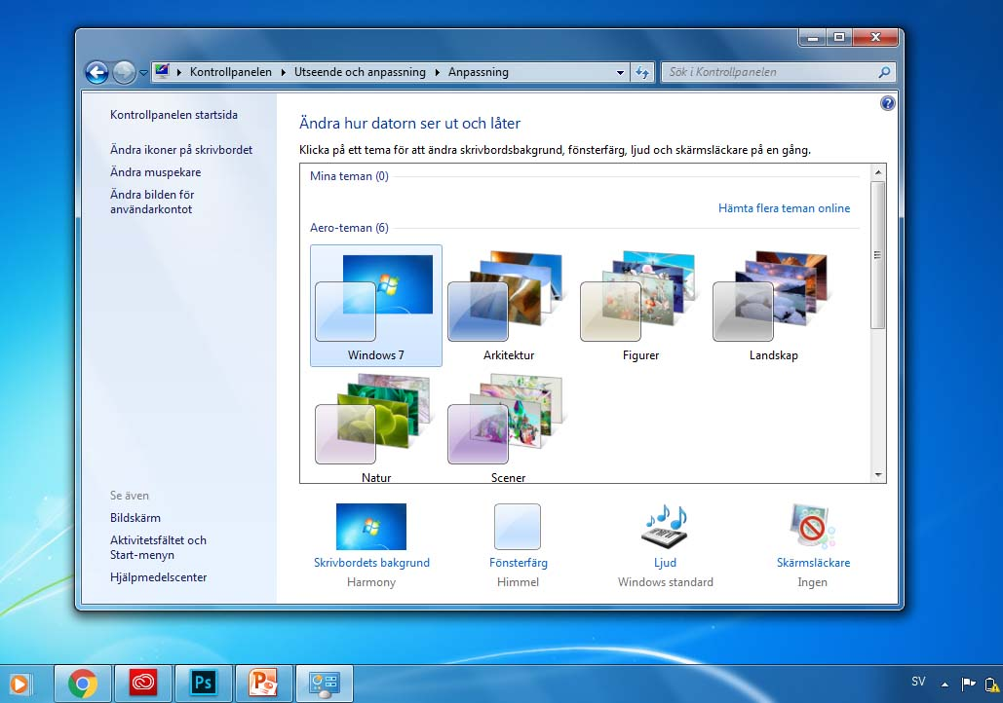
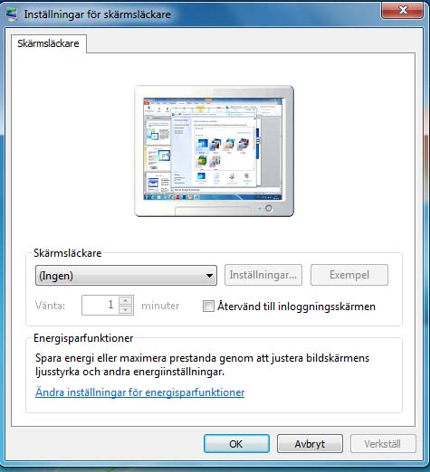
Screen saver
Right-click with the mouse in an empty area on the Desktop. Select "Personalize":
In the window that opens, click "Screen Saver".
In the new window that opens, set which type of screen saver you wish to use.
You can also set how long the computer must be idle before the screen saver starts.
Select the type of screen saver here
  This is where you set the waiting time for the screen saver

Slide 17
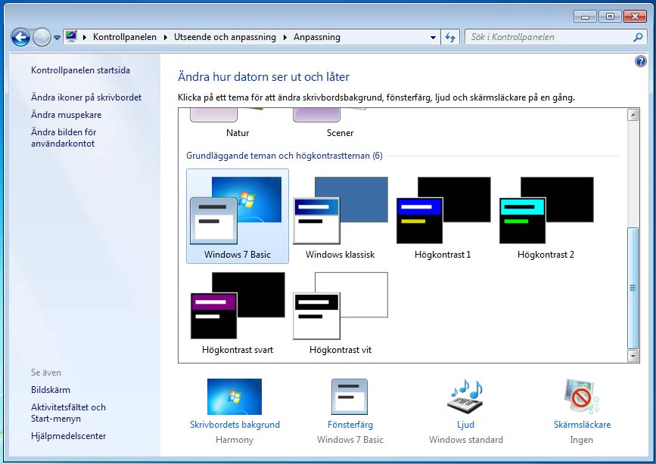
Appearance
Click in the drop-down list below and select different themes or other fonts for your desktop.
you can select colours for the windows and choose from different themes.
You can also configure the size of the icons that display on the Desktop

Slide 18
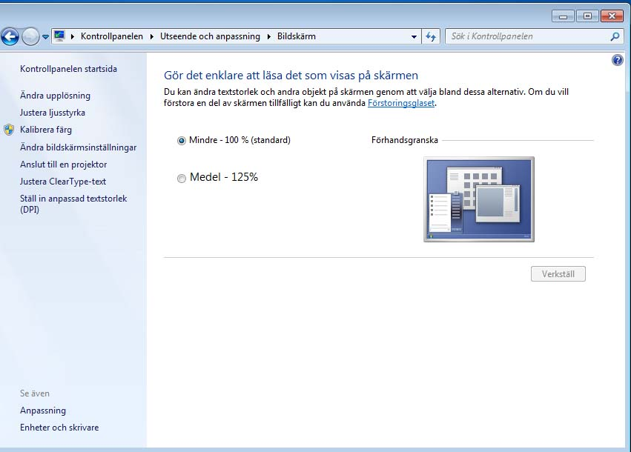
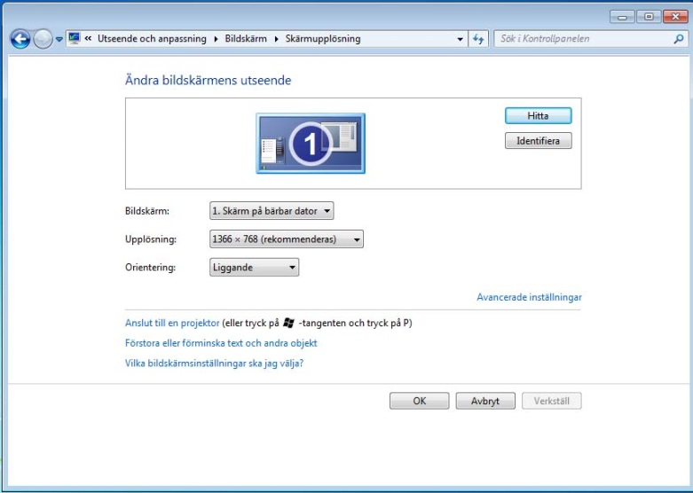
Settings
Click Display first, then click other resolutions, where you can set the colour quality and resolution of the screen.

Slide 19
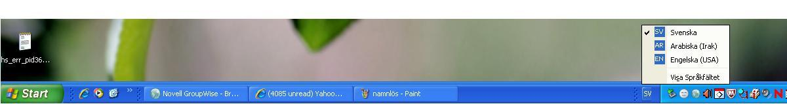
Taskbar
The taskbar is a bar at the bottom of the screen. The Start button is located at the far left-hand corner of the taskbar. The taskbar can be used to launch programs, switch between programs and see which programs are running.
The taskbar is usually found at the bottom of the screen, but it can also be dragged to the left, to the right, or to the top part of the screen by dragging it with the mouse.
(Right-click on the taskbar to make sure it is not locked – if it is locked you will not be able to move it.)
Open files and programs
Languages ​​button
The Start button

Slide 20
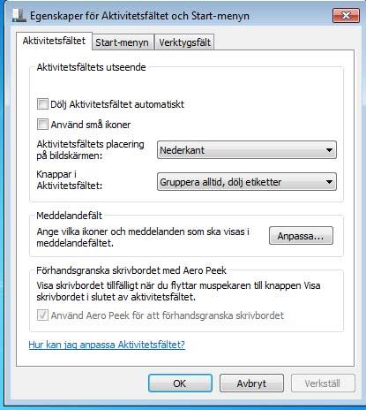
Right-click on the taskbar.
Select Properties.
A dialogue box displays:
Lock the taskbar: When it is locked, the taskbar cannot be moved to a different location.
Auto-hide the taskbar: If this sitting is activated, the taskbar is only displayed when you hover the mouse pointer near it. When you move the mouse pointer away, the taskbar disappears.
Keep the taskbar on top of other windows: This way the taskbar will always display on the screen.
Group similar taskbar buttons: In this case all open Explorer pages, for example, will appear together on the taskbar.

Slide 21
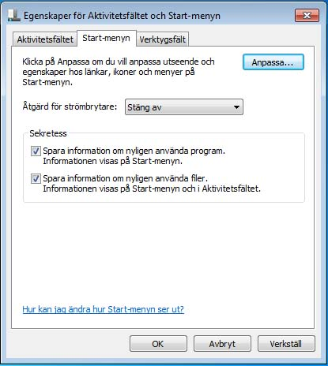
Start button
The Start button is located on the left side of the taskbar. When you click it, a special menu for the operating system and various programs opens.
It is possible to adjust the Start menu properties by right-clicking the Start button. Select Properties from the context menu that displays. Then select the Start menu tab

Slide 22
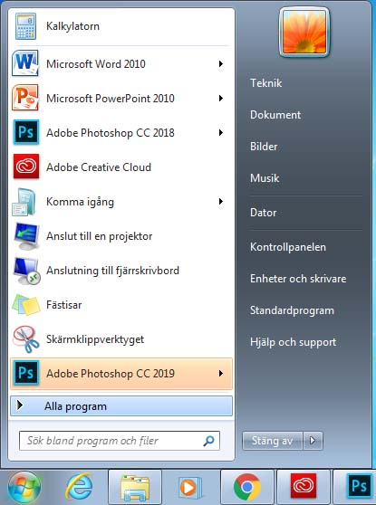
Clicking the Start button displays the most important menu in the Windows operating system, called the Start menu.
The contents of the Start menu
All programs
Displays a list of shortcuts to every program installed on your computer.
Recently used programs
Displays the most recently used programs. You can configure the number of programs you want to display using the Start menu settings.

Slide 23
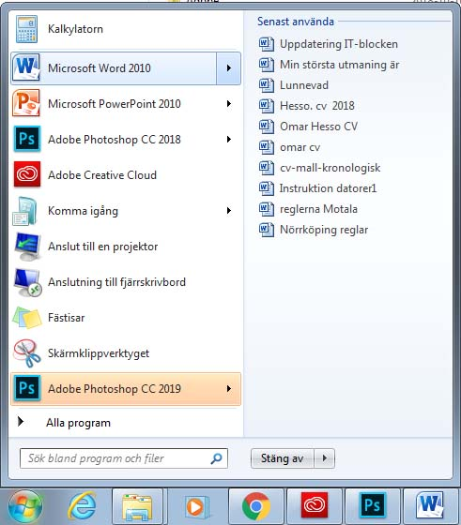
Recent Documents:
The most recently opened documents are displayed when you click recent programs

Slide 24
Search
The search function is located in the Start menu. It can help us find a file on the computer, e.g. a text file, image file or audio file, etc. You type:
Name or part of the file name.
Sentence or phrase found in the file.

Slide 25
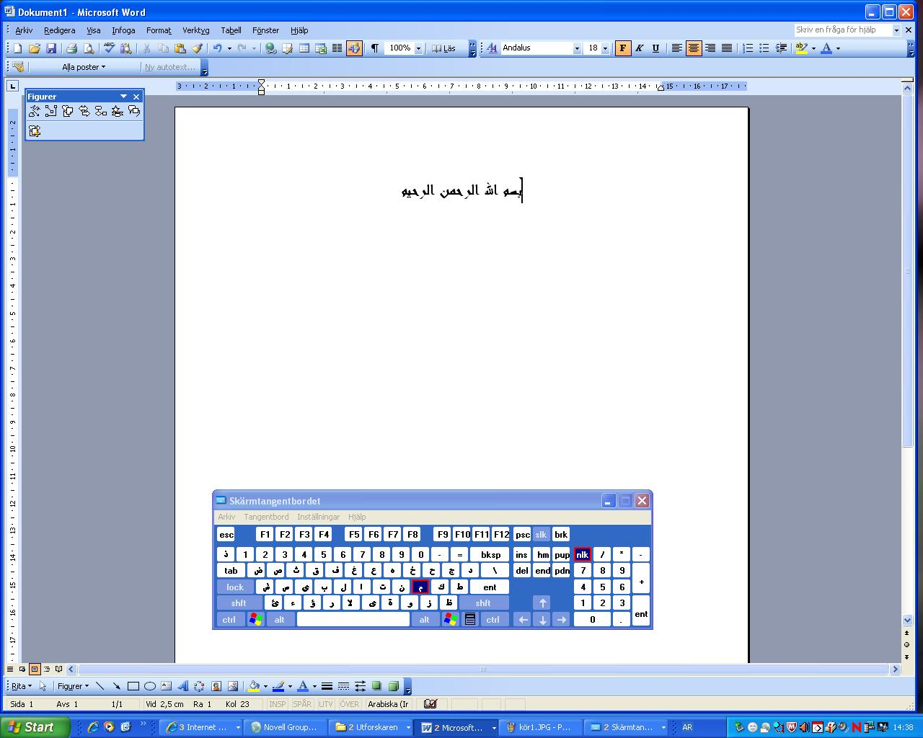
Once you press OK, the keyboard appears on the screen. You can change
the keyboard by changing the language on the taskbar. You can write directly on the screen by using the mouse to click the keys of the onscreen keyboard.

Slide 26
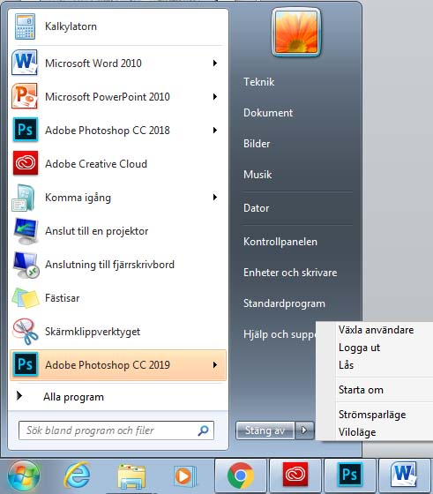
Log off, Shut down
If the computer has more than one user, you can log off one user and log on another without having to shut down the computer.

Slide 27
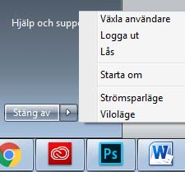
A few options display when you click the Shut down button:
  Shut down: The computer is shut down in a safe manner.
  Restart: The computer shuts down and restarts immediately. This is
  appropriate to use after installing a program.
  Sleep: Use this when you will not be using the computer for a short period of time. The computer will enter standby mode. When you want to start working on the computer again, simply press the power button on the computer.

Slide 28
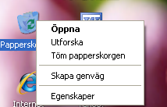
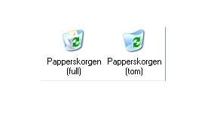
The Recycle Bin
The Recycle Bin is the one folder that will always be on your desktop. This is where Windows stores deleted files temporarily until the user decides to permanently delete them.
It is possible to restore files from the Recycle Bin that have been deleted by mistake: Open the Recycle Bin (by double-clicking it on your desktop). When you open the Recycle Bin, you will see all the deleted files.
You can permanently delete the files in the Recycle Bin by emptying it to free up more space on your hard drive. Empty the Recycle Bin permanently by right-clicking it and selecting the command Empty Recycle Bin.

Slide 29
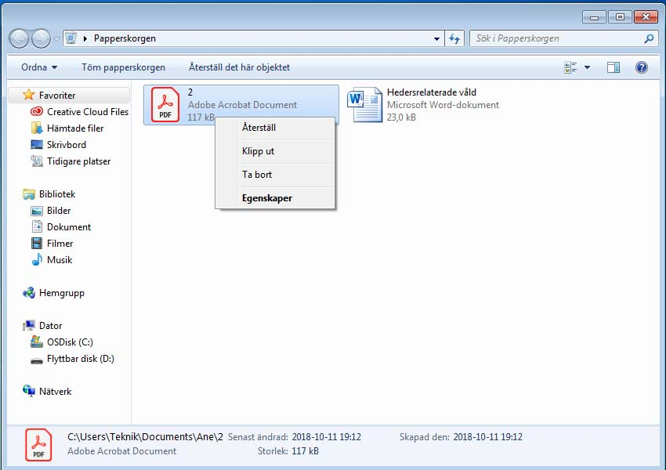
Once you open the Recycle Bin, you can choose which file you want to restore or delete permanently by right-clicking it and choosing from the following options:
Restore: Restore files you deleted by mistake, and restore them to their original locations.
Cut: Cut the file from the Recycle Bin and paste it anywhere.
Delete: Delete the file permanently from the Recycle Bin. After that it will not be possible to recover the file.
Properties: Explore the file’s properties, such as size and location (before the file was put in the Recycle Bin).

Slide 30
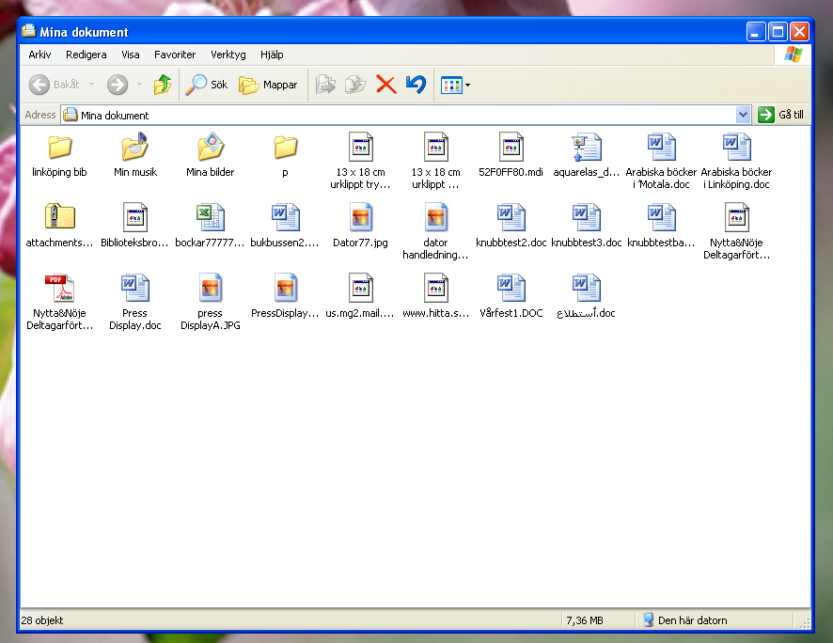
Windows
When you open the program, file or folder, the contents display in a box referred to as a window.
All windows have the following elements:
Name field: The upper blue bar shows the window’s name in the left-hand corner.
At the far right of the bar are three buttons:
Minimize: The window disappears from the Desktop and only appears as a button on the taskbar.
Maximize: The window fills the entire screen. Restore: Resize the window by dragging the window border in or out.
Close: The window disappears from both the Desktop and taskbar.
Menu bar: Contains items that you can click on and then perform operations with in a program.
Workspace: The white area of the window where content displays.
Toolbar: Tools that help us work with the content of the open window.
Information bar: A bar in the lower part of the window with information about the open window.

Slide 31
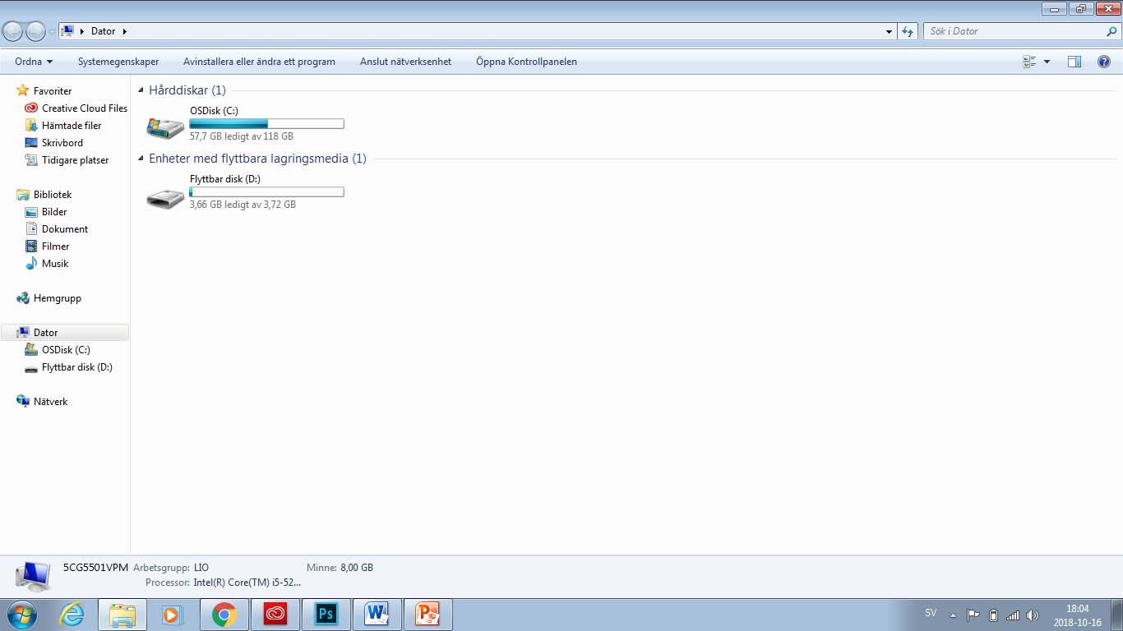
Computer
Shows the content of your hard drive and CD-ROM drive, diskette and network devices.
To open Computer, click the Start button. This opens the Start menu. Then click Computer.
The hard drive is generally divided into two drives: (C:) and (D:).
The CD/DVD drive is designated by the letter (E:).
Removable drives connected via USB. This shows a USB memory drive (F:).

Slide 32
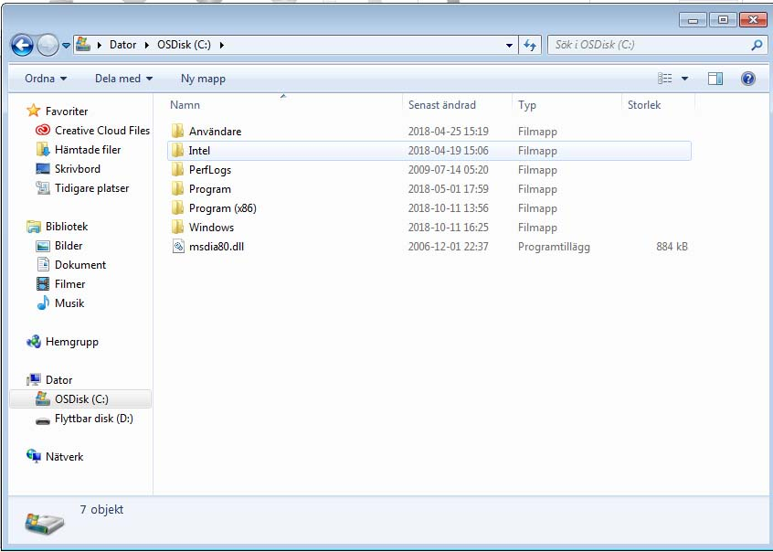
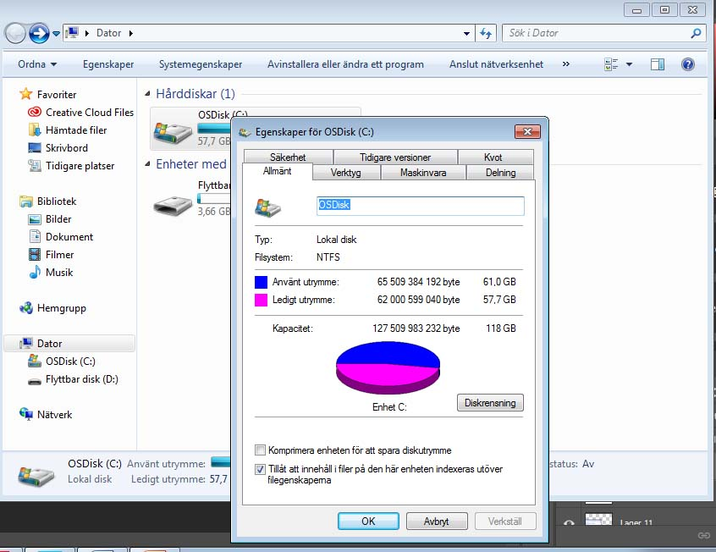
Open drive properties
Open a drive by double-clicking on the drive icon in the computer window.
View the properties of the drive by right-clicking the drive and selecting Properties.
This will display a box with information about free space, used space and drive capacity.

Slide 33
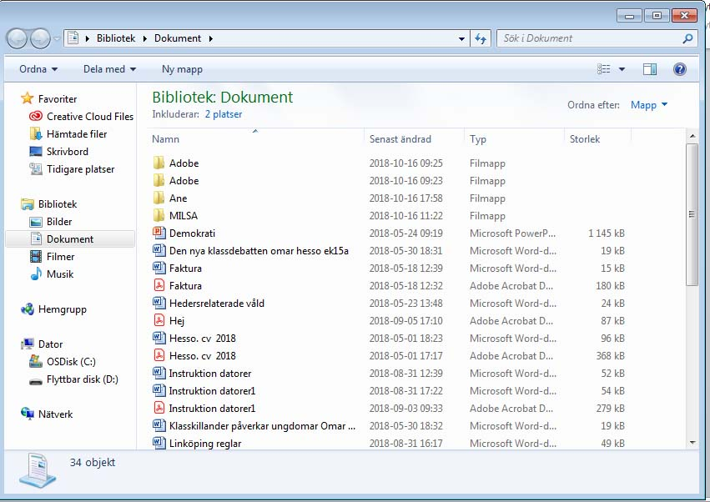

Document
Documents is a personal folder where you can save documents, image files, audio files and other files. If the computer is used by more than one person, a folder named My Documents is created for each user.
Documents can be found in the Start menu

Slide 34
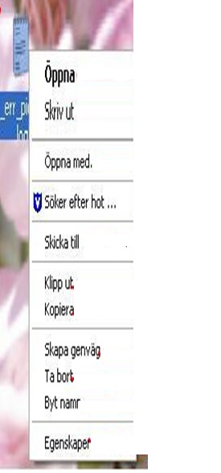
File and folder management
File and folder management is important.
Open a file (three different ways):
Double-click OR
Select the file and press the Enter key OR
Right-click and select Open.
Rename:
Right-click the file you want to rename. Select Rename. Enter the new name. Press the Enter key.
Delete:
Right-click the file and select Delete. Confirm that you wish to delete it. The file is then moved to the Recycle Bin.
Copy:
Right-click on the file. Choose Copy. You can paste a copy of the file into a different location by right-clicking an empty area and selecting Paste. The original file remains where it was.
Cut:
Right-click on the file. Select Cut. You can paste it into a different location by right-clicking an empty area and selecting Paste. When you choose Cut and Paste, you are moving the original file to the new location.

Slide 35
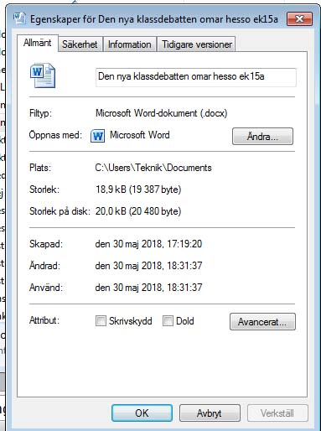
File Properties
Right-click the file and select Properties. This displays a box with the most important information about the file: file name, size, when it was created, when it was last modified, and when it was last used.
Write protection:
If you select Write Protect, it is not possible to modify the file.
Hidden:
If you select Hidden, the user can no longer see the file.

Slide 36
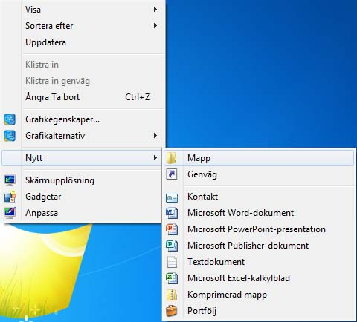
Create a new folder or a new file in a specific window.
Open the window where you want to create a new file or folder. Right-click on an empty area in the window and then select New from the context menu and select a Folder or file type from the next context menu.
Give the new folder a name. The name may not contain special characters such as | ? / ^ * >. Press the Enter key to save the name.

Slide 37
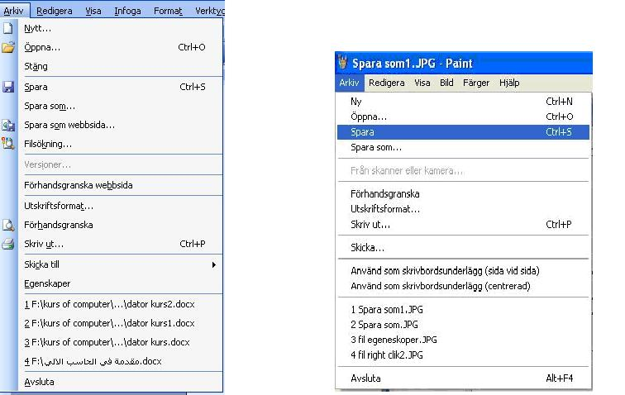
Save and save as
The first time you save a file, use Save As from the File menu. Then choose a file name and where you want to save the file.
In the future, use Save in the File menu to save your document in the same location and under the same name as before. An alternative is to click on the Diskette icon on the menu bar.
If you want to change the name of the file or save it to a different location, use Save As from the File menu. You can select a new file name or a new location using that function.

Slide 38
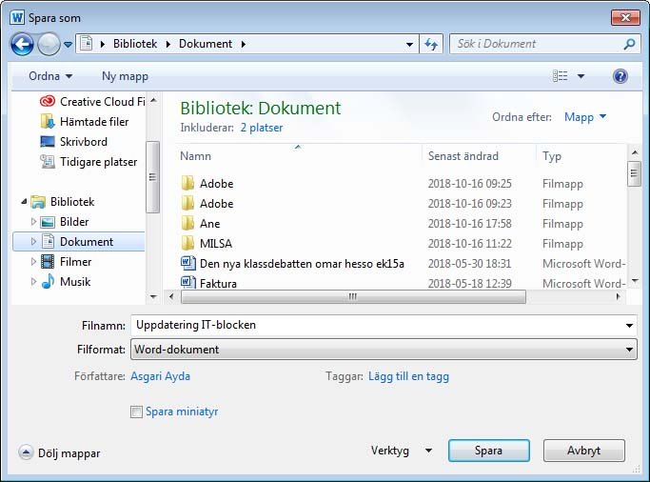
Choosing Save As from the File menu opens a dialogue box. Give the file a name. Specify where you want to save the file. Click Save.
Choose where you want to save the file here
This is where you select
the file type
Enter a name of your choice for the file
Finally, click "Save"

Slide 39
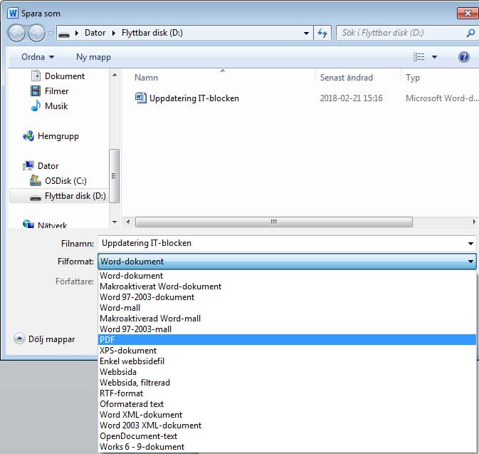
Location where you save the file
File formats that Paint can access
You can choose a file format using the Save As command. Certain programs have several options for the file format, such as the Paint program (see image).
A file name is made up of two parts, e.g. File 1.jpg
The first part, "File 1", is the name we have chosen for the image.
The second part, "jpg", is the file format we chose from among the options available in the image processing program we are working in.
A given file can only be opened by programs that the file format is compatible with. For example, audio files can be opened with Windows Media Player, RealPlayer or some other type of program for audio files. But it is not possible to open a text file with Media Player.

Slide 40
Control Panel
The Control Panel window has icons that you can use to configure personal settings. For example, you can add and remove both hardware and software, install printers and change the appearance of folders and windows.
There are several ways to open the Control Panel:
The Control Panel can be accessed directly from the Start menu.

Slide 41
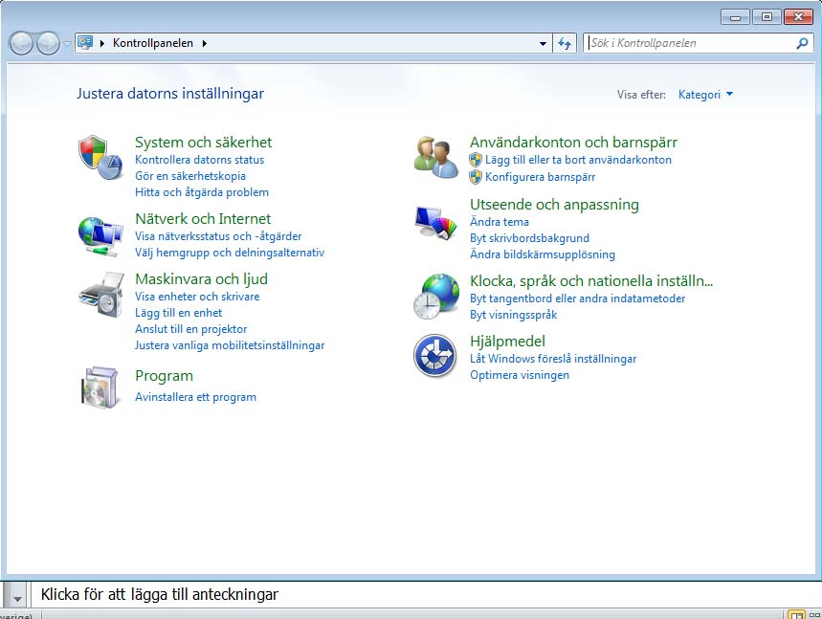
The Control Panel can be used to do plenty of things, but we will restrict ourselves to the most important features here.

Slide 42
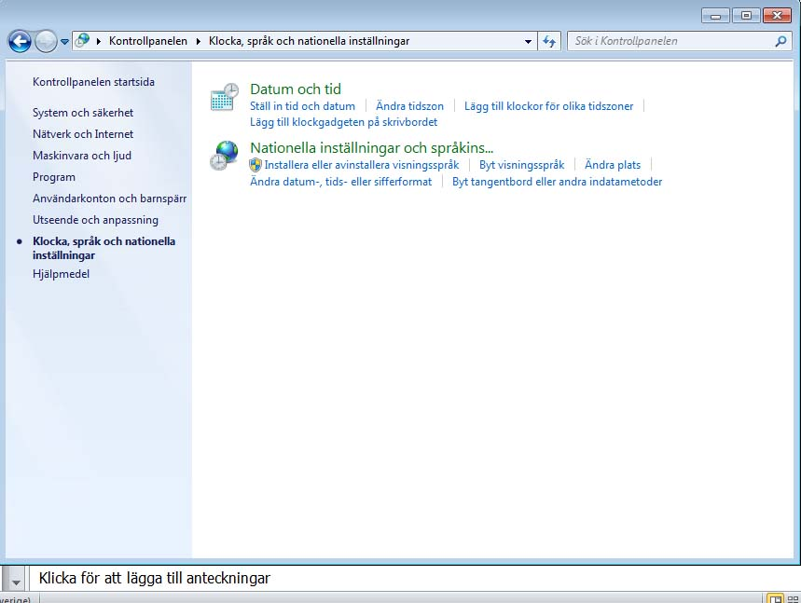

Language option and the way dates and numbers display on the computer
Open the Control Panel.
Select Regional and Language Options by double-clicking using the left mouse button.
A dialogue box displays where you can choose how numbers, currency and dates should be displayed.
To add or remove a language, click the Keyboards and Languages tab.

Slide 43
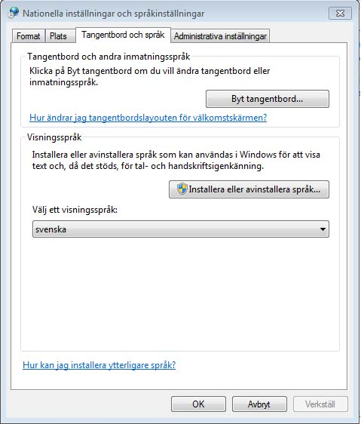
Select the option Install files for right-to-left languages if you want to access this feature. (If your version of Windows does not support these languages, this will not be possible.)
Click the Change keyboards... button (see picture) to bring up the next dialogue box.
Select the option Install files for East Asian languages if you want access to these languages.

Slide 44
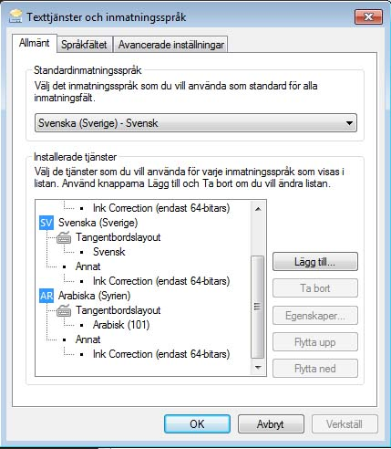
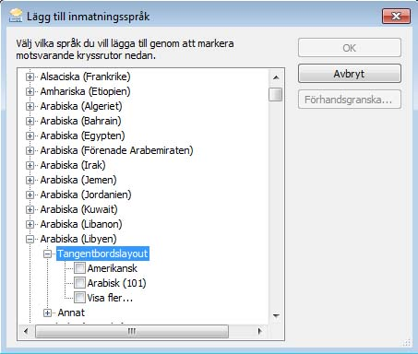
Click Add... to add a new language or Remove in order to delete a language that has already been installed on the computer.
For example, select Arabic (see picture).
Then click OK to save the changes.
Also press OK in the first dialogue box to select the language.

Slide 45
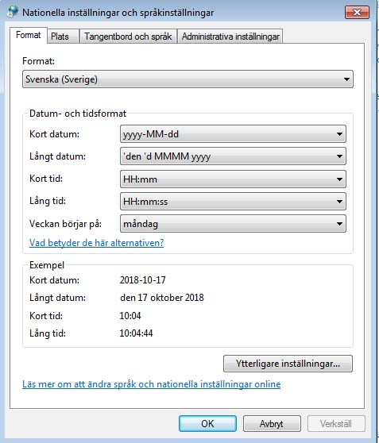
You can use the Control Panel to choose a format for the time and date and to select the time zone. These are often already configured correctly when the computer is set up. But if you need to fix the date or time, it is possible to do so here.
2. Date and Time
Open the Control Panel and double-click Date and Time.
A dialogue box displays where you can set the date and time and make corrections if they were set incorrectly before.

Slide 46

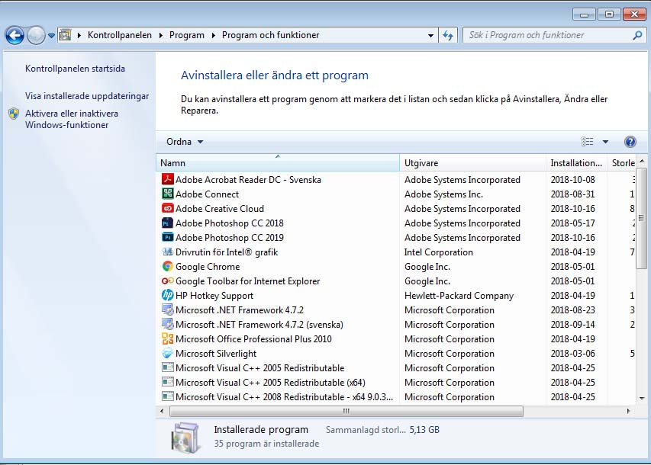
3. Add or Remove Programs
When you click Programs, a list of all the programs installed on your computer will display. You can select the program from the list and remove it.
You can add a new program or remove one of the Windows components, but you must have administrator rights in order to do so.
If you do not have administrator rights, you cannot change or remove an operating system component.

Slide 47

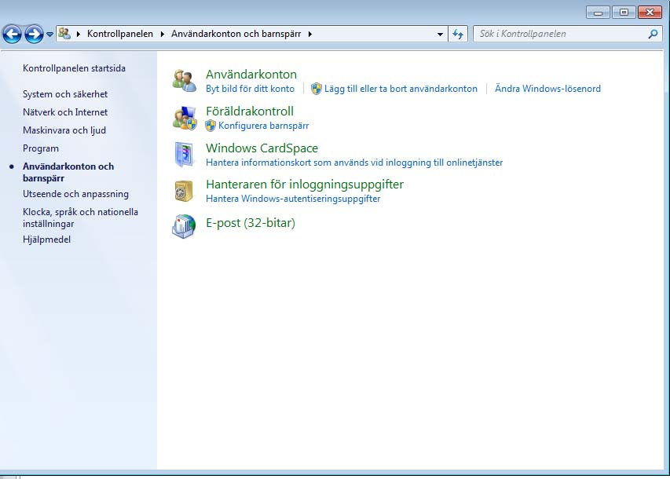
4. User accounts
Another important setting that can be made in the
Control Panel is the ability to add a new user account or
to modify an existing
user.
By providing separate user accounts, every
user can work with their own
files and with their own password. This feature
is needed when there is more than one user using
the same computer.
NB! To set this up you need to have the right to manage the computer
(administrator rights).

Slide 48
5. Printers and Faxes
Printers can be opened from the Start menu. It is also possible to
add a new local printer using the installation CD
accompanying the printer.
To print a document, select Print
in the File menu. In Printers in the Control Panel, you can
monitor your print jobs, cancel printing or
control a print job.

Slide 49
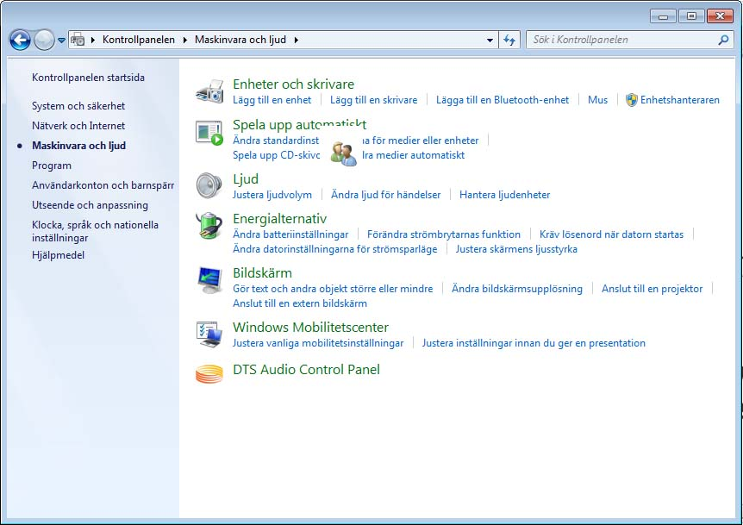
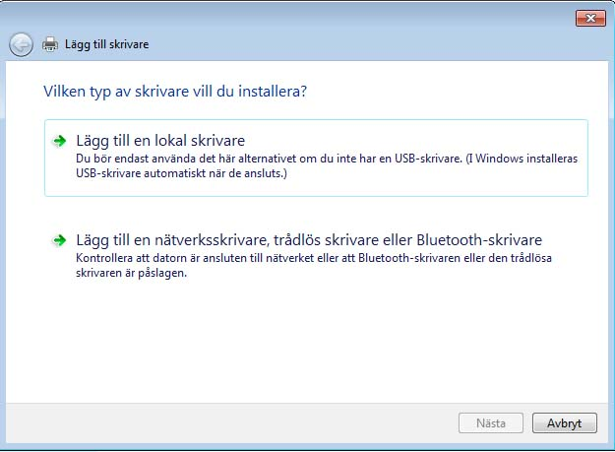
Setting up printers
Here you can add a printer, either using a CD or by installing it via the internet.

Slide 50
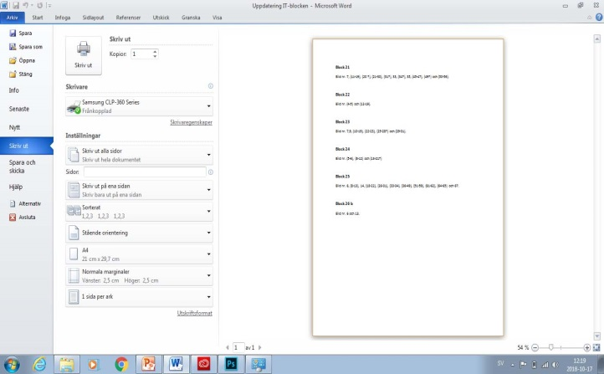
When printing from a program, use Print from the File menu.
If you request a printout by clicking the printer icon on the toolbar, it will not be possible to control the print job. Instead, the printer will print the entire document using the default printer.

Slide 51
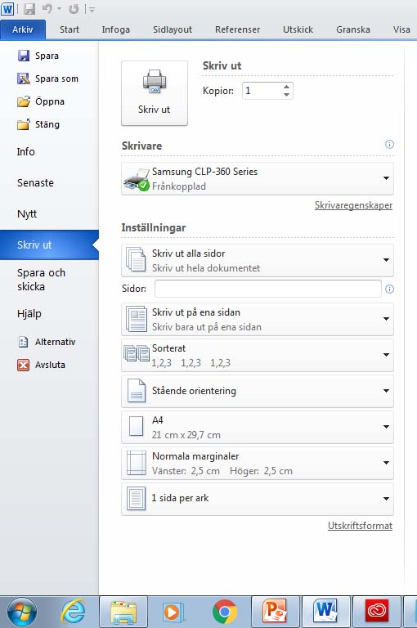
Print
If you print using the File menu, you can select the printer you want to send the print job to (if there is more than one printer connected to the computer).
You can choose which pages you want to print.
You can also print odd or even pages using the next option in the left-hand corner.
Select the number of copies and whether to collate.
Select Printer
Print odd pages, even pages, or all pages

Slide 52
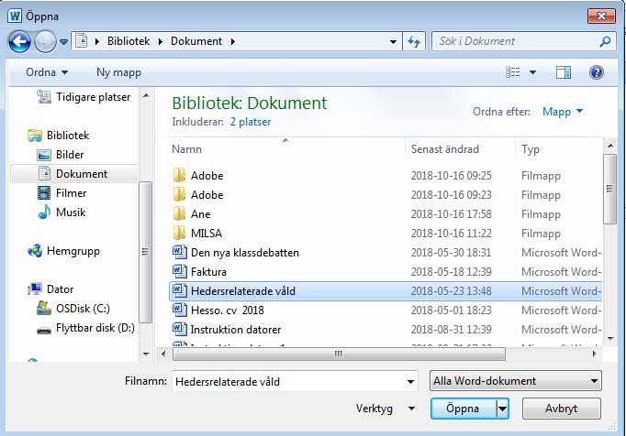
Open in Windows
Every program contains the File menu command Open When you click Open, a dialogue box displays. In this dialogue box you can browse to the location of the saved file. Double-click the file to open it.
Browse from here to the saved file
A program will only open files that are compatible with the program. For example, Microsoft Word will only open Word files.
Select the file you want to open
Click "Open" once you have selected a file

Slide 53

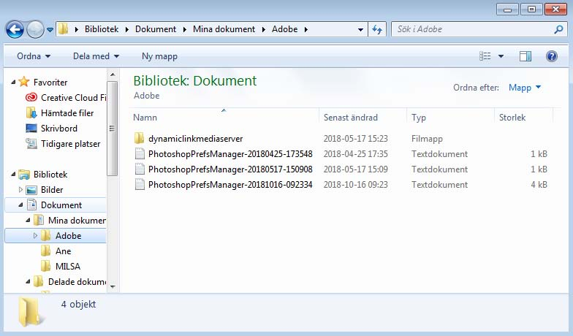
Exploring in Windows
Open Windows Explorer by
right-clicking the Start button
and selecting
Open Windows Explorer.
Windows Explorer consists of two parts, a left pane and a right pane.
Windows Explorer displays the contents of your computer in the form of a tree view. The objects with a plus sign in front of them contain subfolders. Click the plus sign next to a folder to display the subfolder contents.
Once the subfolders are visible in the tree view, the plus sign will have changed to a minus sign. When you click on a folder in the left pane, the folder contents will display in the pane on the right.
To hide the subfolders, click the minus sign next to the folder.
Open the folder with the arrow icon
Contents of the opened folder

Slide 54

It is possible to perform all the operations discussed above in the right pane. You can also delete, rename, cut and paste, etc. from the toolbar (see picture).
You can also control how the content is displayed (Thumbnails, Abstract, Icons, List, Detailed List).
You can also search for a particular file.
Send to
Delete
Select a display mode

Slide 55


Exploring in Windows
Open Windows Explorer by right-clicking the Start button
and selecting Windows Explorer.
Windows Explorer consists of two parts; a left pane and a right pane.
Windows Explorer displays the contents of your computer in the form of a tree view. The objects with a plus sign in front of them contain subfolders. Click the plus sign next to a folder to display the subfolder contents.
Once the subfolders are visible in the tree view, the plus sign will have changed to a minus sign. When you click on a folder in the left pane, the folder contents will display in the pane on the right.
To hide the subfolders, click the minus sign next to the folder.
Open the folder with a minus sign (-)
Contents of the opened folder

Slide 56
It is possible to perform all the operations discussed above in the right pane. You can also delete, rename, cut and paste, etc. from the toolbar (see picture).
You can also control how the content is displayed (Thumbnails, Abstract, Icons, List, Detailed List).
You can also search for a particular file.
Send to
Delete
Select a display mode

