Slide 1

Word processing

Slide 2
Word is a program in the Microsoft Office software suite. The other applications in the suite are Excel, PowerPoint, Publisher, Outlook and Access.
Word is a tool used to create different types of documents, such as articles, letters or reports. It is also possible to add pictures, maps and tables combined with text.
There are a few differences between the various versions of Microsoft Word, but all versions contain tools used to compose and format text documents.
Word can be used to save your text in multiple file formats. One example is PDF format. When you share a PDF file, practically anyone can read it using the free program Adobe Reader.
Microsoft Office is not free, but there are some alternative freeware programs that can be downloaded from the Internet. One example is Open Office. This is a program allowing you to open files created in Word. Word can also open files created in Open Office.
Use the link below to download Open Office free of charge: http://download.openoffice.org/index.html

Slide 3
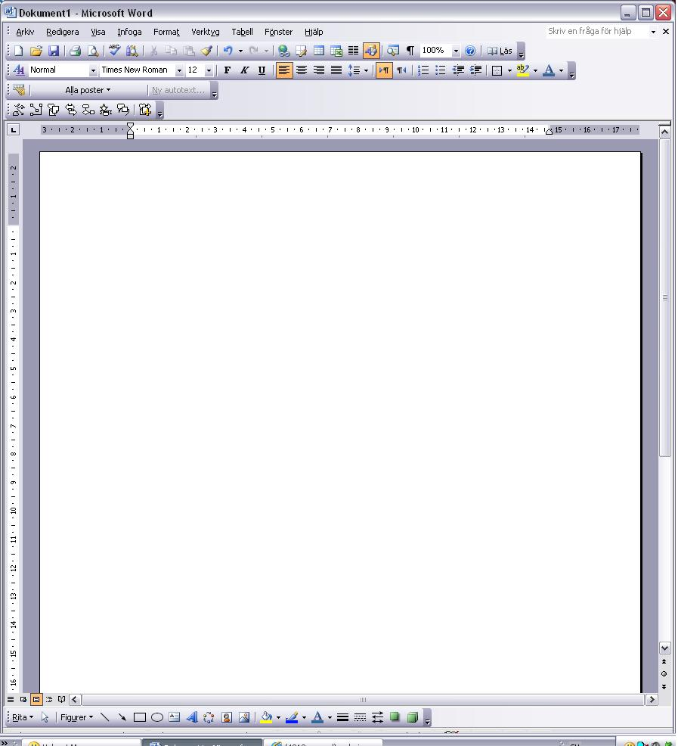
Document name bar
Menu bar
Toolbar
Used to scroll up
Left margin
Right margin
Horizontal ruler
Use the cursor to specify where in the document you want the text to appear. The cursor is a flashing vertical line.
Top margin
The grey rectangle shows the area inside the margins
Vertical bar used to scroll up and down in the document
Vertical ruler
Used to scroll down in the document
Horizontal bar used to scroll left and right.
Drawing toolbar

Slide 4
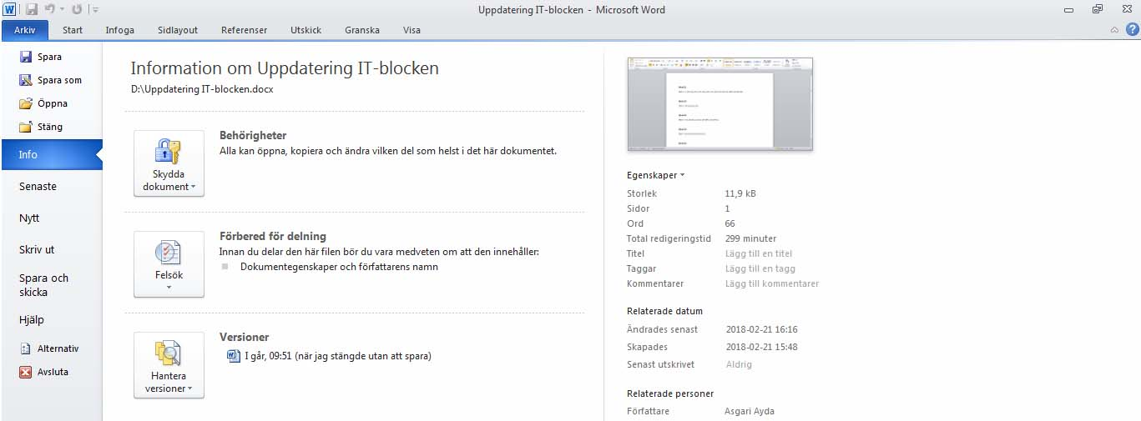
Save: Save the document after making changes, under the same file name and in the same location.
Save as: Saves the document for the first time.
Open: Open a document that you have already created and saved.
Recent: The most recent documents you created.
New: Open a new blank document.
Print: Print an entire document.

Slide 5
Font
Font size
Bold
Italics
Underline
The Formatting toolbar
Font: Select the font by clicking on the small arrow. There are many different fonts.
Font size: Select the size by clicking on the small arrow.
Bold: Click B in order to bold the text. Unbold the text by clicking B again.
Italics: Click I in order to italicize the text. Remove the italics by clicking I again.
Underline: Click U to underline the text. Remove underlining by clicking U again.

Slide 6
Different fonts
Arial mistral Engravers mt curlz MT
Times New Roman اندلسي
Different font sizes
Font size 14 Font size 20 Font size 40 Font size 60
Font style
Bold Not bold
Italics Bold and Italics
Underline
Underline and Bold
Underline, Bold and Italics
Underline and Italics

Slide 7
Undo
Redo
Cut
Copy
Paste
Format painter
Editing tools
Cut: Used to cut out all or selected parts of the document, allowing you to paste them into another location in the document or into another document.
Copy: Used to copy all or parts of the document and paste them into another location in the document or in another document.
Paste: Used to paste the part of the document cut or copied in the previous step. Move the cursor to exactly where you want the text to be and then click Paste once.
Format painter: Make a copy of the text format’s size, style, colour, font, etc., and copy this formatting to another part of the text.
Undo: Undoes the most recent operation If you click this arrow, you can go back in the document and undo multiple steps.
Redo: Click to redo what you just undid.

Slide 8
Left
alignment
Centred
Right
alignment
Justified
Line spacing
Left to right
Right
to left
Numbered list
Bullet list
Decrease Indent
Increase Indent
Formatting toolbar
Align text left: Left margin straight and right margin irregular. The paragraph is aligned with the left margin.
Centred: The paragraph is centred on the page
Align text right: Right margin is straight, and the left margin becomes irregular. The paragraph is aligned with the right margin.
Justified: Produces straight left and right margins.
Line spacing: Specify the spacing between the lines; click on the arrow for a list that you can select from.
Left to right: Sets text direction from left to right, for instance text written in Swedish or English.
Right to left: Sets text direction from right to left, for instance text written in Arabic.
Numbered list: Used when you have written a number of items that you want to number.
Bullet list: Works the same way as a numbered list, but inserts bullets instead of numbers.
Decrease Indent: Decreases the indent of a paragraph.
Increase Indent: Increases the indent of a paragraph.

Slide 9
Align text left
Centred
Align text right
Bulleted list - In order to compose a bulleted list:
Write the first item, and then click Bulleted list on the toolbar. Every time you press
Enter, a new line with a bullet is created. To complete the list, press Bulleted list on the toolbar again.
The first bullet
The second bullet.
The third bullet.
Numbered list - In order to compose a numbered list:
To write a numbered list, begin by writing the first item, and then press Numbered
list on the toolbar. Every time you press Enter, a new numbered line is created. To complete the list, press Numbered list on the toolbar again.
The first number.
The second number.
The third number.

Slide 10

External border
Highlight colour
Font colour
Formatting toolbar
External border: Used to draw a border around the text.
Highlight colour: Used to select the characters’ background colour. You can select any colour from the list by clicking on the arrow.
Font colour: Select the font colour from the list by clicking on the arrow.

Slide 11
Hyperlink
Draw Table
Insert Table
Excel table
Columns
WordArt
Search
Show %
Read/View
The Toolbar
Hyperlink: Used to insert a link to another file or website on the Internet.
Draw Table: Used to draw a table with the mouse pointer.
Insert Table: Used to add a table – you can determine the number of rows and columns.
Excel Table: Insert an Excel spreadsheet.
Columns: Split text into columns – you decide how many columns you want.
WordArt: Used to add decorative text.
Search: Used to search for a word or paragraph in the document.
Zoom %: Increase or reduce the level of zoom with which the document is displayed.
Read/View: Read/View the document in full screen mode.

Slide 12
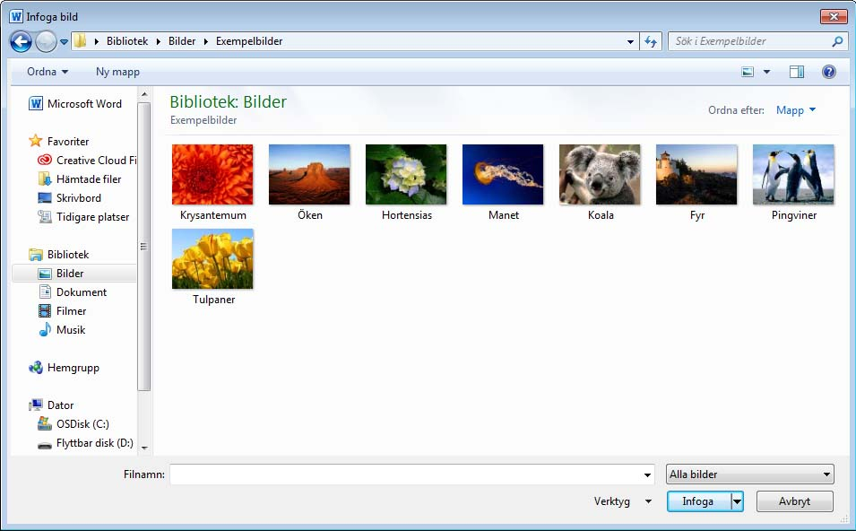
Insert images
Click Insert. Select Image.
Opens a dialogue box where you can select an image from the computer, then click Insert.
Word 2010

Slide 13
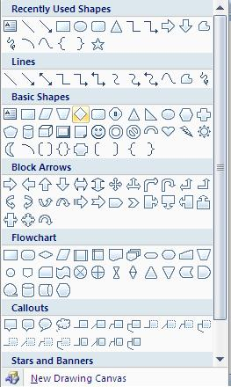
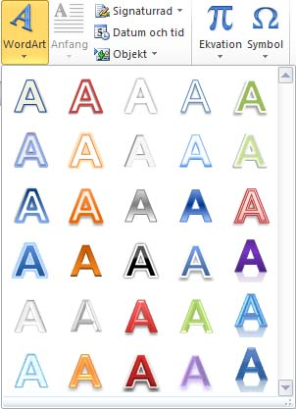
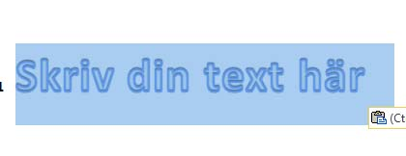
Inserting shapes or WordArt in documents
Used to add a shape or to combine multiple shapes. Click on the Insert menu and choose Shapes. You can choose among lines, standard geometric shapes, arrows, etc.
It is possible to change the size of a shape by hovering the mouse over the edge of the shape. When the mouse pointer becomes a double arrow, you can drag the shape to make it larger or smaller.
Use the Insert menu and select WordArt to add decorative text to a document.
Opens ready-made models that you can choose from.
You can make changes to existing WordArt, such as to the font size and text colour, by using the drawing tool options that automatically appear when you insert or select WordArt in a document. Or right-click on the shape using the mouse, and select Format Auto Shape.
Selects decorative text you can add to a document
Select the shape you want to insert in the document
Maria
Write text here

Slide 14
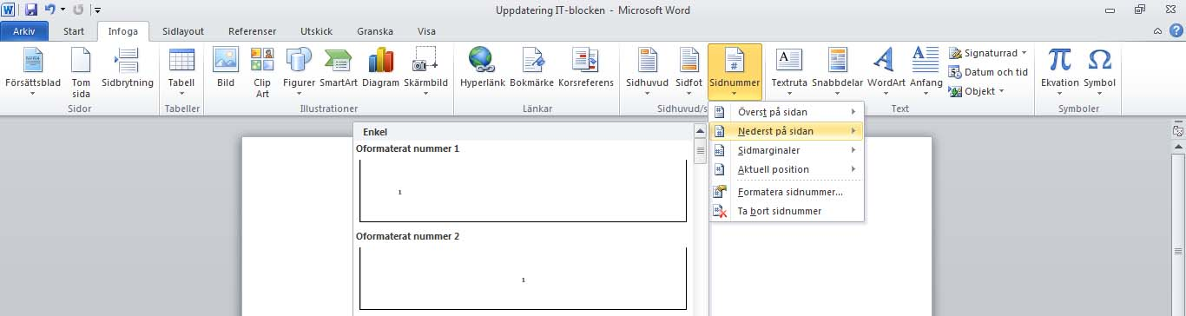
Inserting page numbers
Click on the Insert menu and select Page Number.
You can decide where you want the page number to appear in the dialogue box.
You can choose whether you want to use letters or numbers for the pagination, and which letter or number you want the pagination to begin with
Choose where the page numbers are to display here
Click here to display the number format.

Slide 15
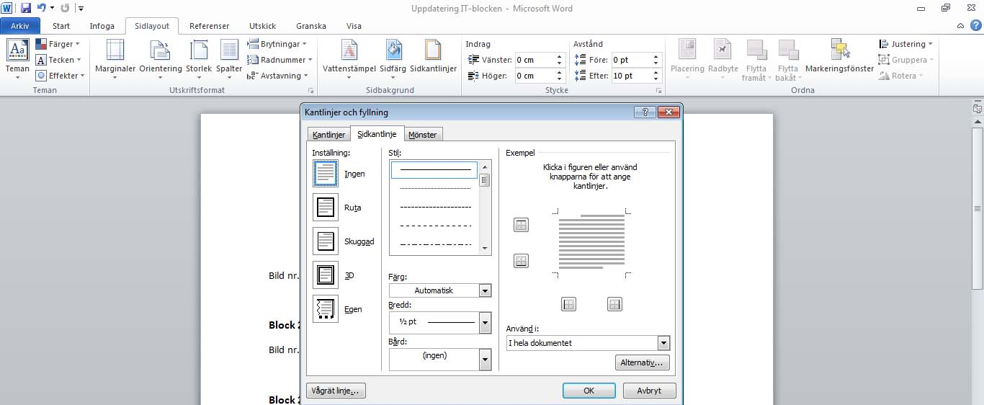
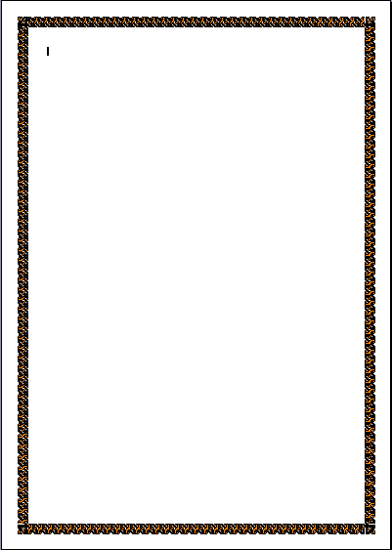
Borders
Previews the page border
. Open Page Layout and then click Page Borders.
The following dialogue box opens where you can select the style of the page border, page border type, the width of the page border, as well as art.
Borders and Shading
Tab 1, Borders
Tab 2, Page Border
Tab 3, Shading
Choose whether to apply a page border to the entire document, or some other option.
Page border style

Slide 16
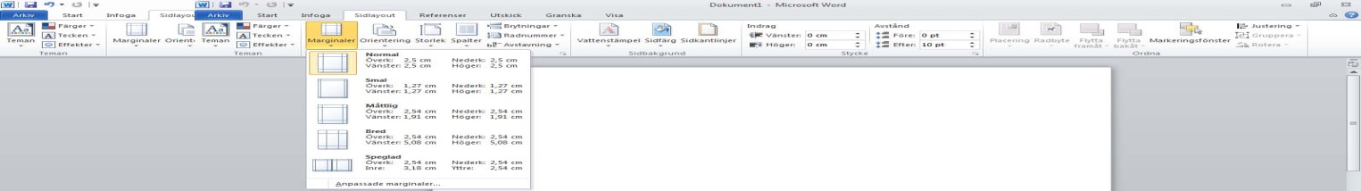
Margins and Page Setup
Control the margins by opening Page Layout and choosing Margins.
Notes:
’ش

Slide 17
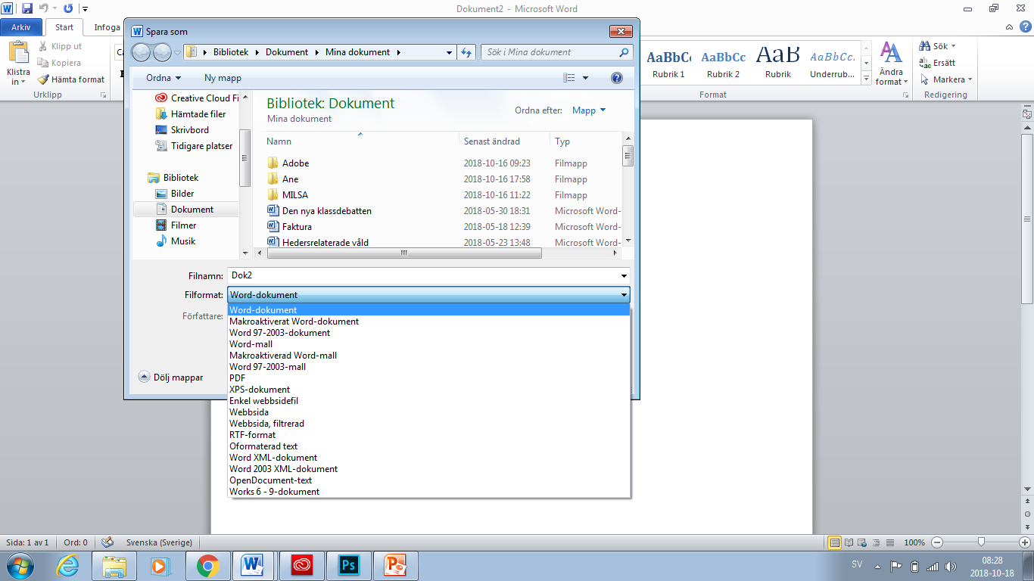
Save
Save a new file by opening the File menu and selecting Save As.
There are several file saving options in Word.
A dialogue box displays where you can choose where you want to save the document, the name you want, as well as the format.
To create a new document, select Save As from the File menu. To save the changes you have made to a previously saved document, click Save on the toolbar or select Save from the File menu.
To make a copy of an existing document, select Save As and enter a new name for the document.
Choose where you want to save the document here
File format
File name
Save the file as a PDF

Slide 18
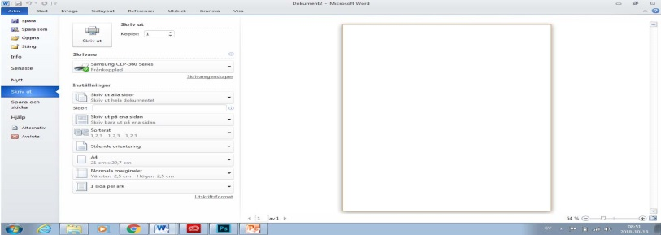
Preview and print
Before printing, it may be good to have an idea of what your document looks like. Preview mode displays each page in the document as an image.
Open the Print menu and select Print. There are several options to choose from.
Open the Print menu and select Print. A new dialogue box displays where you can choose from various printing options.
Print entire document
Number of copies
Choose a printer
In order to print specific pages, enter the page number in the adjacent box
Collation

