Slide 1

Email

Slide 2
Email
Email is an easy way to communicate.
It costs nothing to send an email, but it does require a connection to the Internet.
You can send email to anyone, anywhere in the world.
Your email address is personal, and does not change if you move or travel to a different location.

Slide 3
Setting up an email account
If you do not have an email address, you can create one yourself. There are several free email services. A few examples:
Gmail (provided by Google), Yahoo Mail and many others.
In this presentation we will be explaining how to create a Gmail account.

Slide 4
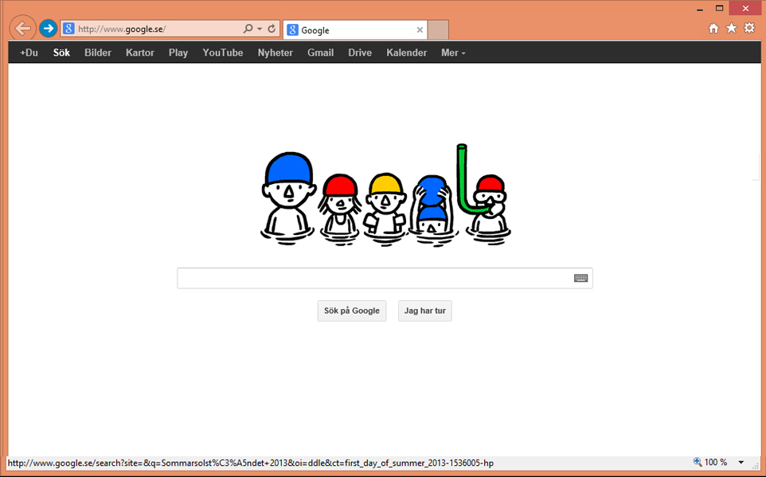
Enter the Google web address in your browser: http://www.google.com
Click Gmail.

Slide 5
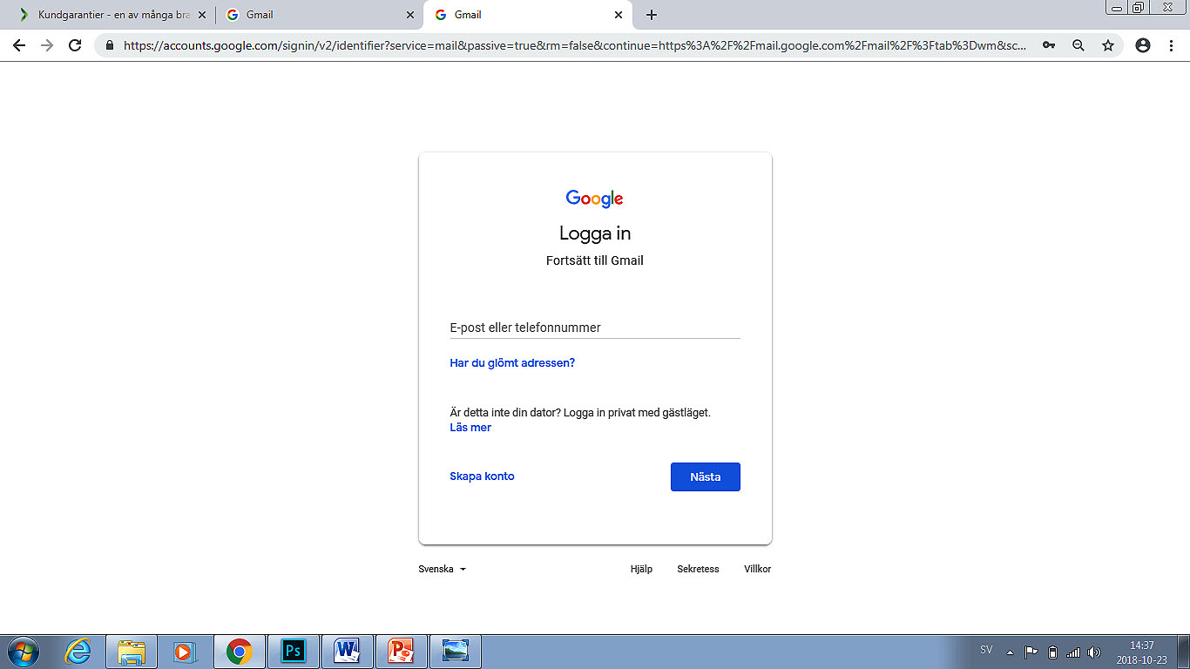
If you do not have an email address and you want an email account, click Create account.
If you already have a Gmail account, enter your email address (in the username field) and your password, and then click the “Sign in” button.
Enter your
email address.
Click here
to create an
email account.
click next to create your password.

Slide 6
Tips for creating a new email address
The information you will have to enter depends on which email provider you select (for instance Gmail).
Every email address is unique, and you can only choose an address that no one else has. The email service verifies the availability of the address you entered and then suggests similar addresses if the one you want is already taken. You cannot use the letters å, ä or ö. You can choose to use your real name or an invented one.
A password should consist of at least six characters. Use a mix of letters, numbers and/or special characters (for instance !, @, #, $, %, ^, &, *) in order to compose a secure password. Avoid using your name or date of birth as your password.
You are not required to provide personal information, such as your personal identity number or gender.
The alternate email address and possible security question are used to protect your email account. If you lose access to your email account, it will be easier to recover your account if you have provided one of the above. Make sure you have access to the email address you provided as your alternate email address. Make sure you choose an answer that you will not forget and which no one else will be able to guess if you have entered a security question (Gmail does not offer this option).
Keep your password in a secure location so that no one else can access it.

Slide 7
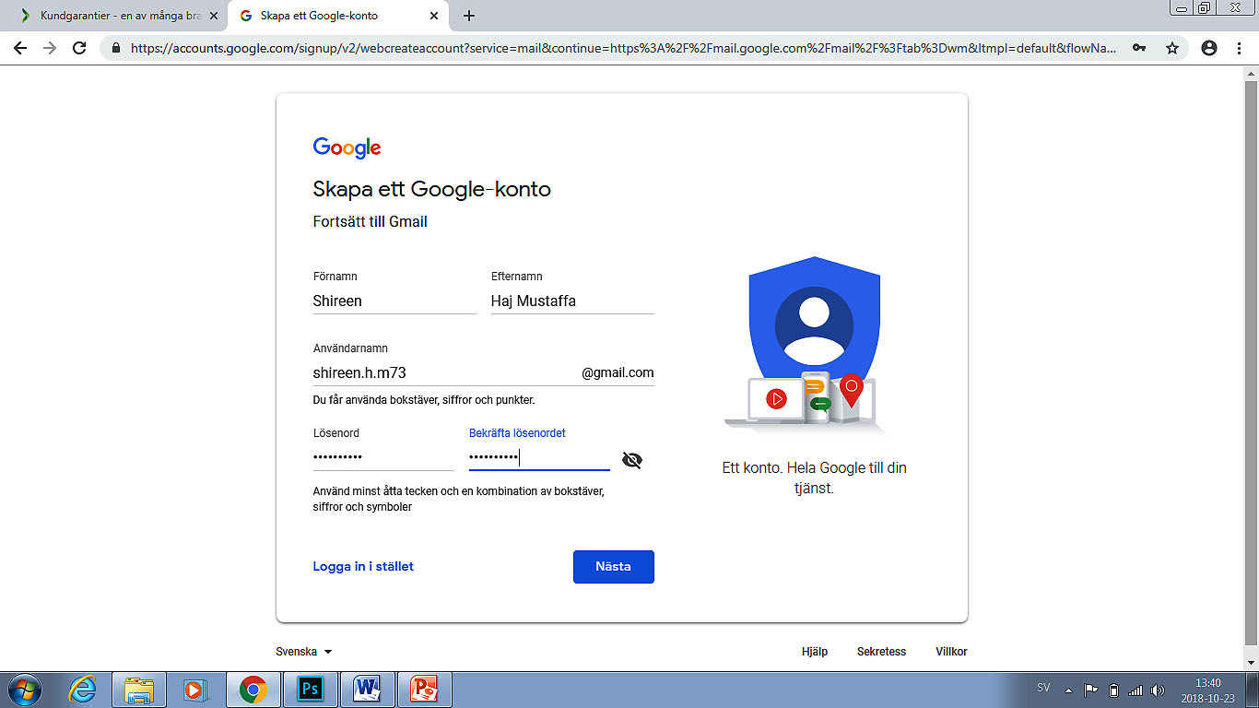
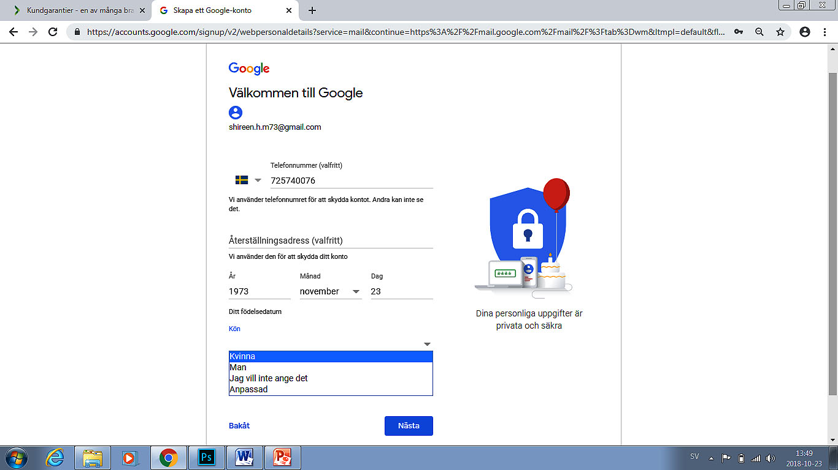
Creating a new email account
Enter your mobile number as an additional unique identifier.
Enter your name.
Choose the email address you want.
Enter the year, month and
day you were born.
Choose a password.
Indicate whether you are a man or woman, or select "Other".
Repeat the password.

Slide 8
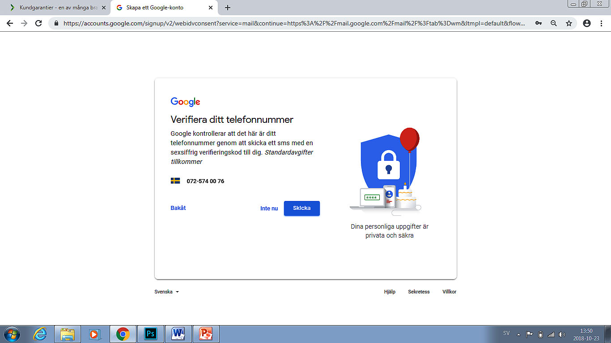
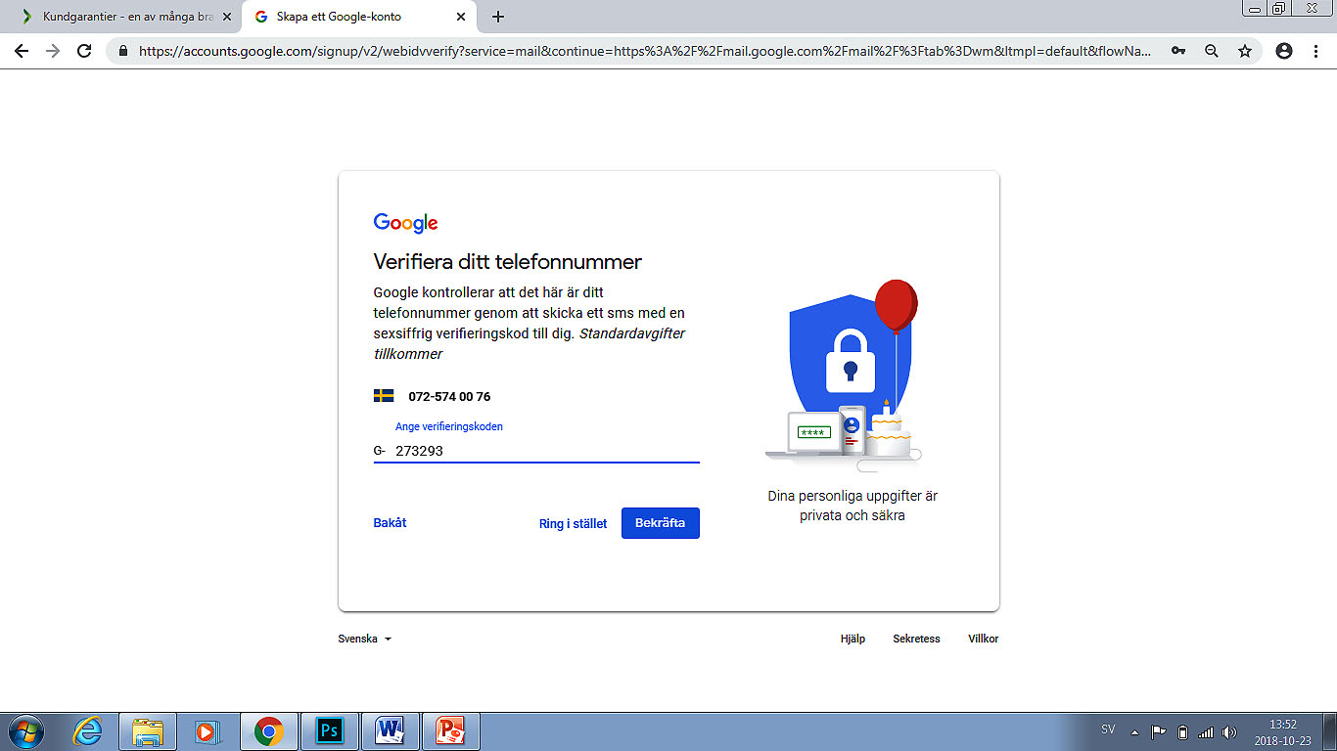
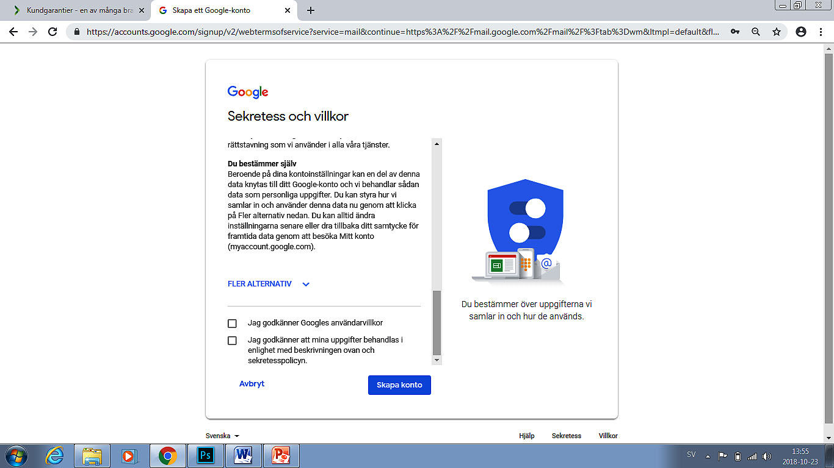
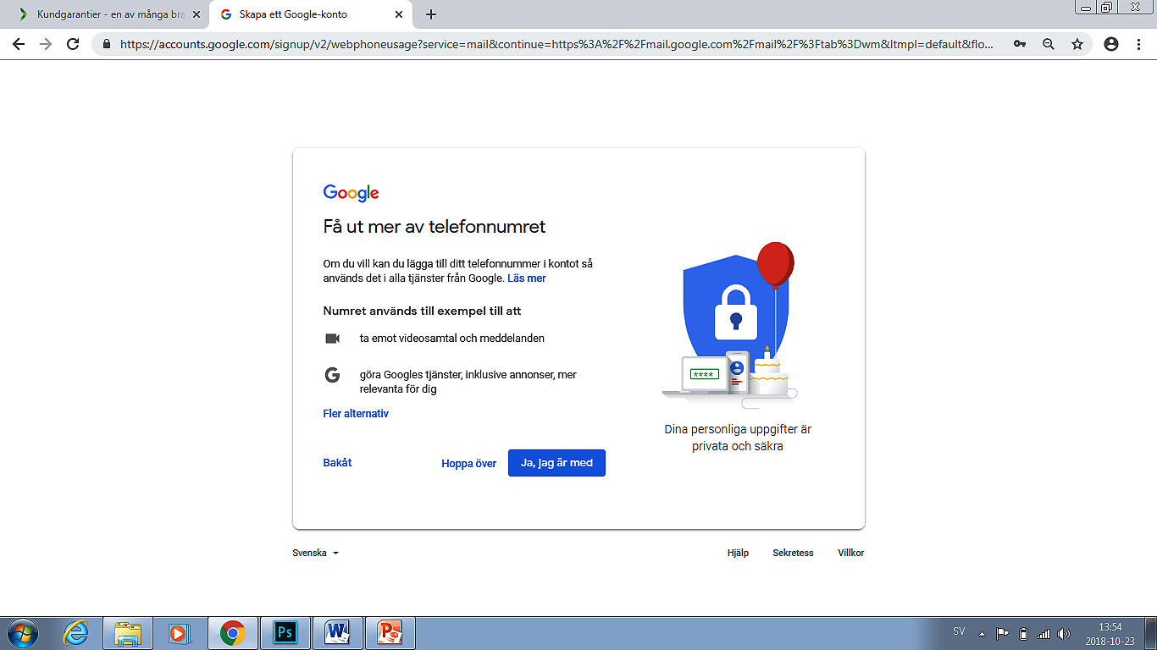
Creating a new email account
Read through the terms of service or ask someone to help you.
Click "Next step" to get a code from Gmail confirming your telephone number.
Accept the agreement by placing a checkmark in the box.

Slide 9
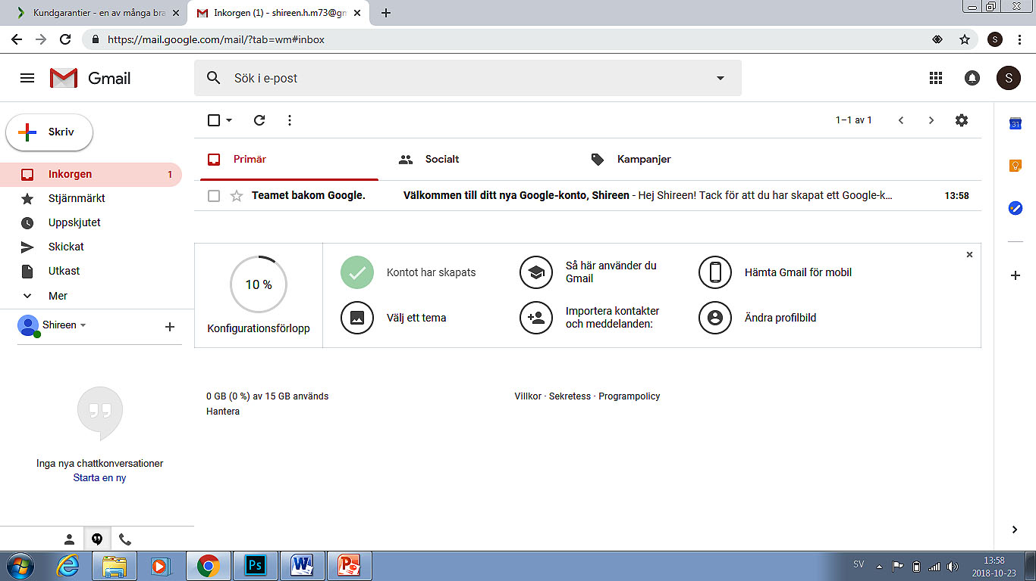
INBOX
When you open your inbox, you will see all the messages that have been sent to you. Every message is displayed on its own line, and consists of the following elements: date and time, subject/title, sender, and a box used to select the message. Click anywhere on the line to open the message.
Explanations:
  Select – use this to work with specific messages. For instance to move or delete them.
  Refresh - use this to retrieve any new messages that may have been sent to you.
  Compose - use this to create a new email message.
  Spam - These are unwanted emails that may contain advertising for a product or service, or messages that contain blocked images, links or file attachments.

Slide 10
Your emails appears here.
Click the "Inbox" to
view your email messages.
You can star a message by clicking on the star shape next to a message.
Stars let you assign a special status to emails to make them easier to find.
"Sent Mail" contains the
email messages you have sent.
"Drafts" is where
email messages that have not yet been sent are stored.
Use "More" to display trash, spam, chats, etc.

Slide 11
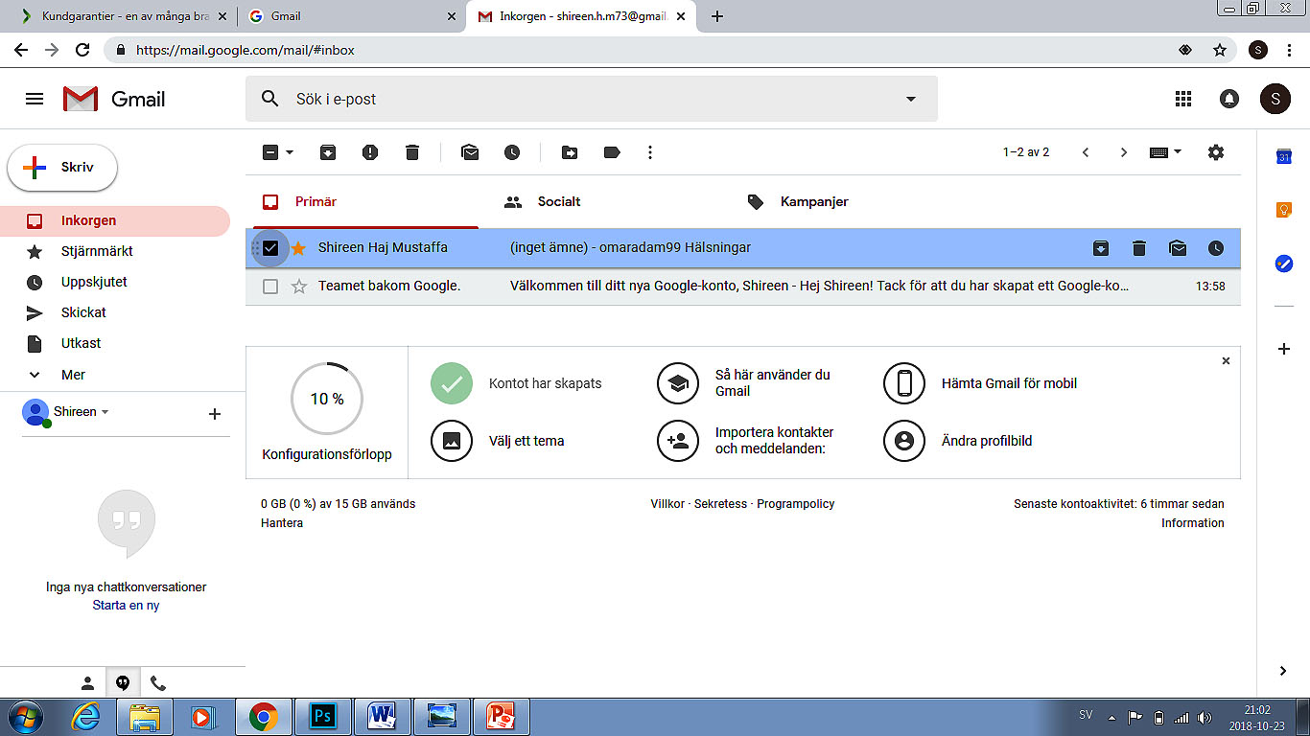
Archive
Report spam
Move to
More functions
Labels
Delete emails
Select one or more messages in order to move them or put them in the trash.
If one or more
emails are selected, a new toolbar displays.

Slide 12
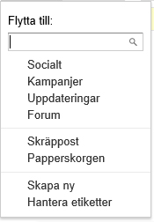
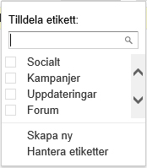
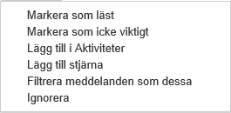
Labels
More functions
Move to
Use "Move to" to file selected emails under existing labels. You can also choose to create new labels.
You can use "Label as" to connect one or more email addresses to various labels. You can also create new labels.
Go to "More" for more choices with regard to assigning a status to selected
emails.

Slide 13
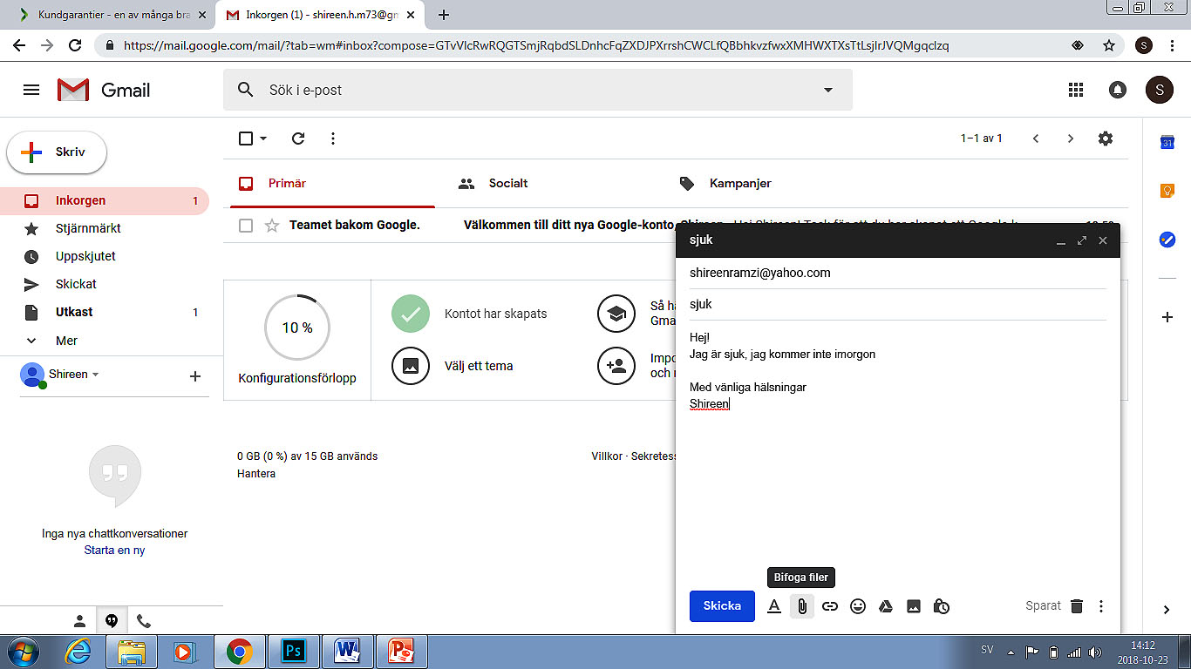
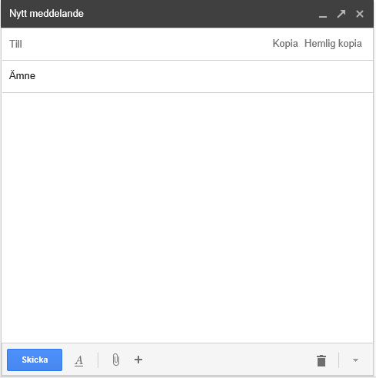


Click "COMPOSE" to open a new message window.
In the "To" field, enter the email address of the person or people you want to send the message to. The message can be sent to any number of recipients.
Use the "Bcc" field to send a copy of the message without this address being shown to the rest of the recipients.
The "Cc" field can be used to enter the email address of the person you want to receive a copy of the message.
The "Subject" field is used to briefly summarize what the message is about.
Click here to attach a file or image from Google Drive.
Click here to attach a photo.
Click here to attach a file.
Click here to insert a link.
Click here to insert emoticons.
Click here to display text formatting options.

Slide 14
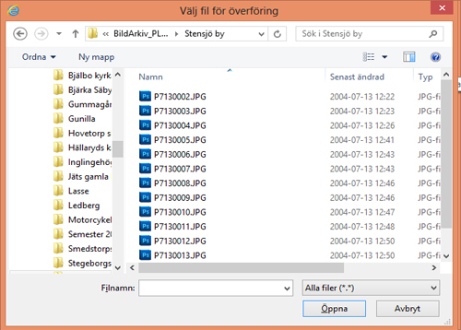
Select the file you want to add to the message.
Click "Open" to attach the file to your message.
Click here to attach a file.

Slide 15
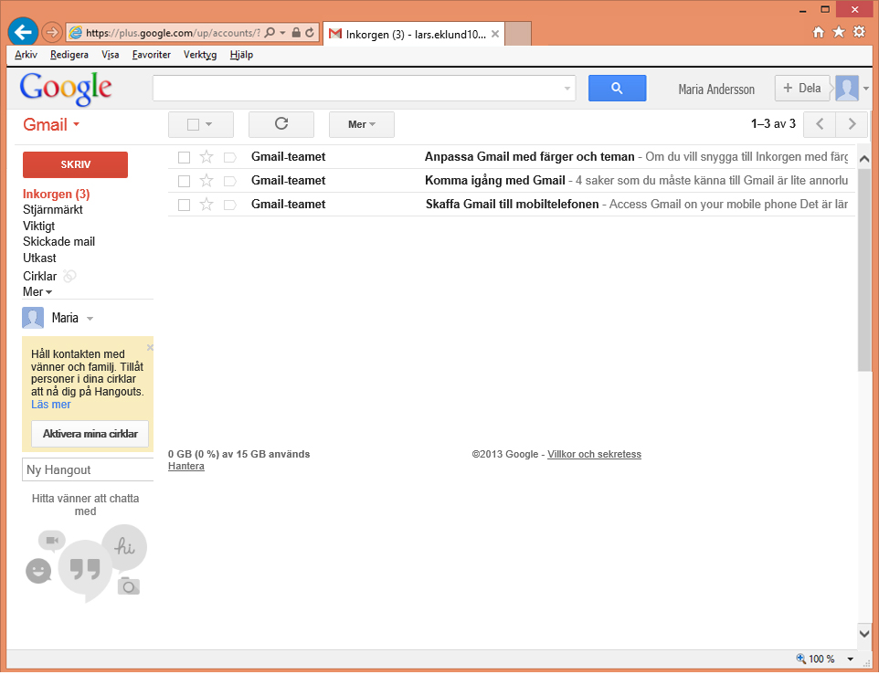
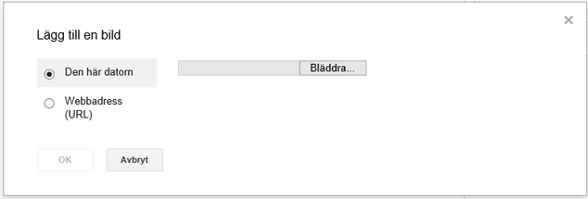
Select the file you want to add to the message.
Click browse.
Click "Open" to attach the photo to your message
Finish by clicking "Send" to send the message.
Click here to attach a file or image from Google Drive. NB! You need to have this type of account in order to use this feature!
Insert photo

Slide 16
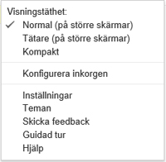
Click the gear icon to display a menu where you can make settings configurations.
Click on "Settings".

Slide 17
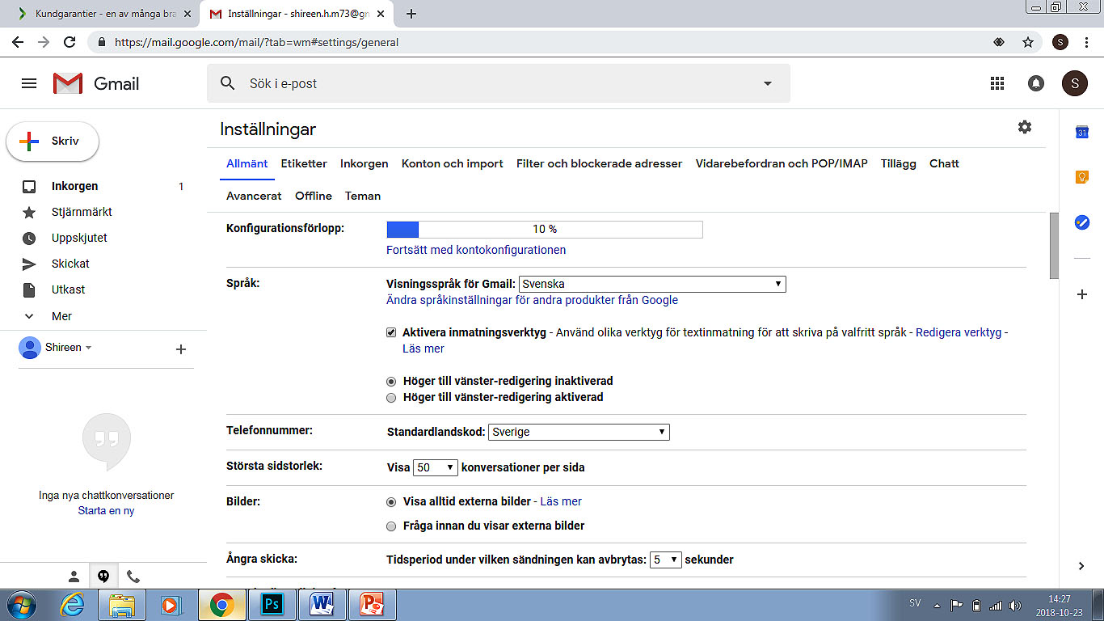
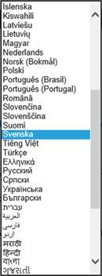
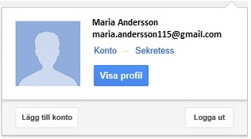
Then click here!
To make sure that no one else will be able to read your messages, sign out of your email account once you're finished using it . This is particularly important if you are using a public computer.
Click here to set the language!

Slide 18
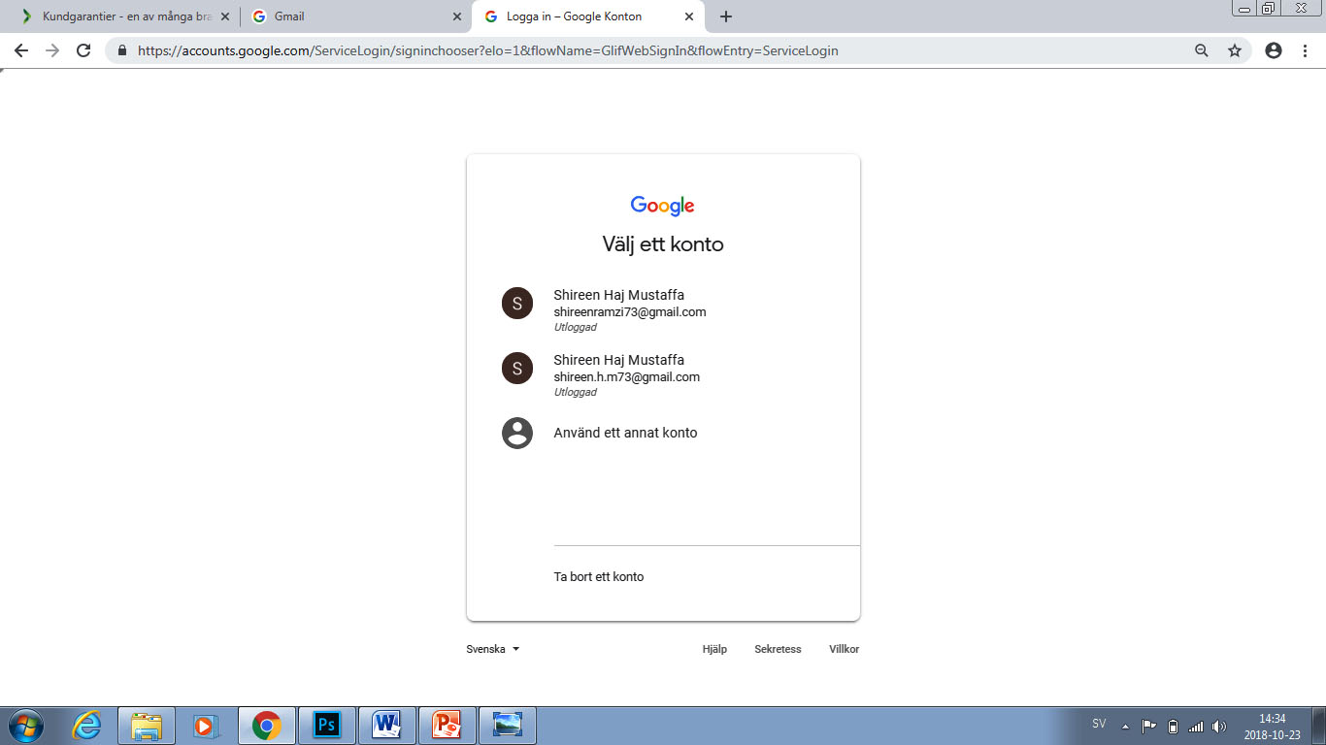
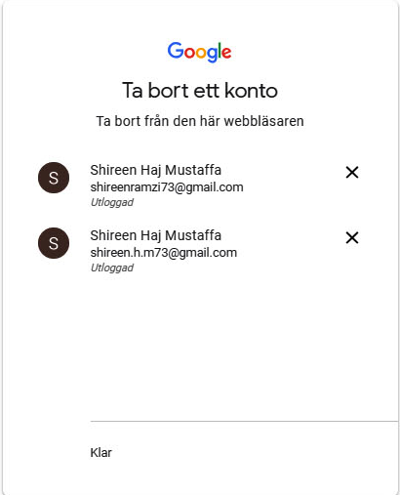
Delete account

