Slide 1

Payment services
and
Mobile Bank ID

Slide 2
Log in to your bank account online using your bank security token
https://demo.swedbank.se/app/ib/logga-in/

Slide 3
Open Swedbank’s website http://www.swedbank.se
Click on Log in in the upper-right hand corner.
Use your personal Security token to identify yourself.
(Store your Security token and bank card in a safe place.)
Enter your personal identity number and select Security token or
Corporate security token.
Click Log in.
Turn on the security token by pressing the blue button.
A control image appears on your computer screen or mobile device. Direct the security token’s camera at the control image.
Enter your PIN in the security token and press “OK”.
The security token’s window now displays your personal identity number along with information that you are about to identify yourself to Swedbank och Sparbankerna. Confirm by pressing “OK”.
The security token’s window will again display the same text along with a one-time code. Enter the one-time code in the blank field in the Internet Bank or in the app. Click Continue.
You are now logged in.

Slide 4
Pay bills from your bank account online.
https://www.youtube.com/watch?v=Mqr4h-K5mJU

Slide 5
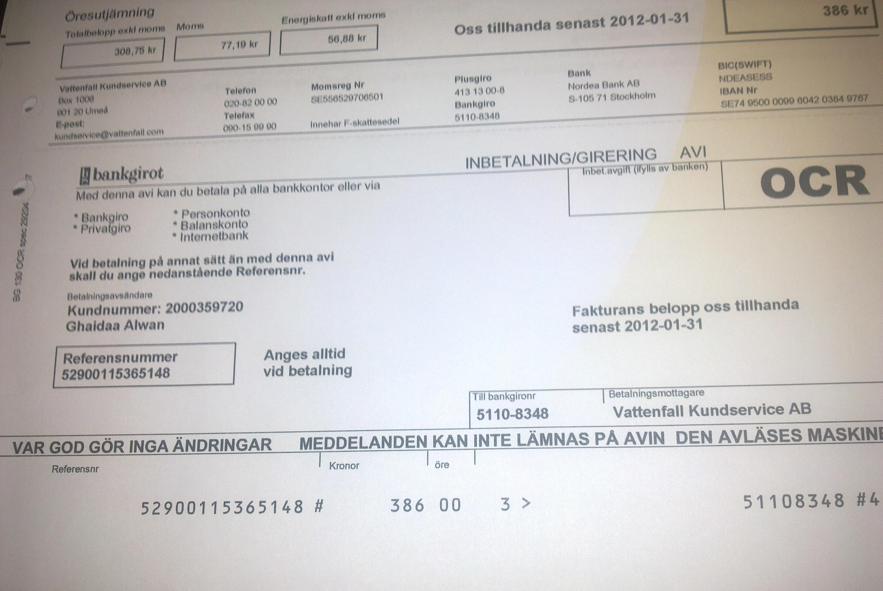
You will find all the information you need in order to pay in the invoice:
Payment routine (Bank giro, PlusGiro), recipient number,
Amount, OCR number, and due date for the payment.
Payment routine Bank giro, PlusGiro
Amount
OCR
Recipient number

Slide 6
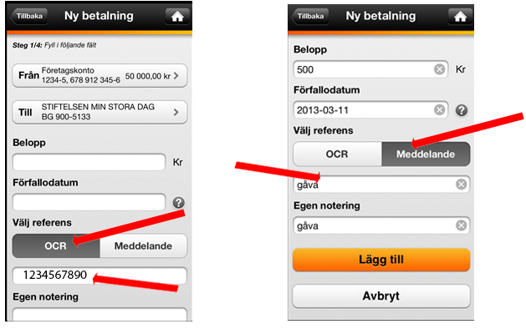
Invoice with or without OCR
With OCR Without OCR

Slide 7
When you are done, click Log out at the bottom of the left-hand menu.

Slide 8
Open/close your card for internet purchases
In order to shop online using your card, you need to open your card for internet purchases, which you can easily do in the Internet Bank or in the app.
If you have received a new bank card, you first need to activate the card before you can open it for internet purchases. How to activate your new bank card
As soon as you have opened your card for internet purchases, you can start using it online. At stores connected to Mastercard Identity Check, you will need to confirm your purchase using Mobile BankID. If you are unable to use Mobile BankID, you can instead confirm your purchases using passwords and SMS.
https://www.swedbank.se/privat/kort-och-betala/kort/sa-fungerar-ditt-kort/handla-med-kort-pa-natet/oppna-stang-ditt-kort-for-internetkop.html

Slide 9

Get Mobile Bank ID

Slide 10
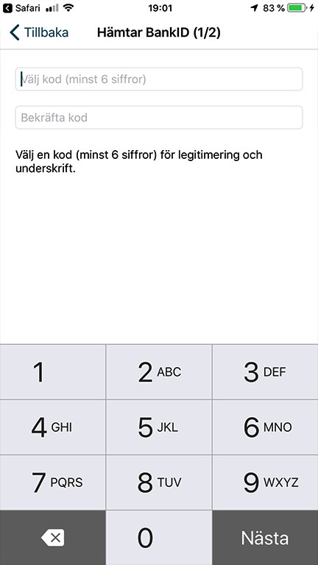
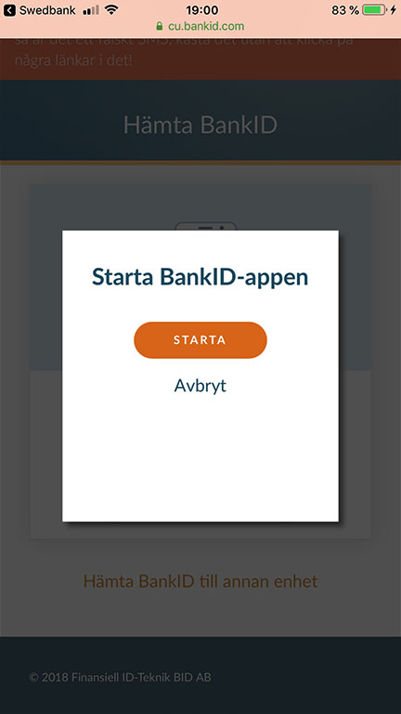
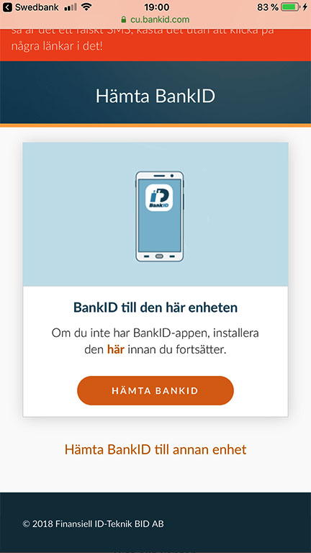
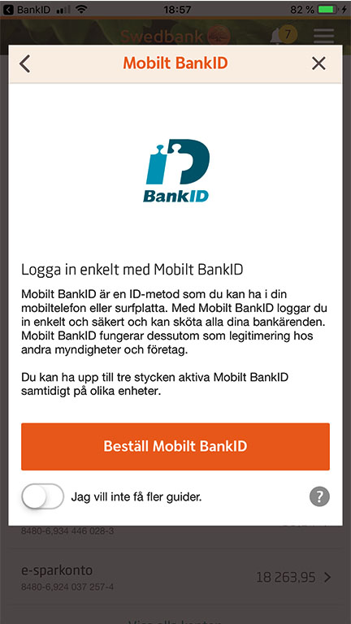
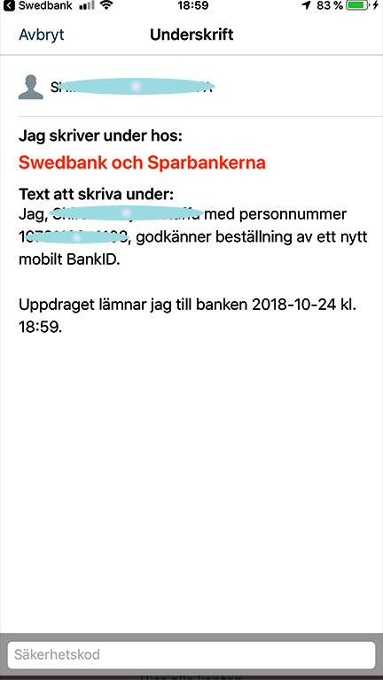
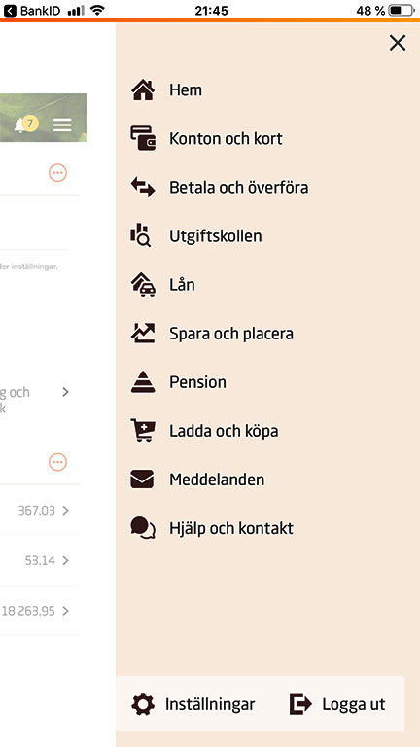
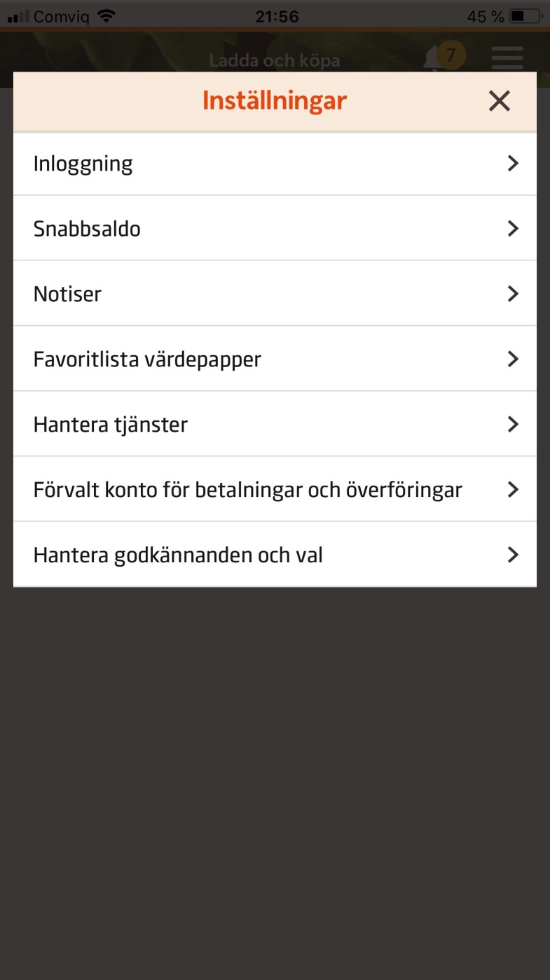
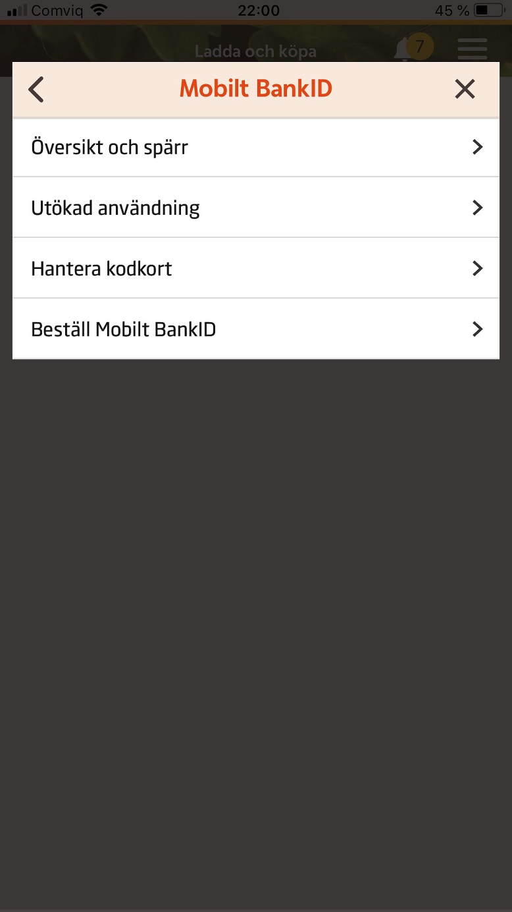
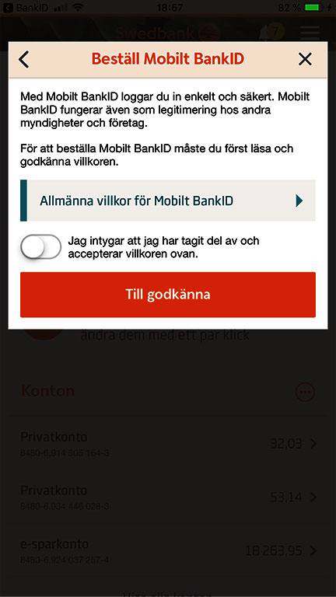
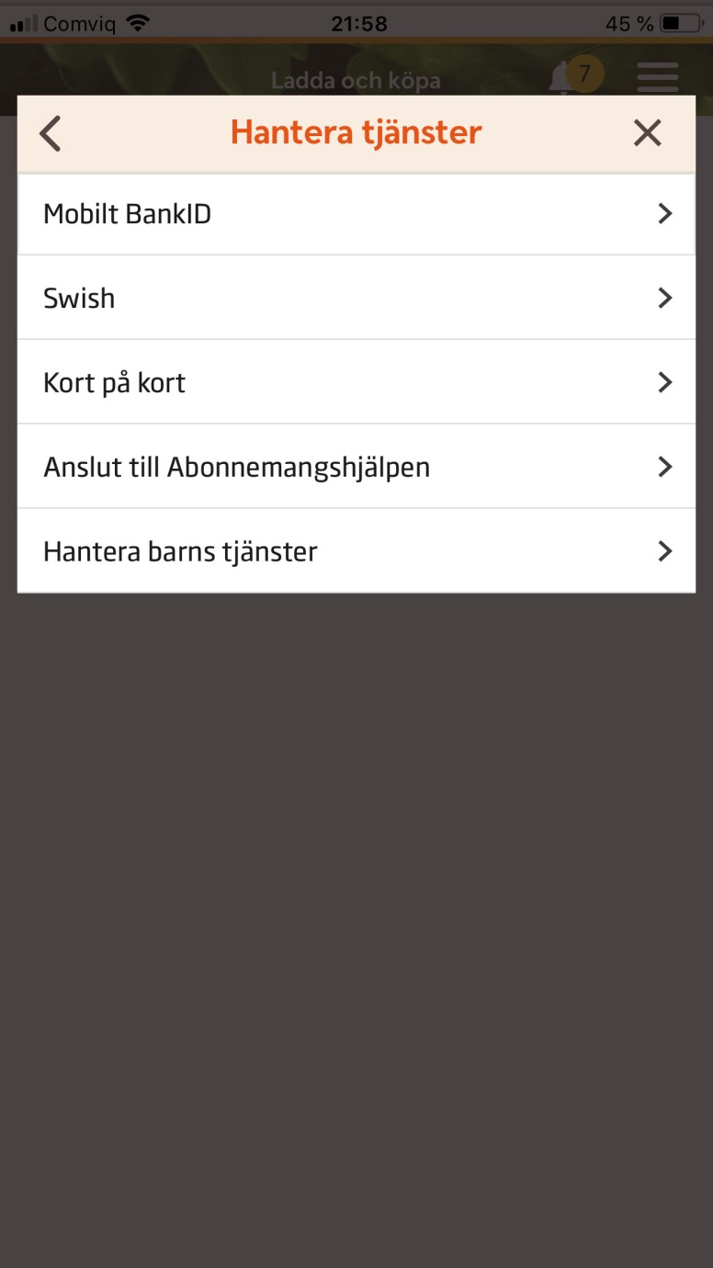
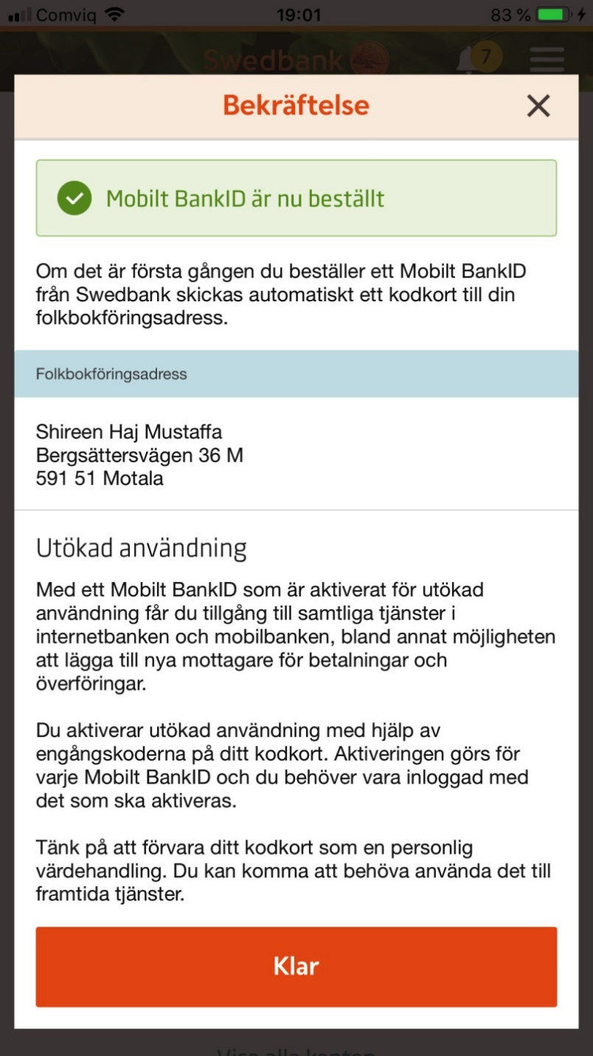
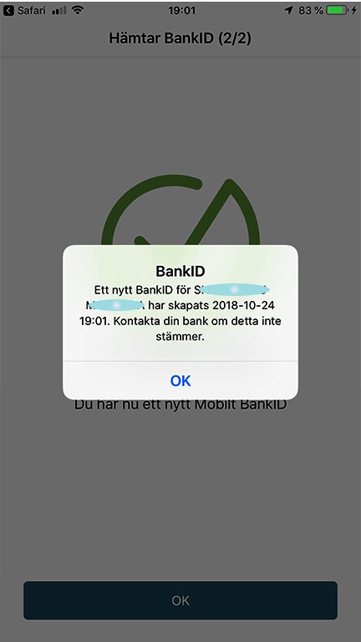
Mobile Bank ID
Click Settings
Manage services
Mobile Bank ID
Order Mobile Bank ID
To approve
Enter your code
Download bank ID
Start
Choose a code and confirm.
Finish by clicking Done

Slide 11
Log in to your bank account
via Bank ID

Slide 12
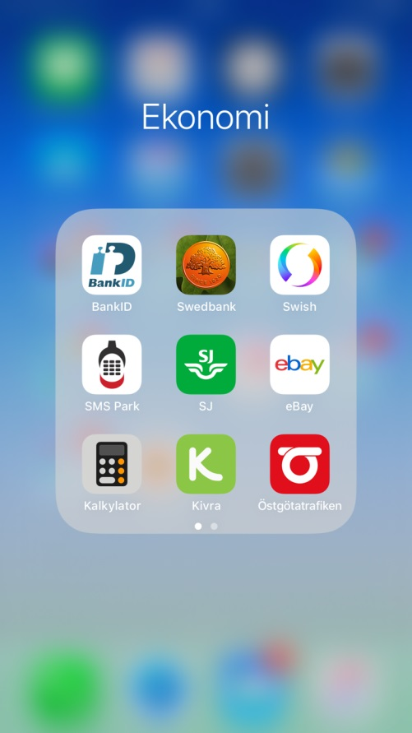
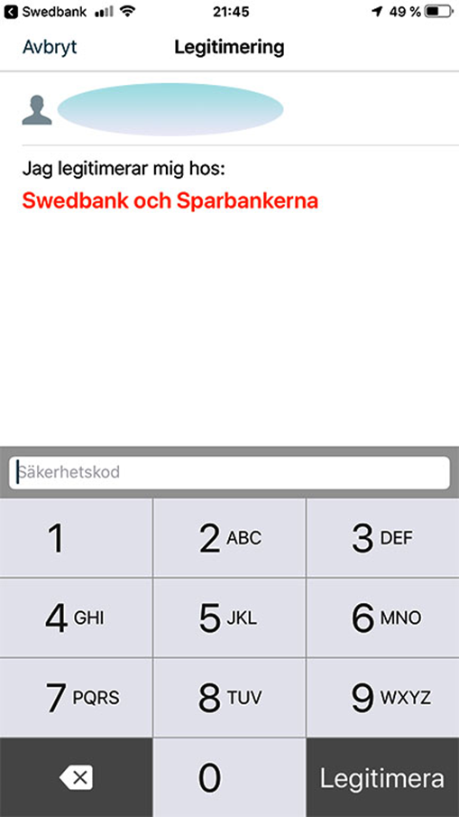
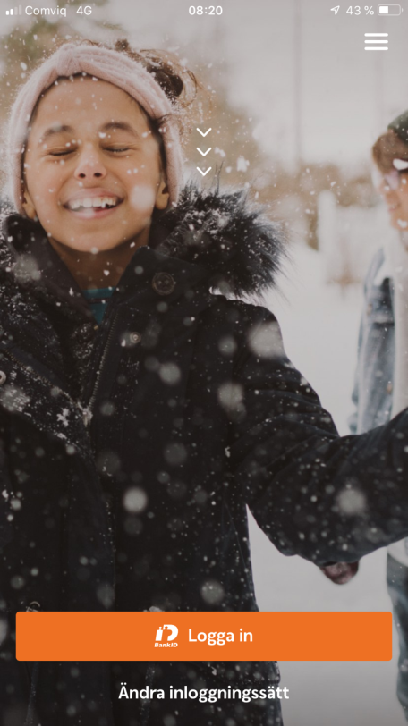
Swedbank App
Click Log in
Enter your personal code in bank ID
Click Identify

Slide 13
Menu in the Swedbank app
Here you will see your balance, account, and e-invoice
All accounts you have (children's account, savings account)
Pay your bills or transfer money.
Top up your phone card.
Settings

Slide 14
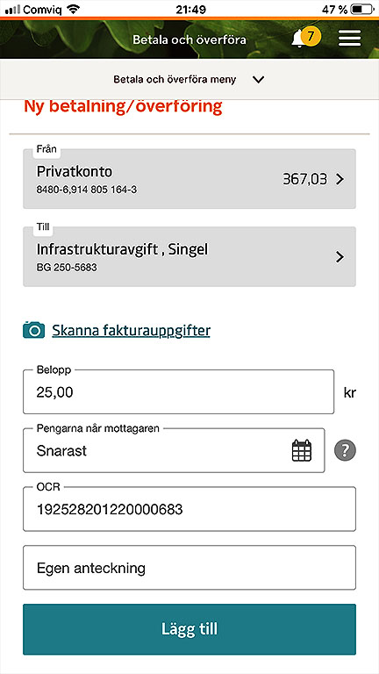
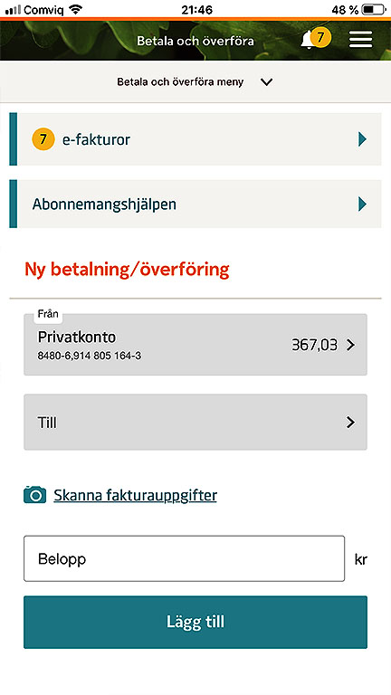
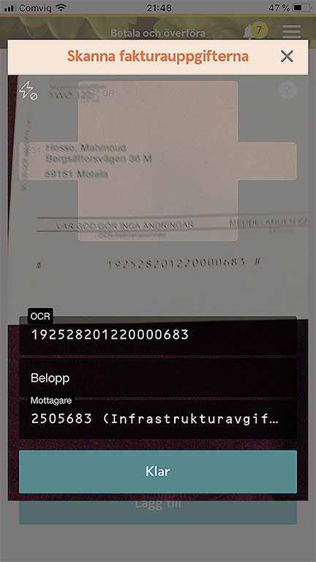
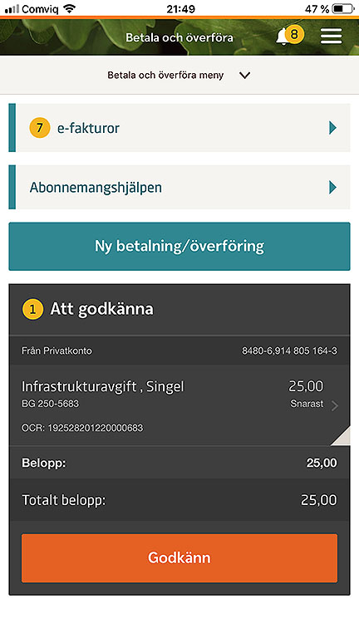
Pay bills
Select Payments and Transfers
Select the account to pay from
Use camera to scan all invoice details such as OCR, recipient, and amount.
Click Done
Add
Approve

Slide 15
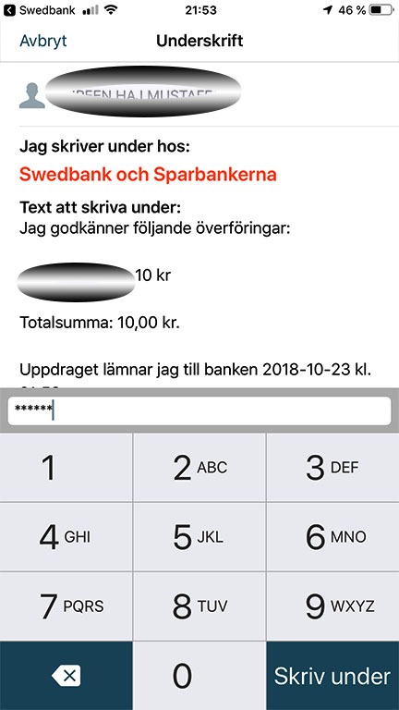
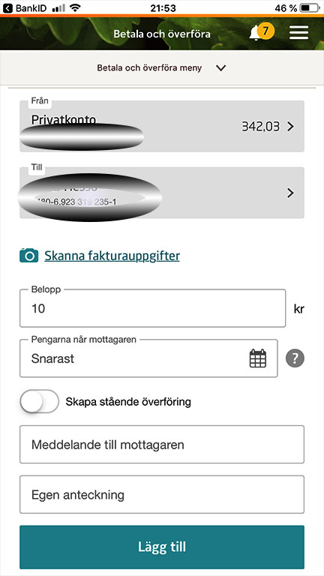
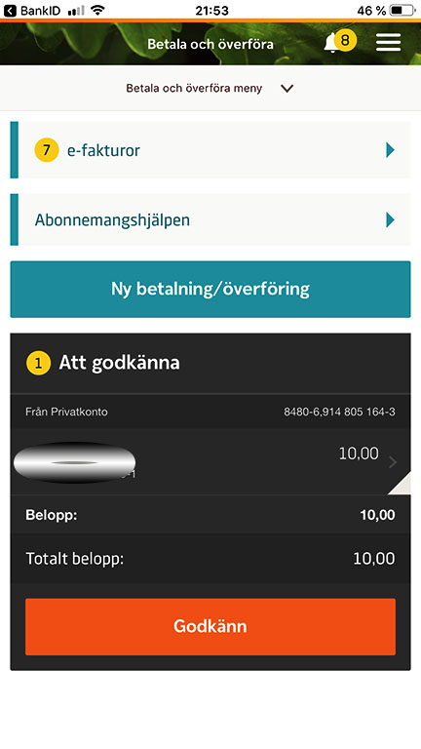
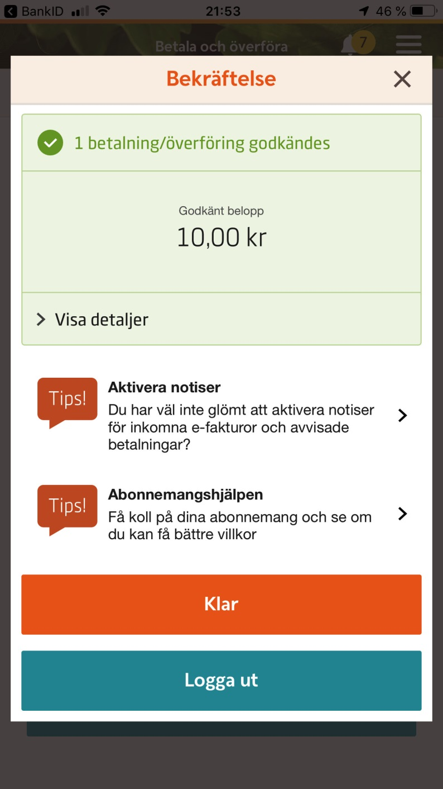
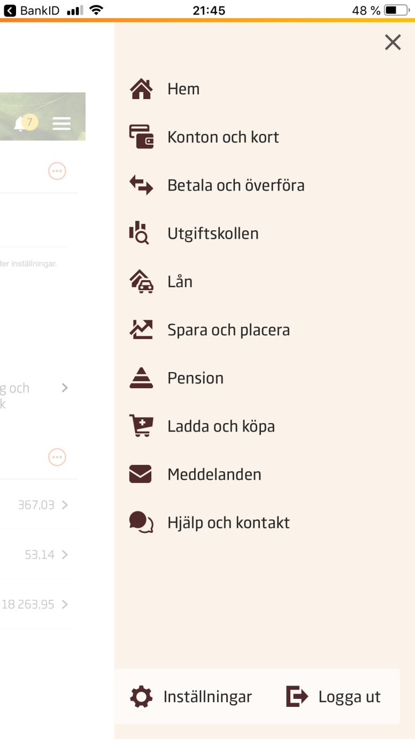
Transferring money
Select Payments and Transfers
Select the account from which to make the transfer
Select who to transfer to.
Amount
Click Add
Approve
Enter your bank ID code and sign
Finish by clicking Done

Slide 16
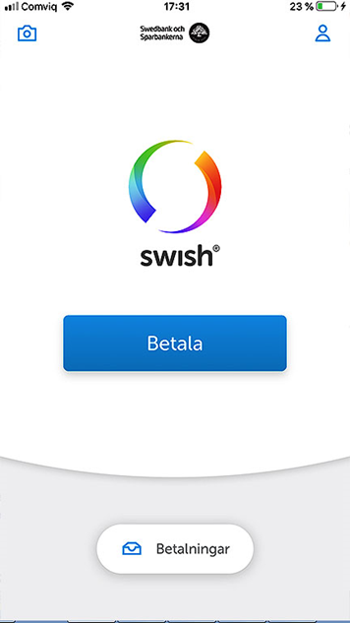
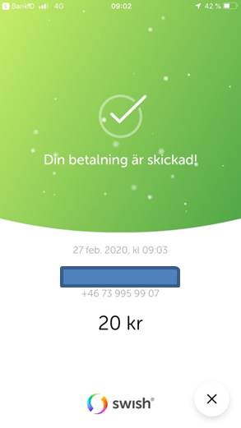
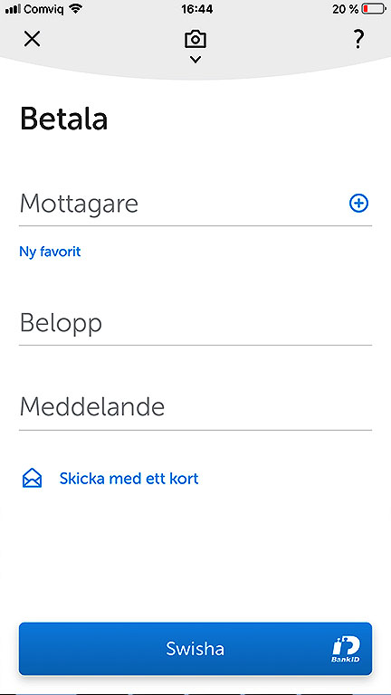
Swish
With Swish, you can quickly and securely send and receive money via your mobile number, which is connected to your bank account. The money is sent directly — even if the recipient is with another bank.
Click Pay
Enter the recipient’s telephone number
Amount
Swish

Slide 17
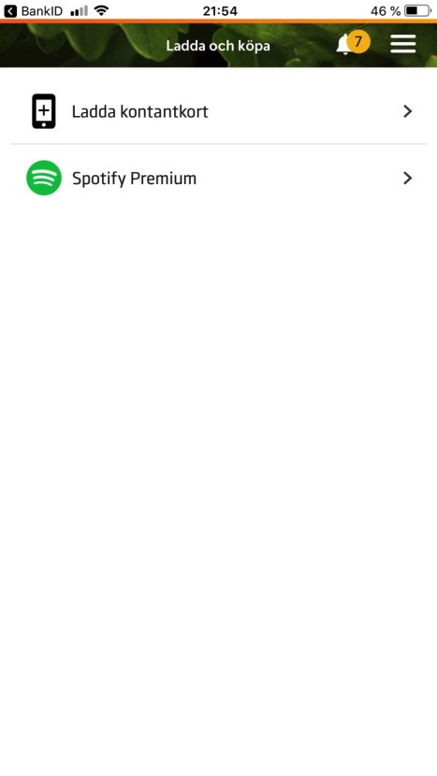
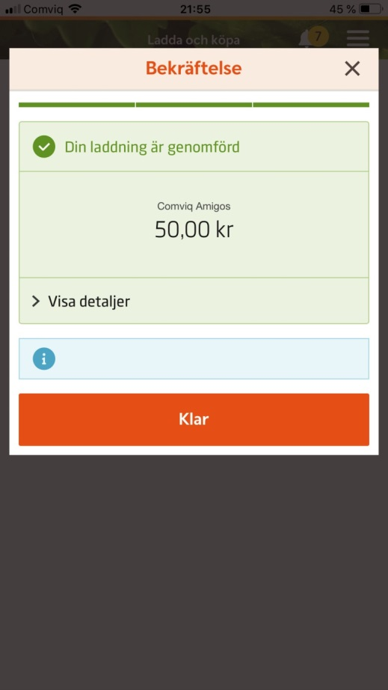
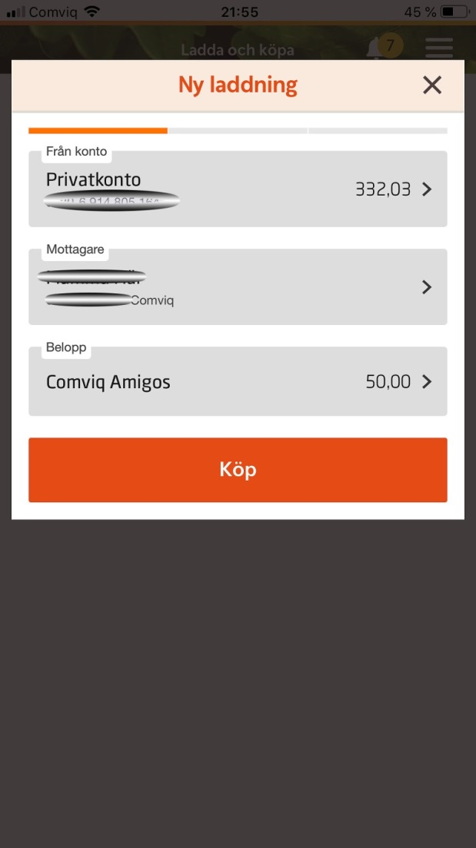
Top Up Phone Card
Click Refill your phone card
Choose from which account to pay, recipient, and what amount, then click Purchase
Click Done

Slide 18
Do not forget to log out of the bank and close the browser before you turn off your computer!

