Slide 1

Adeegyada lacag
bixinta iyo
mobilt bank-ID

Slide 2
Koontadaada bangiga ku soo gal adigoo soo maraaya Internetka oo isticmaalaaya aalada bangiga (bankdosa)
https://demo.swedbank.se/app/ib/logga-in/

Slide 3
Furo bogga internetka ee swedbank http://www.swedbank.se
Guji Logga in ee geeska kore ee ee bogga ku taala.
Isticmaali adiga aaladaada amaanka (Säkerhetsdosa) si aad iskugu cadeyso.
(Meel sugan ku keydi adiga aaladaada amaanka iyo kaarkaaga bangiga.)
Ku buuxi lambarkaaga dhalashada/shakhsiga oo ka dibna dooro xulashada aalada amaanka haddii kale aalada Shirkada ku xiran (Företagskopplad).
Riix ”Logga in”.
Shid aalada amaanka adigoo riixaaya badhanka buluuga ah.
Sawir xaqiijin ah ayaa shaashadda kombiyuutarkaaga ama qalabka moobaylka lagugu tusayaa. Ku been kamarada ku taala aalada amaanka sawirka sugida.
Lambarkaaga sirta ah geli aalada amaanka oo riix "OK".
Waxa shaashada aalada amaanka hadda lagugu tusayaa lambarkaaga dhalashada oo uu weheliyo macluumaadka ku saabsan inaad ku sii wajahan tahay inaad iska cadeyso Swedbank iyo Sparbankerna. Xaqiiji adigoo riixaaya "OK".
Waxa shaashada aalada amaanka lagugu tusayaa mar kale qoraal uu weheliyo kood hal mar la isticmaalayaa. Koodhka halka mar ku qor goobta bannaan ee bangiga internetka ama app-ka. Riix Fortsätt.
Hadda ayaad soo gashay.

Slide 4
Ka bixi biilkaaga koontadaada bangiga ee internetka.
https://www.youtube.com/watch?v=Mqr4h-K5mJU

Slide 5
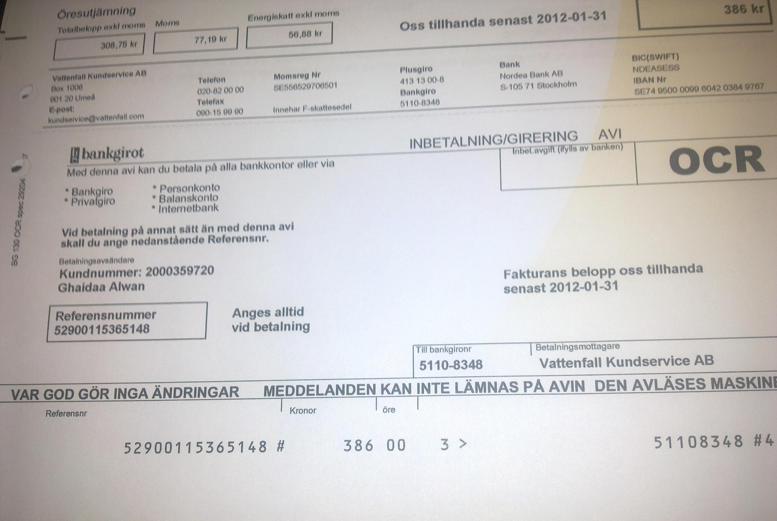
Waxaad qaan sheegadka ka heli doontaa dhammaan macluumaadka aad u baahan tahay si aad ugu awooddo inaad bixiso: Nidaamka lacag bixinta joogtada ah (bankgiro, plusgiro), lambarka loo diraha,
Qadarka, lambarka OCR ka, iyo taariikhda ugu danbeysa ee lacag bixinta.
Nidaamka lacag bixinta joogtada ah Bankgiro, plusgiro
Qadarka
OCR
Cida loo diraayo

Slide 6
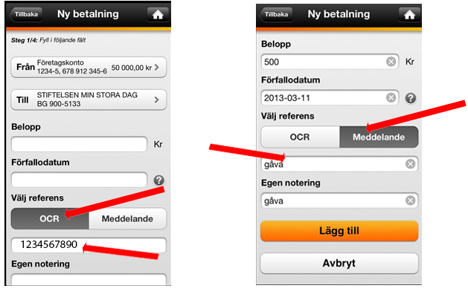
Qaansheegad leh ama aan laheyn OCR
Leh OCR Aan laheyn OCR

Slide 7
Hadda ayaad diyaar u tahay inaad ka baxdo adigoo gujinaaya Logga ut xagga hoose ee liistada bidix.

Slide 8
U fur/ka xir kaarkaaga wax iibsiga internetka
Si aad ugu awoodo inaad kaarkaaga internetka wax kaga iibsato, ayaad u baahan tahay inaad kaarkaaga u furto internet wax ka iibsiga, taas oo aad si sahlan ugu samayn karto bangiga internetka ama app-ka.
Haddii aad kaar bangi oo cusub heshay ayaad u baahan tahay inaad marka hore ka shaqeysiiso kaarka ka hor inta aanad u furin internet wax ka iibsiga. Sidan ayaad kaarkaaga bangiga ee cusub uga shaqeysiineysaa
Marka ugu horeysa ee aad koontadaada ugu furto internet wax ka iibsiga, ayaad ku bilaabi kartaa inaad ku isticmaasho internetka. Dukaamada ku xiran Mastercard Identity Check, ayaad u baahan doontaa inaad wax iibsigaaga ku xaqiijiso Mobile BankID. Haddii aanad haysan furad aad ku isticmaasho Mobilt BankID ayaad taas bedelkdeeda wax iibsigaaga ku xaqiijin kartaa xarafka sirta iyo SMS.
https://www.swedbank.se/privat/kort-och-betala/kort/sa-fungerar-ditt-kort/handla-med-kort-pa-natet/oppna-stang-ditt-kort-for-internetkop.html

Slide 9

Sameyso mobilt bank-ID

Slide 10
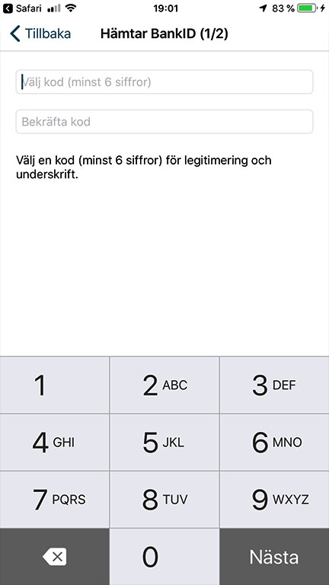
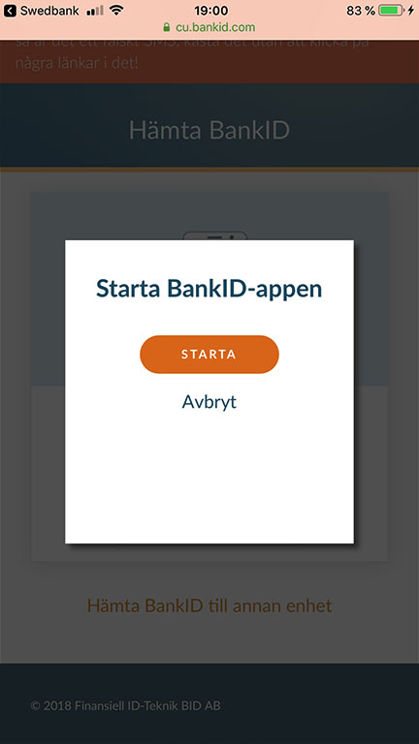
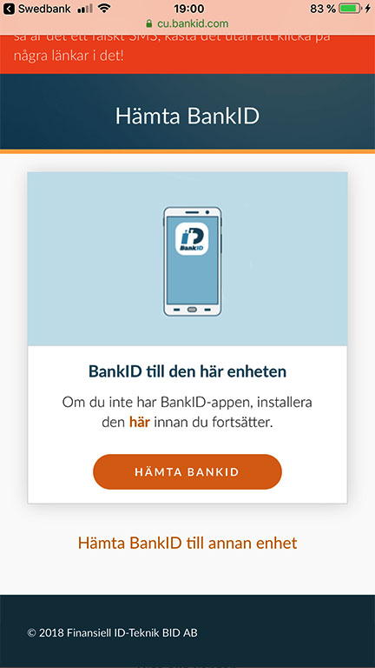
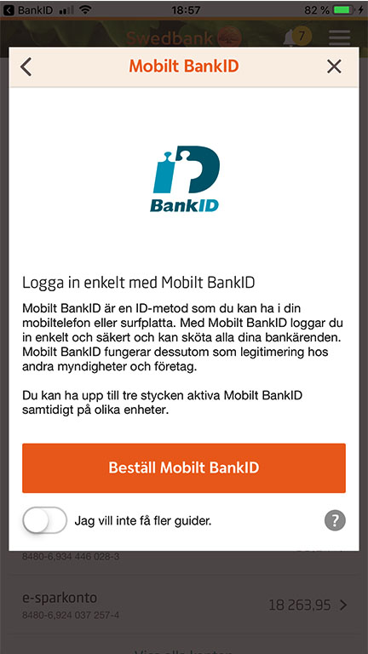
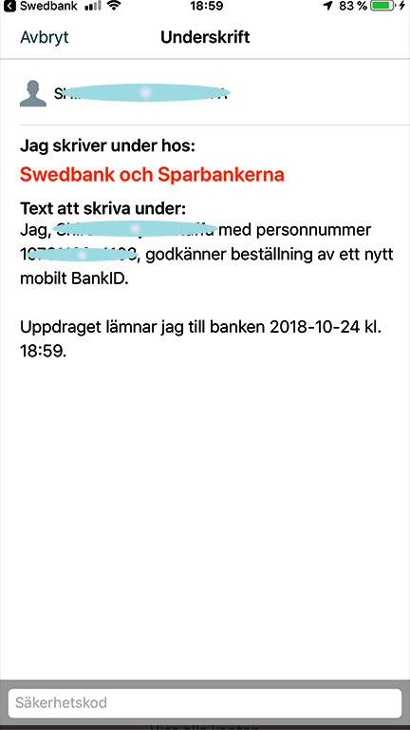
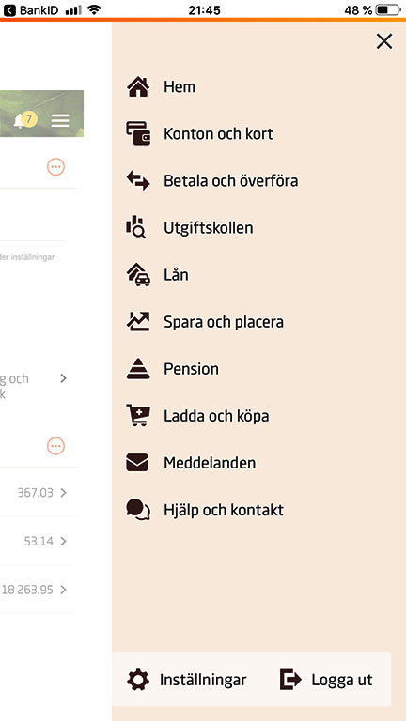
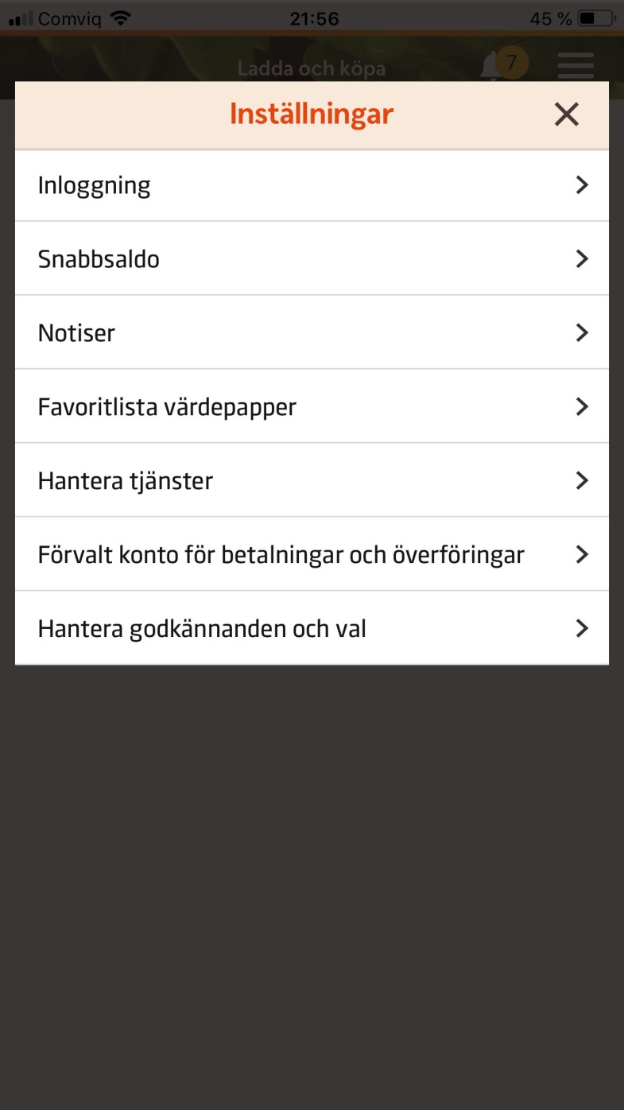
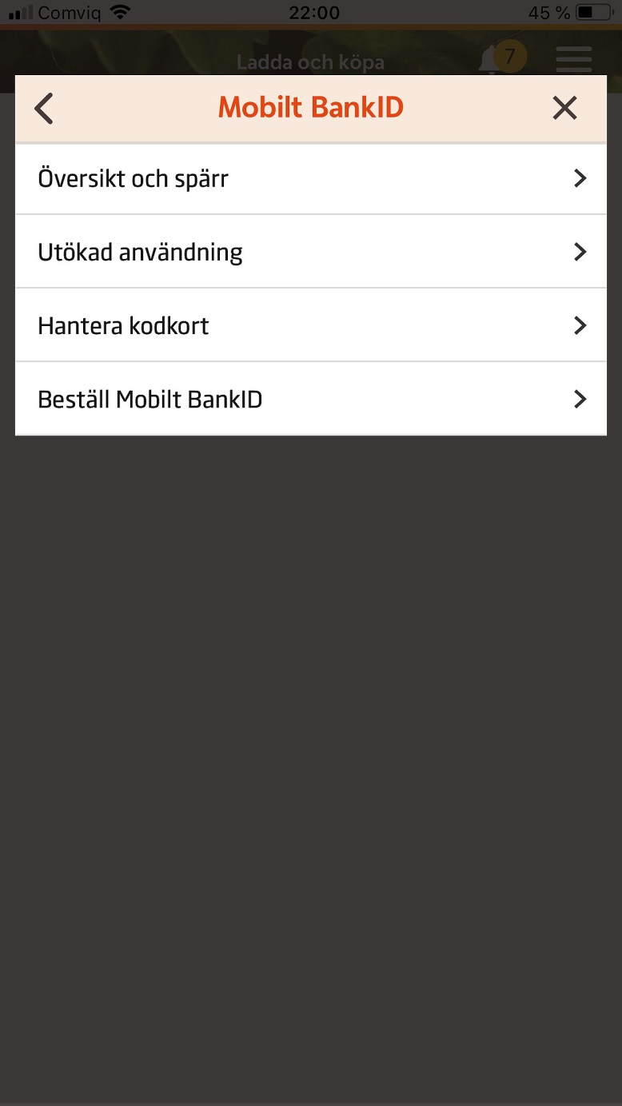
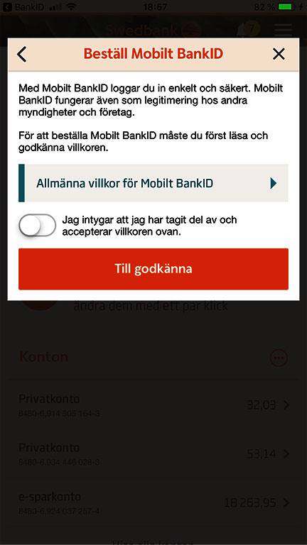
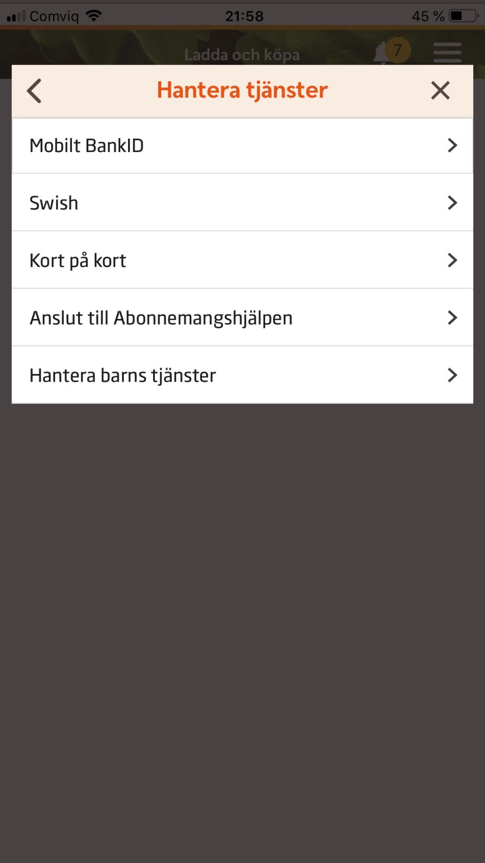
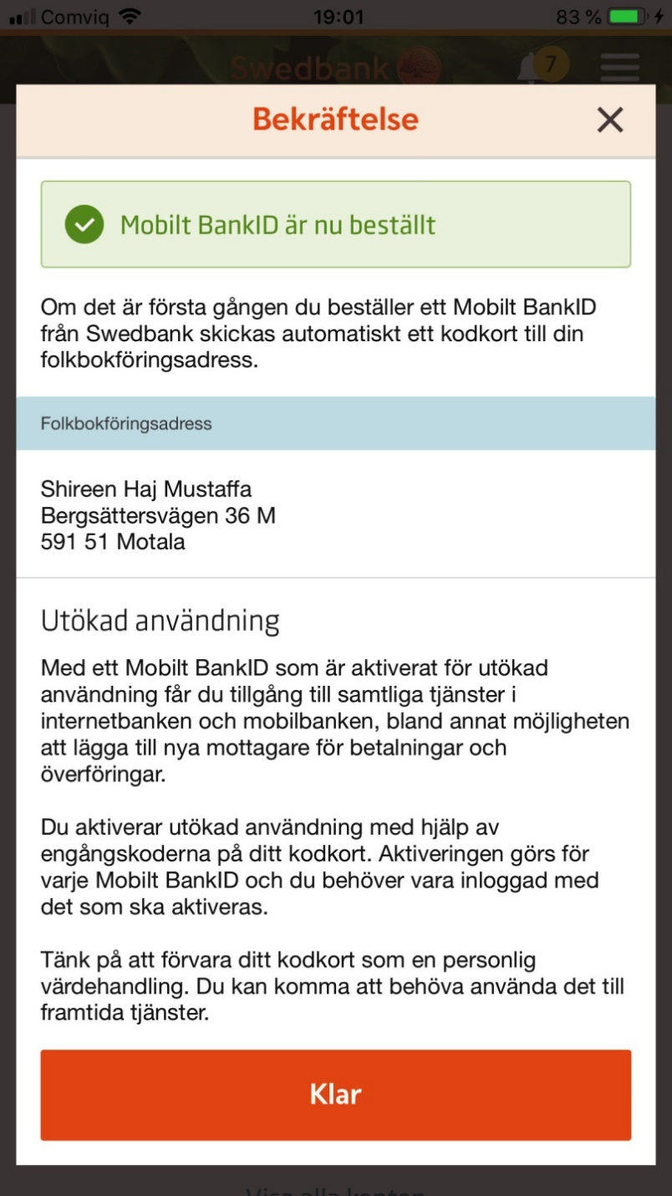
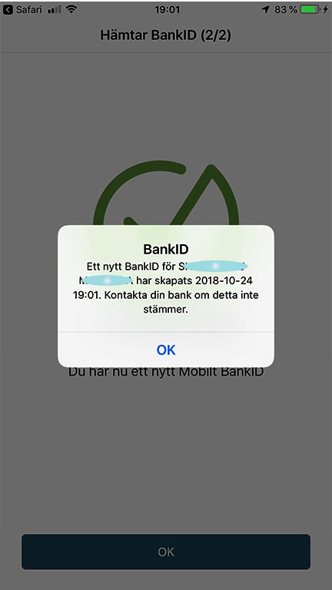
Mobilt bank ID
Riix "Setting ka (meesha wax laga kala bedbedelo".
    Maaree adeeg
    Mobilbank ID
    Dalbo Mobilt bank ID
    Ansaxin
    Ku qor koodhkaaga
    Soo qaado Mobilt bank ID
    Bilow
    Koodh dooro oo kaas xaqiiji.
Ku soo afjar klar

Slide 11
Koontadaada bangiga ku soo gal adigoo soo maraaya bank-ID

Slide 12
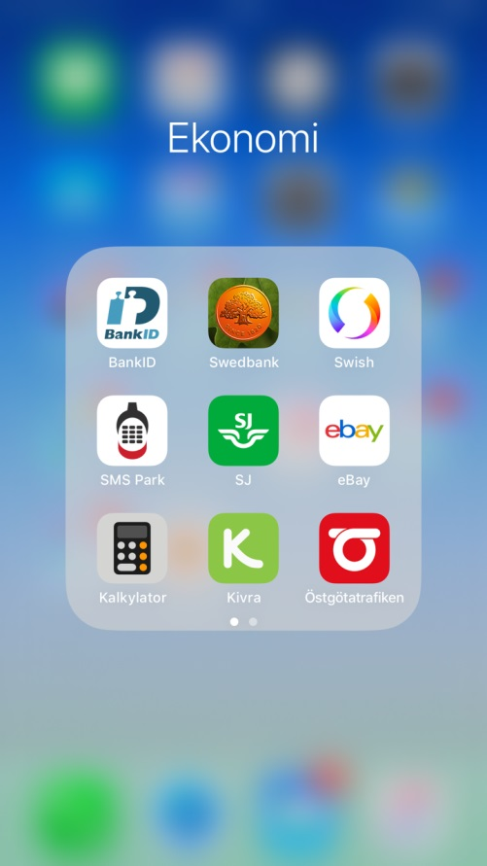
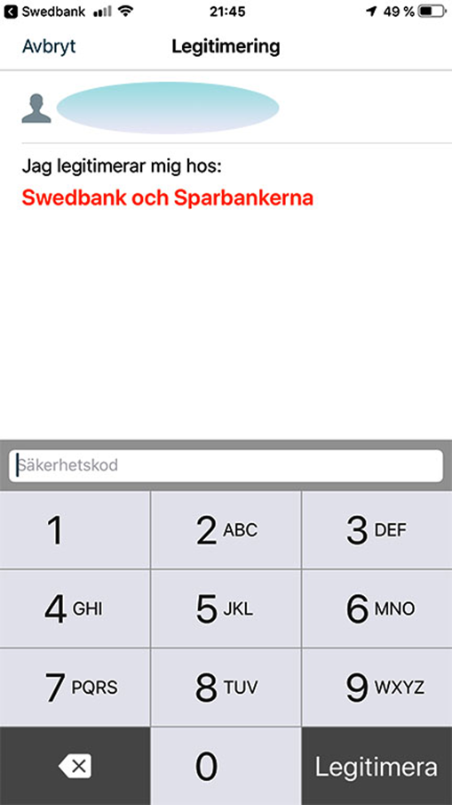
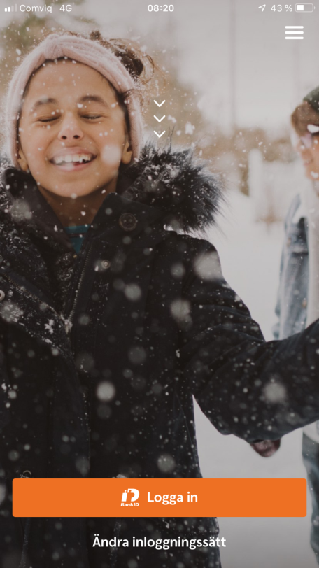
Swedbank App
Riix logga in
Ku qor koodhkaaga gaarka ah ee bank ID ga
Riix Legitimera

Slide 13
Meny-ga app-ka Swedbank
Halkan ayaad ku arkaysaa haraaga (lacagta kuugu jirta koontada), koontada iyo qaansheegta elektaroonigga ah
Dhammaan koontooyinka aad leedahay (koontada carruurta, koontada wax keydsiga)
Bixi biilashaada ama lacagta xawilaadda.
Ku shubo kaadhkaga lacagta.
Setting ka (meesha wax laga kala bedbedelo)

Slide 14
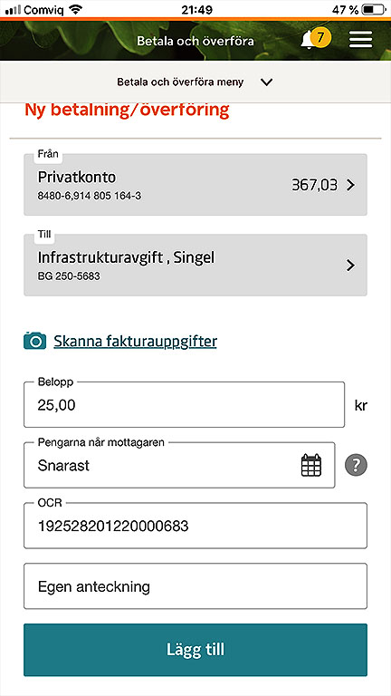
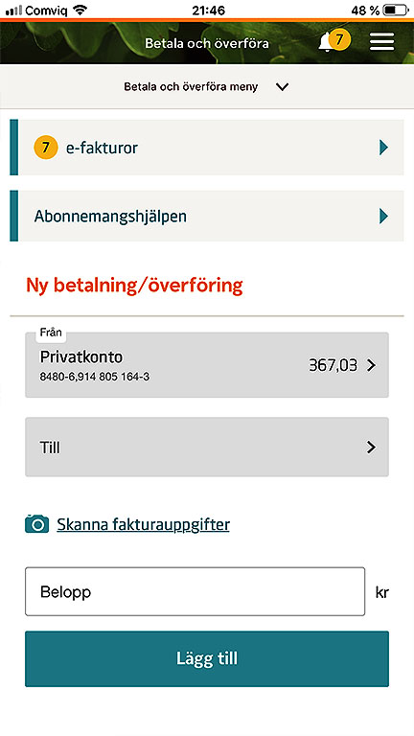
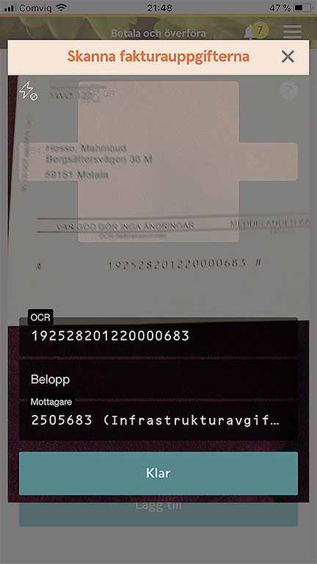
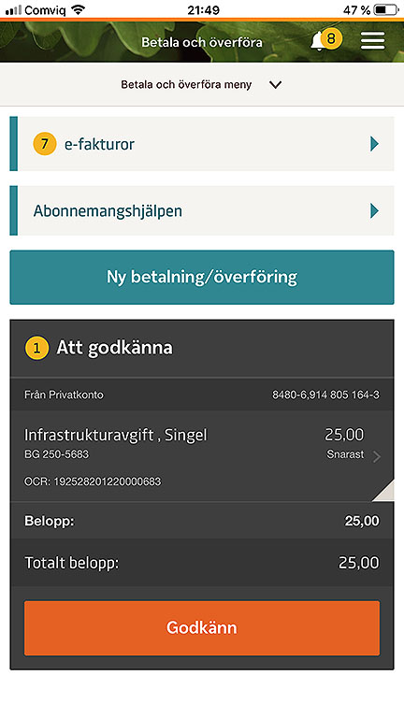
Bixi biilasha
Dooro Betala oo Xawil
  Dooro koontada aad rabto inaad ka bixiso
  Isticmaal kamaradda si aad ugu iskaan gareyso dhammaan macluumaadka sida OCR, cida loo diraayo iyo qadarka.
  Riix klar
  Ku dar
Godkänna

Slide 15
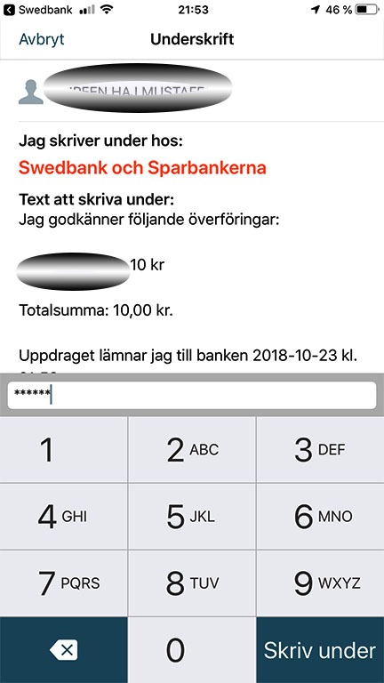
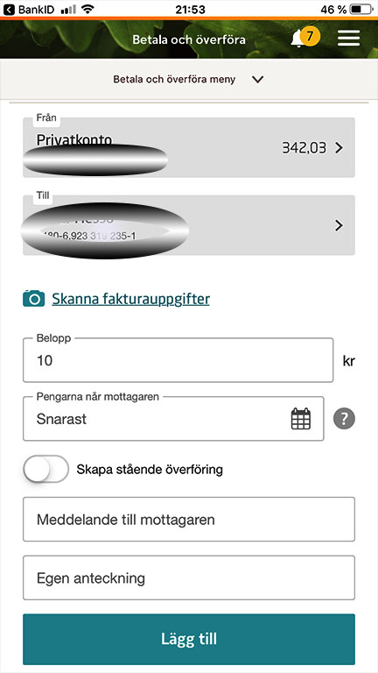
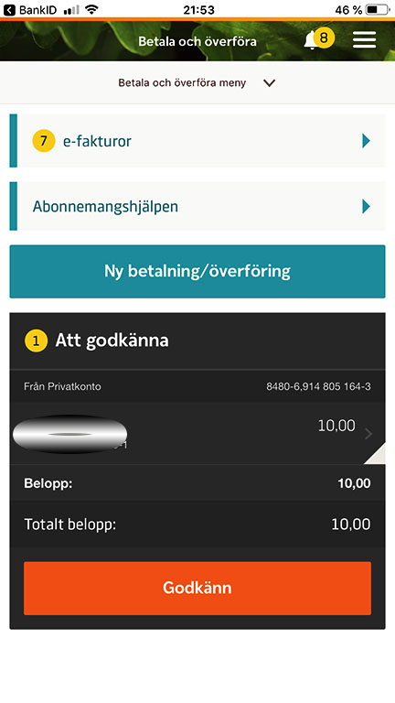
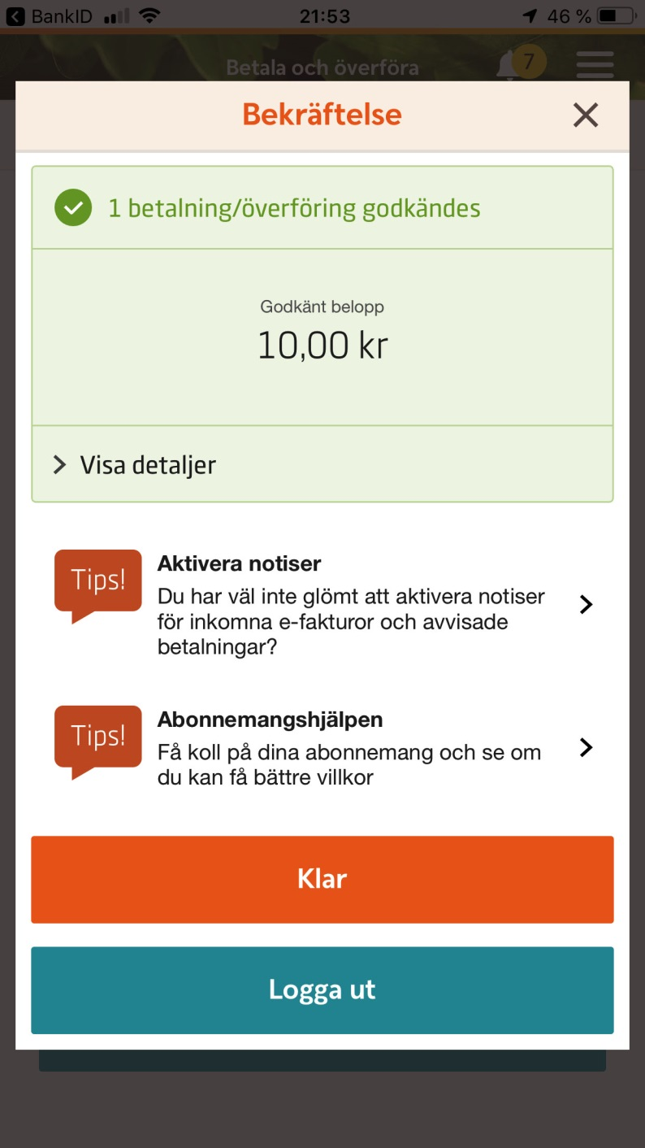
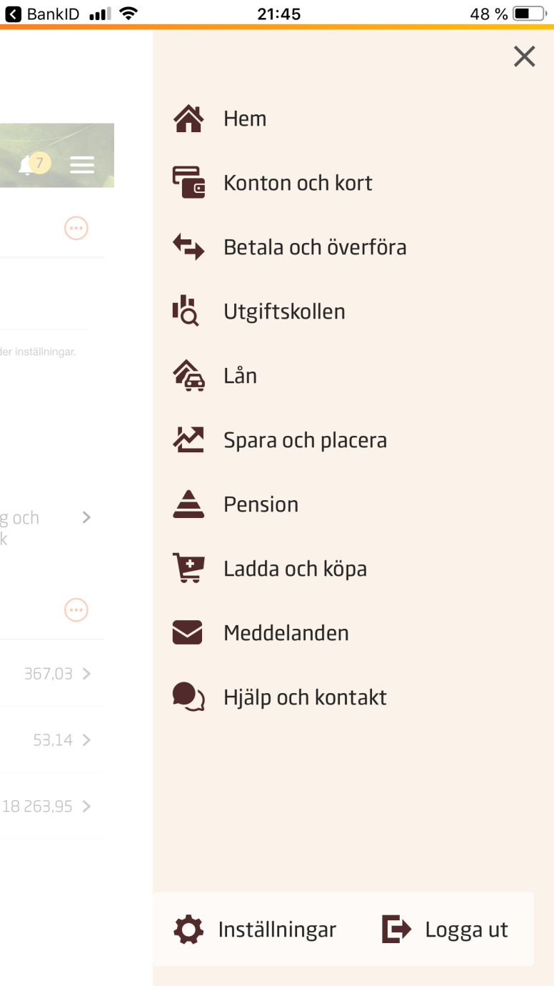
Lacag xawil
Dooro bixi oo xawil
  Dooro koontada aad ka xawileyso
  Dooro cidda aad u wareejinayso
  Qadarka
  Riix Lägg till
  Ogolow
  Riix koodhkaaga bank id ga oo saxeex
Ku dhamee adigoo riixaaya klar

Slide 16
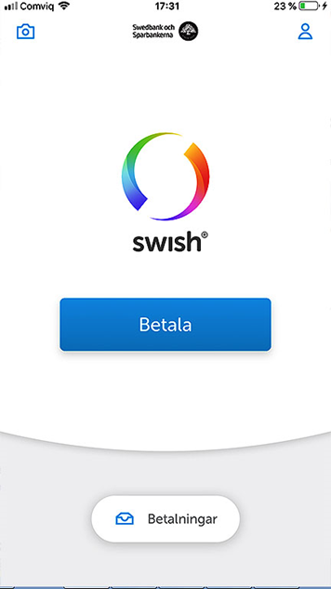
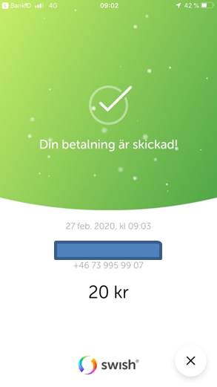
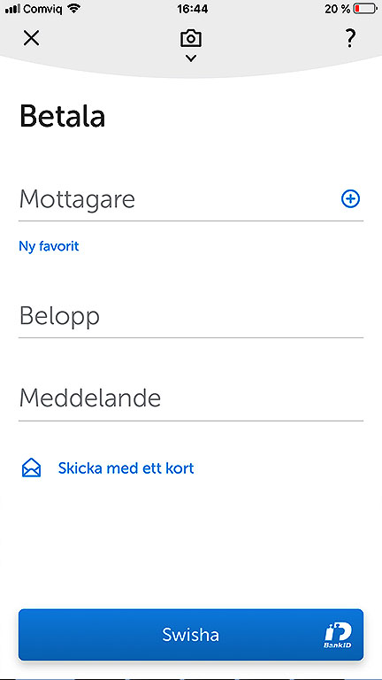
Swish
Waxaad Swish si degdeg ah oo ammaan ah ugu diri kartaa oo aad ugu heli kartaa lacag lambarka moobaylkaaga, ee koontadaada ku xiran. Lacagta ayaa toos loogu soo dirayaa – xitaa haddii qofka helaya uu bangi kale leeyahay.
Riix Betala.
Ku qor lambarka telefoonka ee cida lacagta loo diraayo
Qadarka
Swish

Slide 17
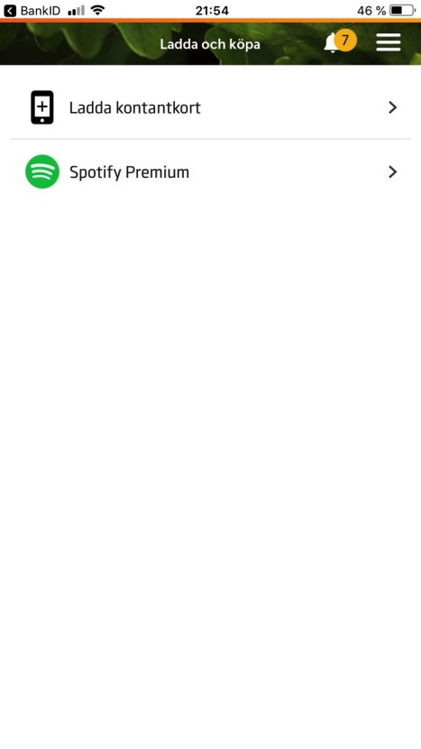
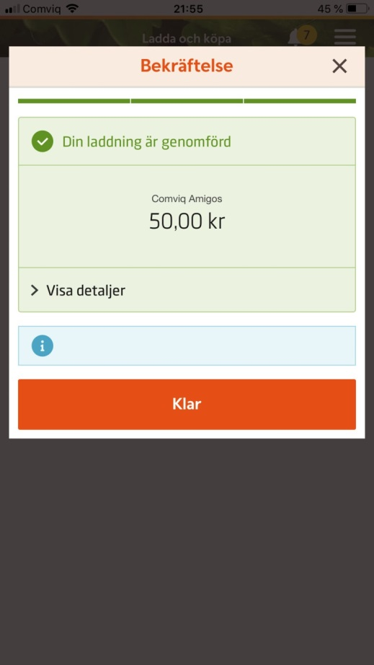
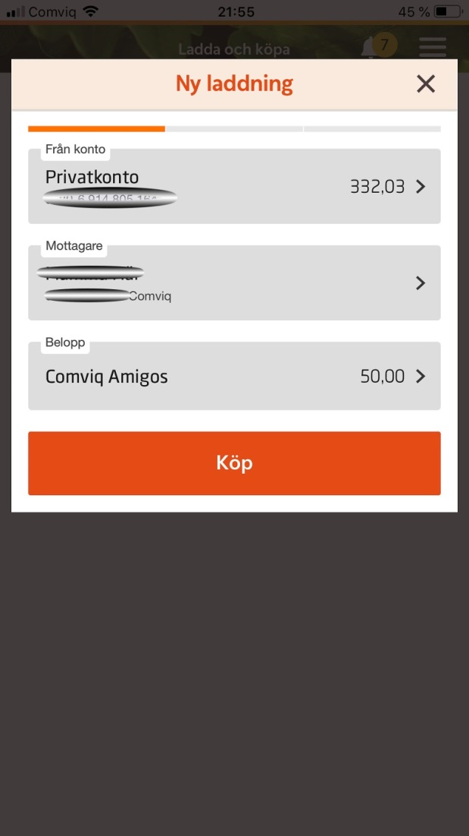
Ku shubo kaadhka lacagta.
Riix ku shubo kaadhkaga lacagta.
Ka dooro koontada ay tahay inaad ka bixiso, cida loo diraayo iyo qadarka ka dibna riix iibso
Riix klar

Slide 18
Ha iloobin inaad bangiga ka baxdo oo aad xirto baraawsarka ka hor inta aanad kombiyuutarka xirin!

